Slide 1

Manipulation
What you can do and can’t do
Jill Sneesby Hon MPSSA
Thanks to those photographers who have given permission for their images to be used in this presentation.
Notes:
Transgressing the rules can be intentional with the photographer trying to beat the system or it can be done by mistake or by not understanding the rules. This presentation is intended to remove some of the grey areas.

Slide 2
Manipulation
What you can do and can’t do
Breaking the rules can be intentional with the photographer trying to beat the system
or it can be done by mistake or by not understanding the rules.
This presentation is intended to remove some of the grey areas.
Jill Sneesby Hon MPSSA
Thanks to those photographers who have given permission for their images to be used in this presentation.
Notes:
Transgressing the rules can be intentional with the photographer trying to beat the system or it can be done by mistake or by not understanding the rules. This presentation is intended to remove some of the grey areas.

Slide 3
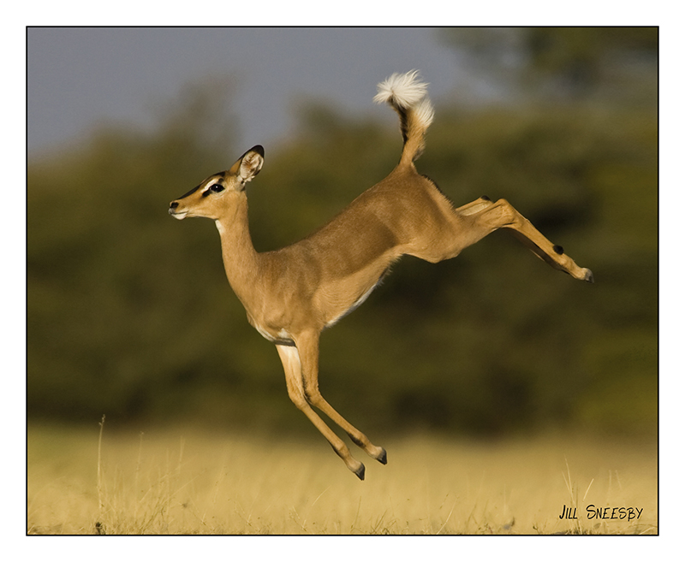
They can be accidental – such as my Leaping Impala – or is it Impala Leaping?
I entered this image many years ago in the Al Thani Awards and it was published in their catalogue.
I entered it again quite a number of years later in the PSA International and they informed me that I had changed the title – a definite no no and something I did without even realizing it.
Notes:
They can be accidental – such as my Leaping Impala – or is it Impala Leaping? I entered this image many years ago in the Al Thani Awards and it was published in their catalogue. I entered it again quite a number of years later in the PSA International and they informed me that I had changed the title – a definite no no and something I did without even realizing it.

Slide 4
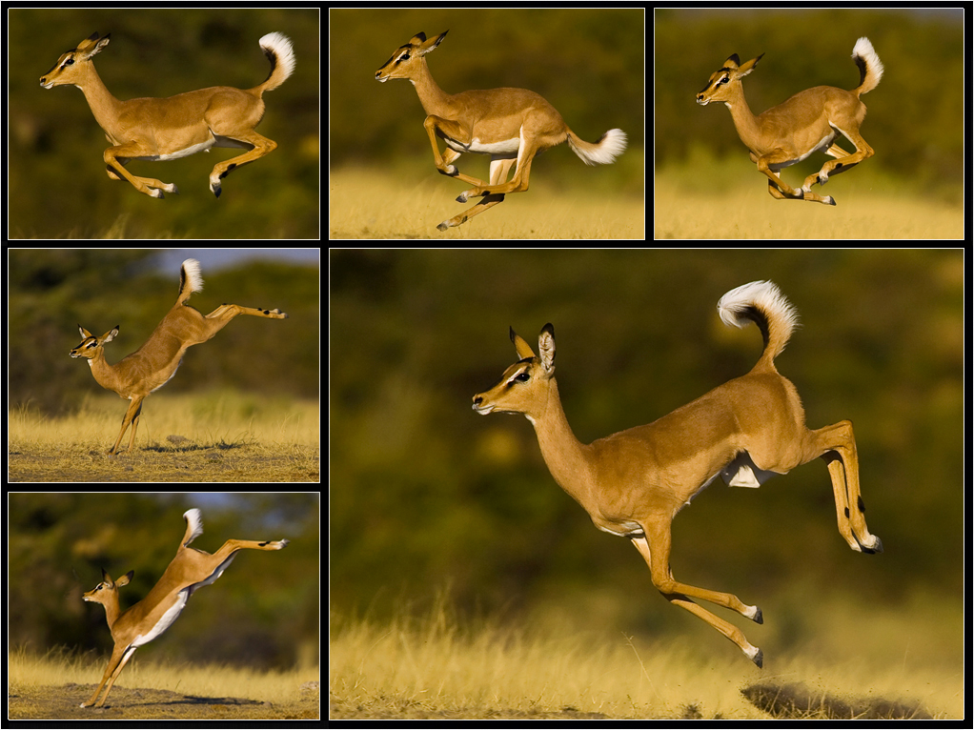
SAME or SIMILAR?
Similar implies that it is almost the same time, or almost the same place, or almost the same situation – just another frame in an action series is not necessarily sufficiently different to make it a different image. By being almost the same it is a similar shot.s
When is it the same or similar?
How different does it have to be to be too similar?
What do you think?
Notes:
When is it the same or similar? How different does it have to be to be too similar?

Slide 5
SAME or SIMILAR?
Similar implies that it is almost the same time, or almost the same place, or almost the same situation – just another frame in an action series is not necessarily sufficiently different to make it a different image. By being almost the same it is a similar shot.s
While they are different moments
in time I would probably only use
two of the images – one with legs together and the other stretched out.
Notes:
When is it the same or similar? How different does it have to be to be too similar?

Slide 6
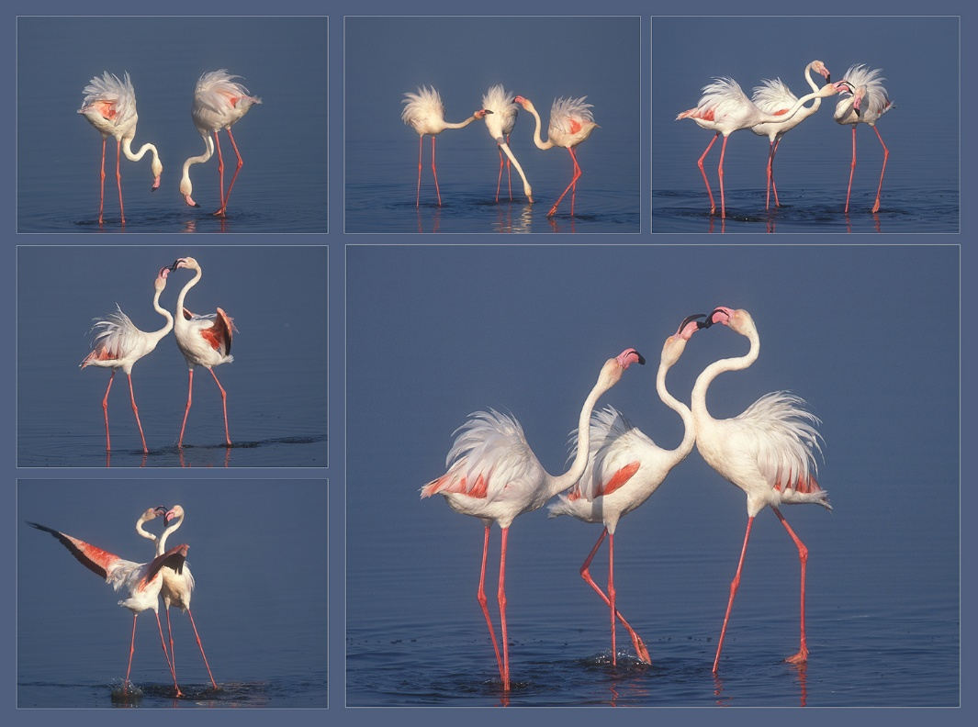
SAME or SIMILAR?
Similar implies that it is almost the same time, or almost the same place, or almost the same situation – just another frame in an action series is not necessarily sufficiently different to make it a different image. By being almost the same it is a similar shot.
Are these too similar
–
what do you think?

Slide 7
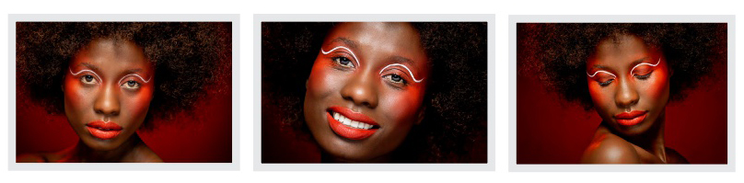
SAME or SIMILAR?
Similar implies that it is almost the same time, or almost the same place, or almost the same situation – just another frame in an action series is not necessarily sufficiently different to make it a different image. By being almost the same it is a similar shot.
Something to remember is that it is not just nature – the same is true for any genre.
The make-up and lighting are the same but by changing the pose and the crop the actual essence of the image has been changed – so they sufficiently different.
Read the article in the Oct 2023 e-Image
Notes:
Something to remember is that it is not just nature – the same is true for any genre.

Slide 8
Changing the title
Each image must have a unique name; the name of the image may not be altered as acceptance records are based on the image name.
Different titles may not be used for Colour and Monochrome versions
or Print and Projected Digital Image versions of the same image.

Slide 9
Changing the title
Each image must have a unique name; the name of the image may not be altered as acceptance records are based on the image name.
Different titles may not be used for Colour and Monochrome versions
or Print and Projected Digital Image versions of the same image.
Monochrome and colour variations originating from a single image are considered identical unless there is a substantial difference in artistic treatment

Slide 10
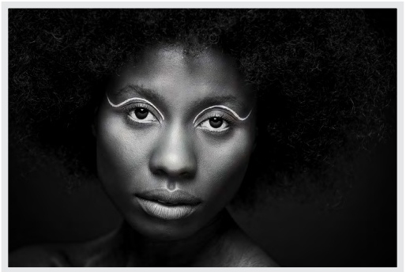
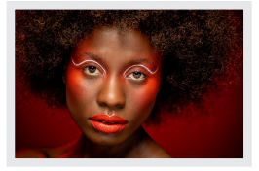
Changing the title
Monochrome and colour variations originating from a single image are considered identical unless there is a substantial difference in artistic treatment
In this case Cynthia has used the same image but processed it very differently and very effectively, so that the emphasis is now on the shape of the face. The hair and makeup colour, which was so much part of the colour version, just disappears into nothingness. They are therefore different.

Slide 11

It is not just PSSA who has rules and regulations and naughty lists – the Photographic Society of America does as well, as do all the other major photographic societies worldwide.
DQ’s
Jill Sneesby Hon MPSSA
Notes:
It is not just PSSA who has rules and regulations and naughty lists – the Photographic Society of America does as well, as do all the other major photographic societies worldwide.

Slide 12
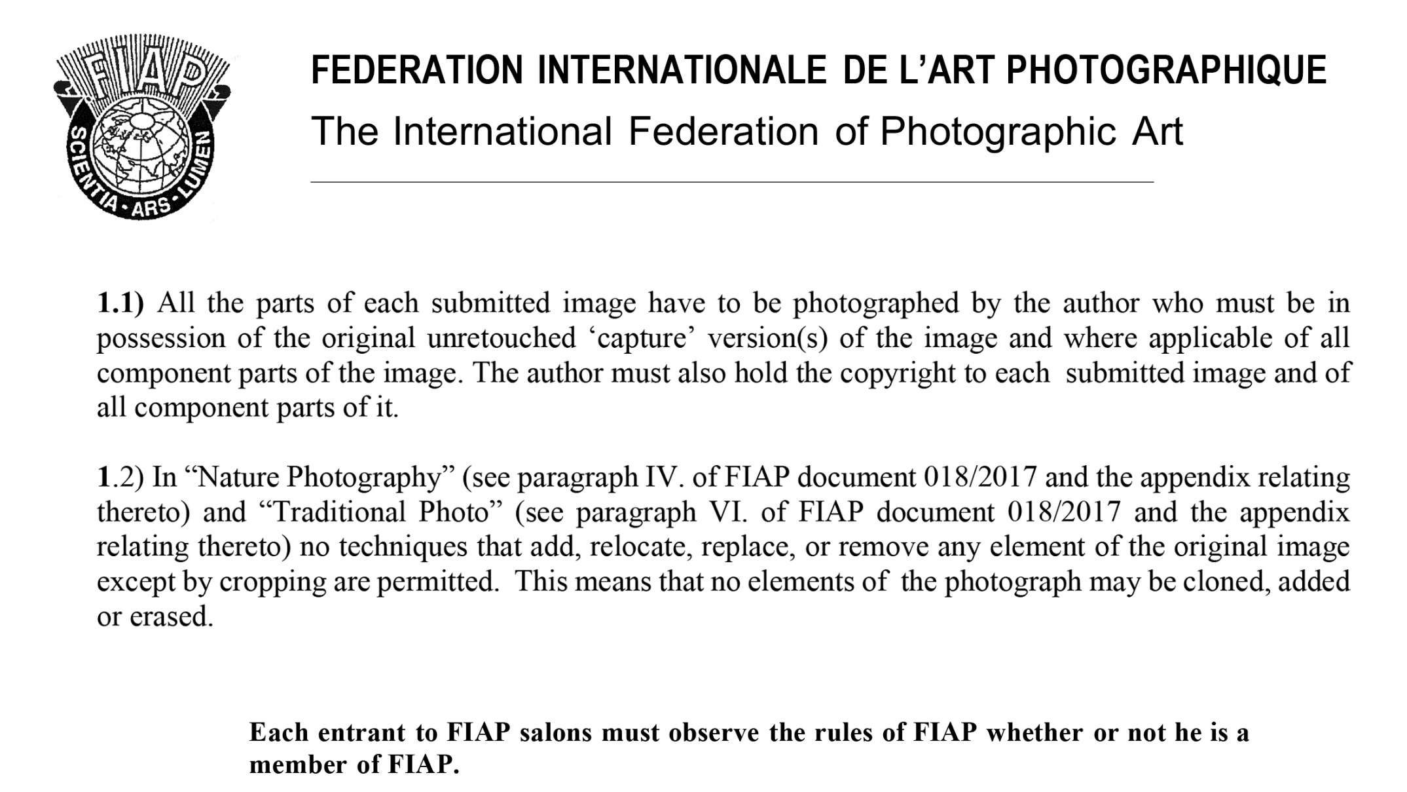
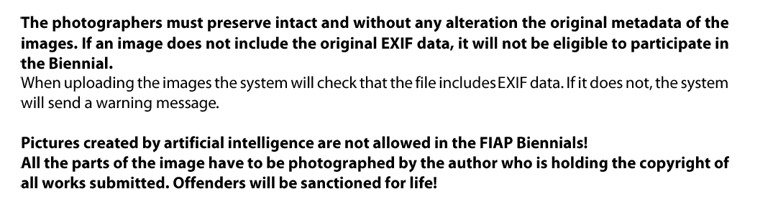
DQ’s
Jill Sneesby Hon MPSSA

Slide 13
DQ’s
You can get inspiration from someone else’s image
– but you cannot just photograph it and call it yours.
Jill Sneesby Hon MPSSA

Slide 14
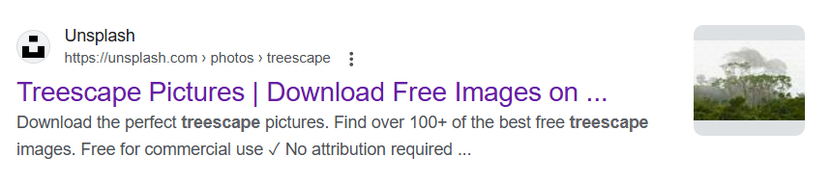
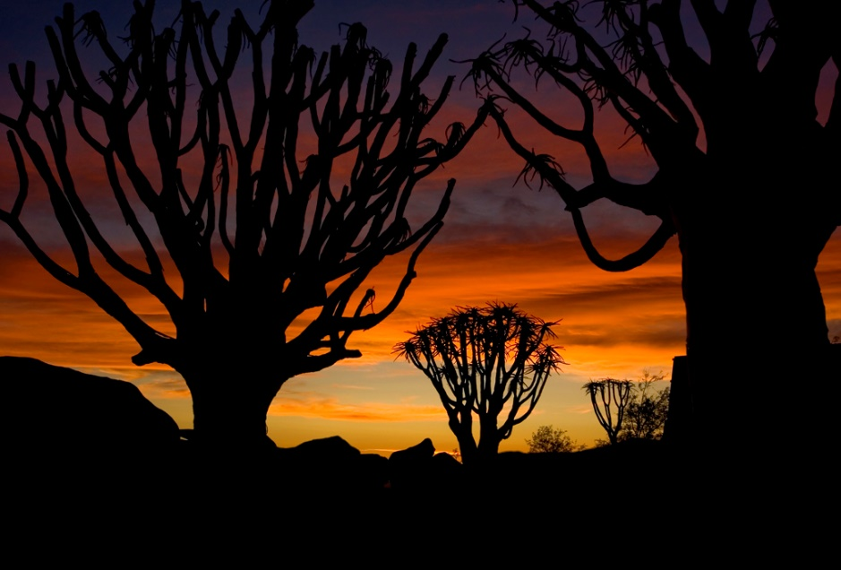
Whether its from the internet, or a picture in a gallery, a book or from absolutely anywhere, even if it says you can download them for free, unless you were there and actually
Photographed the trees at sunset it is not your work and is not allowed.
Jill Sneesby
Notes:
Whether its from the internet, or a picture in a gallery, a book or from absolutely anywhere, even if it says you can download them for free, unless you were there and actually
Photographed the trees at sunset it is not your work and is not allowed.

Slide 15

Whether its from the internet, or a picture in a gallery, a book or from absolutely anywhere, even if it says you can download them for free, unless you were there and actually
Photographed the trees at sunset it is not your work and is not allowed.
Jill Sneesby
Notes:
Whether its from the internet, or a picture in a gallery, a book or from absolutely anywhere, even if it says you can download them for free, unless you were there and actually
Photographed the trees at sunset it is not your work and is not allowed.

Slide 16
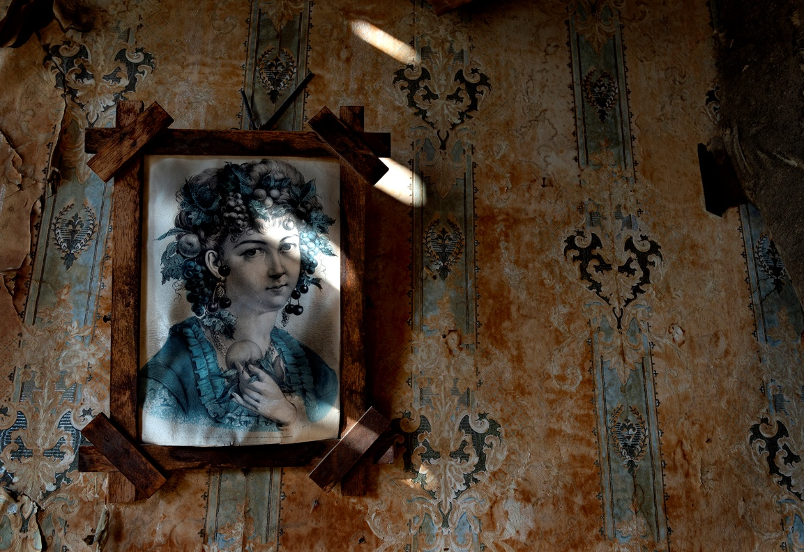
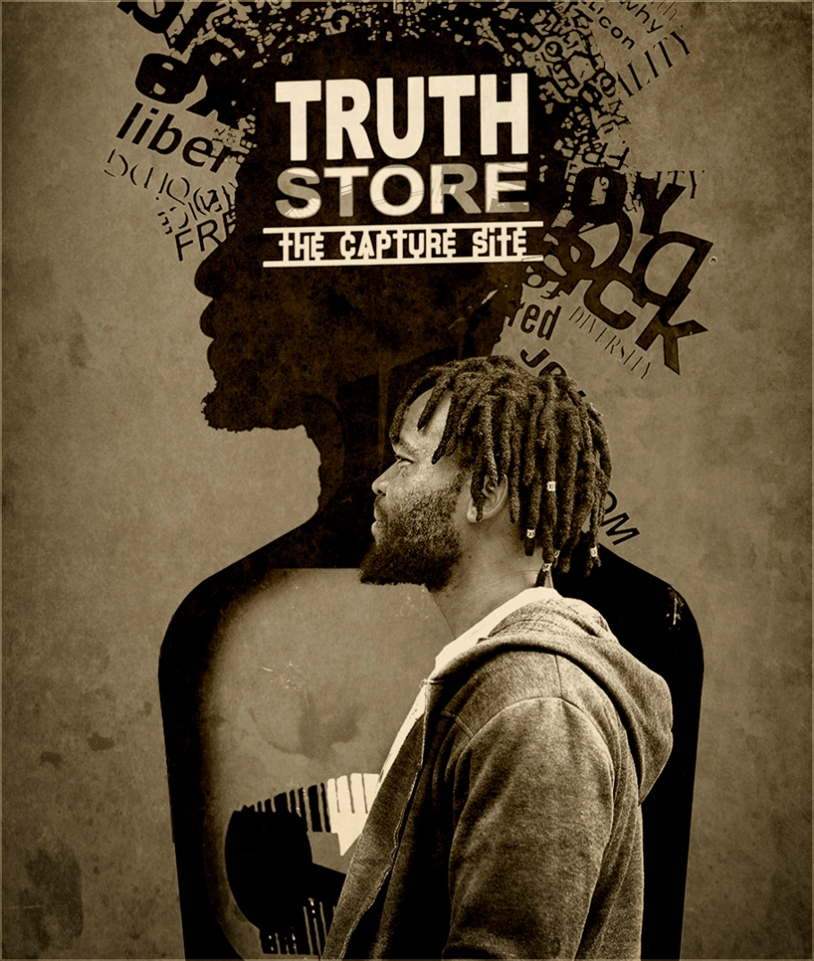
Picture on the wall - Here you are photographing some else’s art but by including the light and shade and wallpaper etc. you are creating an image and not just copying it.
The Truth Store pic is someone elses art but by introducing the figure it is only an element in the image. Both are OK.
Notes:
Picture on the wall - Here you are photographing some else’s art but by including the light and shade and wallpaper etc. you are creating an image and not just copying it.
The Truth Store pic is someone else\s art but by introducing the figure it is only an element in the image. Both are OK.

Slide 17
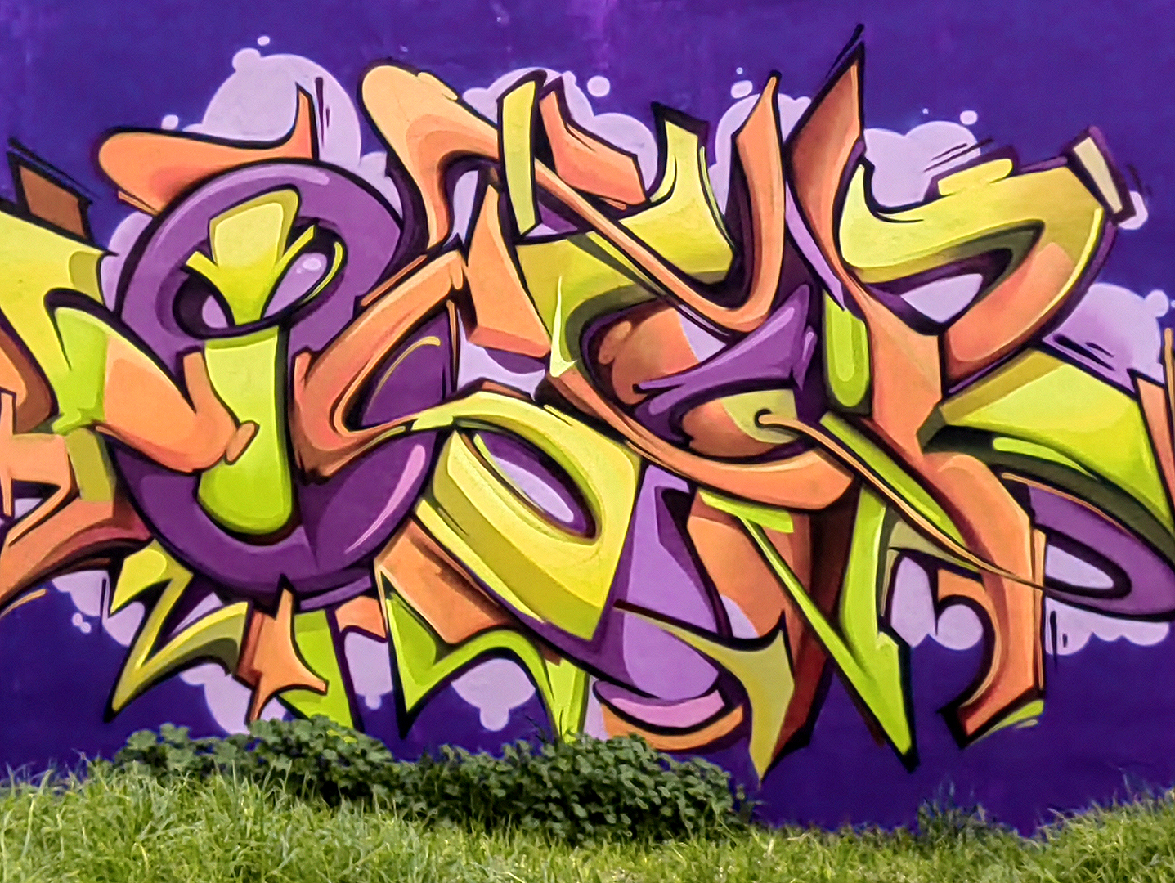
Photographing Graffiti is
photographing someone else’s art.
What have you done
to make it your own?
You have added nothing – it is therefore just a picture of someone else’s art.
Notes:
You have added nothing – it is therefore just a picture of someone else’s art.

Slide 18
Photographing Graffiti is
photographing someone else’s art.
What have you done
to make it your own?
You have added nothing – it is therefore just a picture of someone else’s art.
The inclusion of the plants and grass is not enough to make it yours.
Even if you want to argue the point, do the plants and grass make it an interesting photo?
Notes:
You have added nothing – it is therefore just a picture of someone else’s art.
The inclusion of the plants and trees here, is not enough to make it yours. And their inclusion has not made it into a more interesting photo – they have not added anything.

Slide 19
Photographing Graffiti is
photographing someone else’s art.
What have you done
to make it your own?
You have added nothing – it is therefore just a picture of someone else’s art.
The inclusion of the plants and grass is not enough to make it yours.
Even if you want to argue the point, do the plants and grass make it an interesting photo?
Notes:
You have added nothing – it is therefore just a picture of someone else’s art.
The inclusion of the plants and trees here, is not enough to make it yours. And their inclusion has not made it into a more interesting photo – they have not added anything.

Slide 20
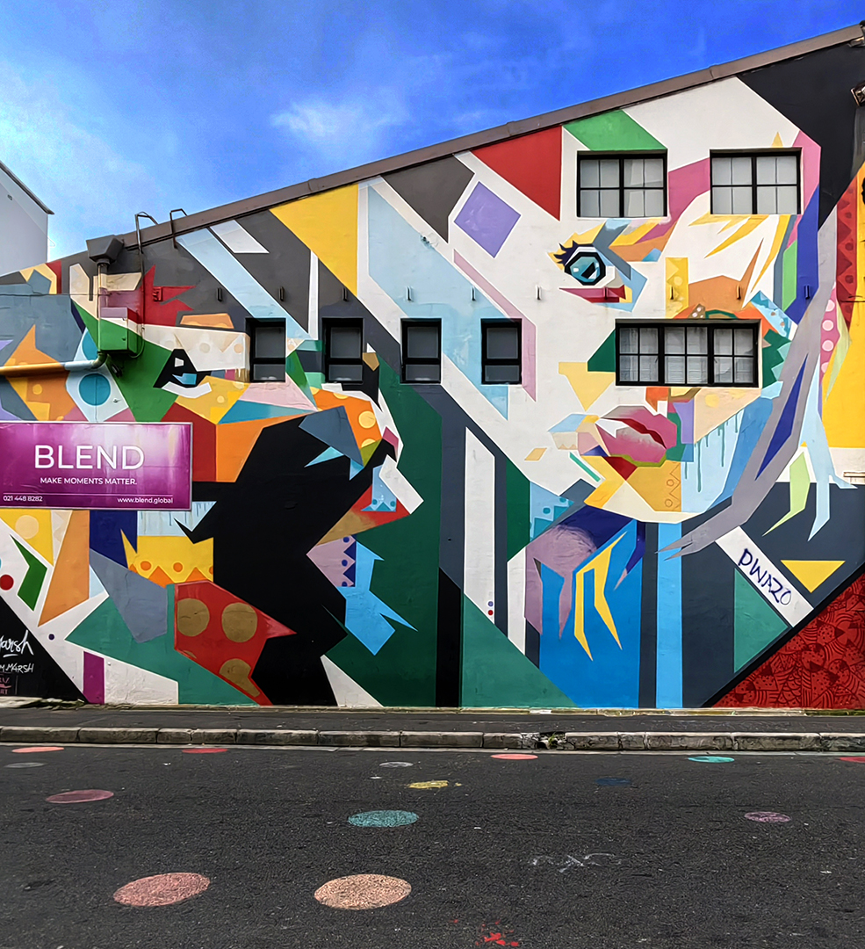
Once again – just graffiti – does the inclusion of the sky make it yours?

Slide 21
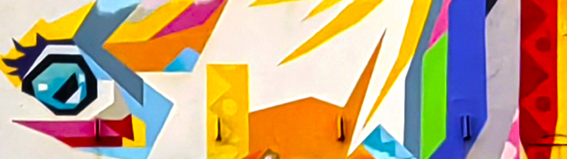
Does the inclusion of the road (left)
or zooming in (above) help?
It certainly does make for a more interesting
photo in both instances. BUT?
All you have added is a different viewpoint
of someone else’s art.

Slide 22
Does the inclusion of the road (left)
or zooming in (above) help?
It certainly does make for a more interesting
photo in both instances. BUT?
All you have added is a different viewpoint
of someone else’s art.
Perhaps if there were people looking out of the windows or something more to make it more interesting it would be OK.
Notes:
You have still not added anything of your own.

Slide 23
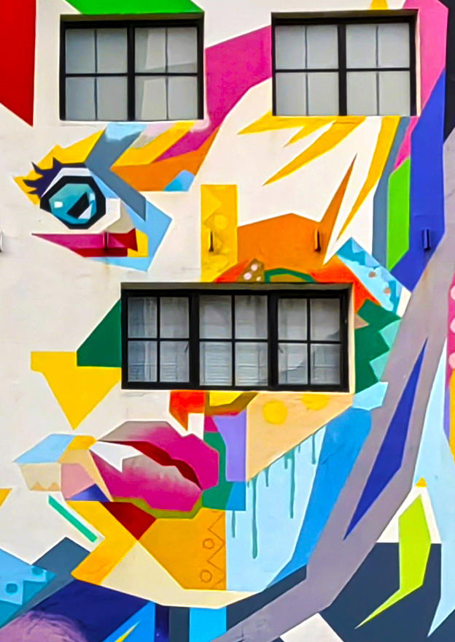
Does the inclusion of the road (left)
or zooming in (above) help?
It certainly does make for a more interesting
photo in both instances. BUT?
All you have added is a different viewpoint
of someone else’s art.
Here is a bit more of a grey area – the emphasis on the windows – is it enough to make an interesting image and more that a picture of someone else’s art?
Notes:
You have still not added anything of your own.
Perhaps if there were people looking out of the windows or something more to make it more interesting it would be OK.

Slide 24
While I wouldn’t be happy using either as my own competition pictures I would be happy to use them
in an AV about Grafitti.

Slide 25
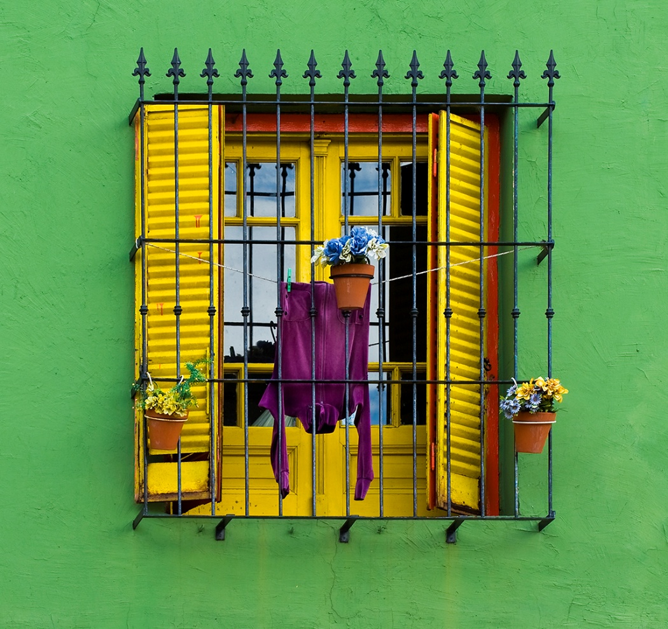
The photograph of the window below is of a scene,
and as lovely as it looks it was not created as someone’s art, so it is OK.
Notes:
The photograph of the window on the right is of a scene, and as lovely as it looks it was not created as someone’s art, so it is OK.

Slide 26
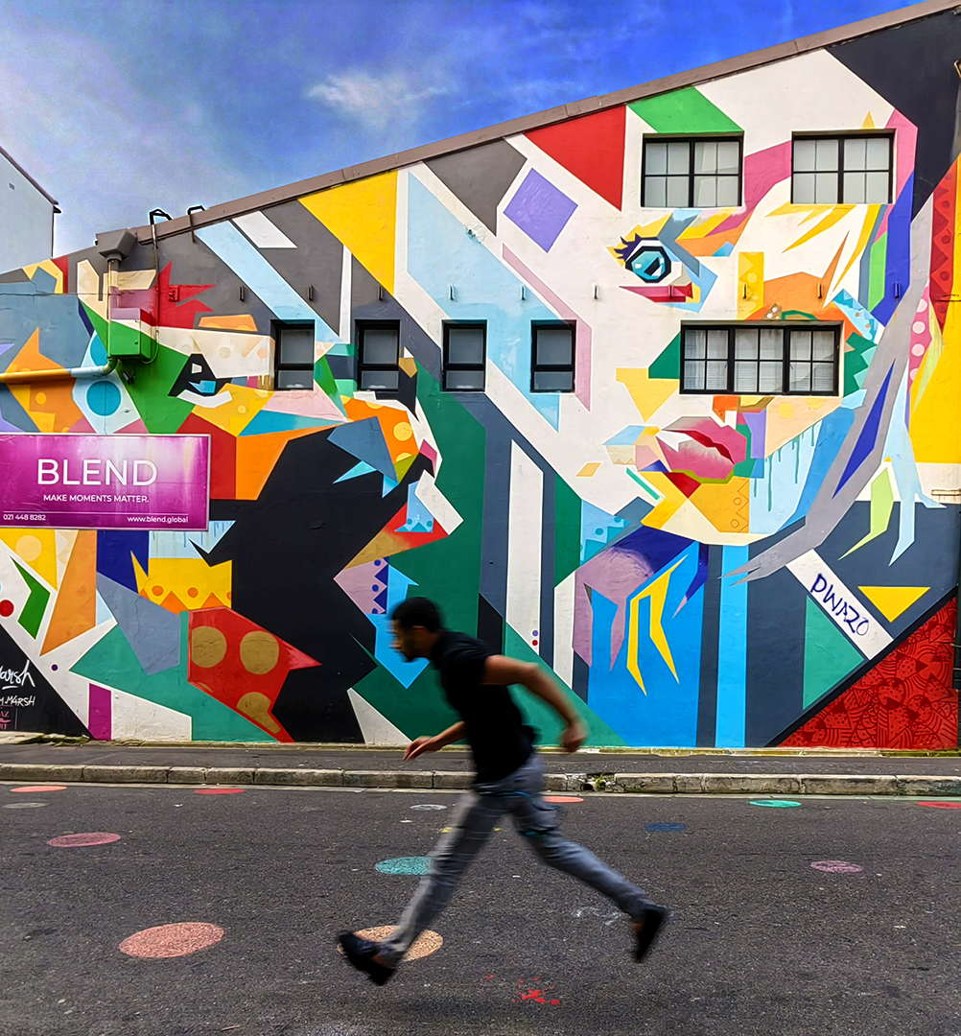
The inclusion of the guy running turns the graffiti into a backdrop – but still a very important part of the picture.
This is OK.
Notes:
The inclusion of the guy running turns the graffiti into a backdrop – but still a very important part of the picture.
The photograph of the window is of a scene, and as lovely as it looks it was not created as someone’s art, so it is OK.

Slide 27
DQ’s
PICTURES CREATED BY ARTIFICIAL INTELLIGENCE ARE NOT ALLOWED IN THIS COMPETITION!.
All parts of the image have to be photographed by the author who is holding the copyright of all works submitted.
Offenders will be sanctioned for life! (INFO 260/2023)
Jill Sneesby Hon MPSSA
Notes:
This is true for FIAP, the RPS, PSA, PSSA and all the other photographic societies worldwide.

Slide 28
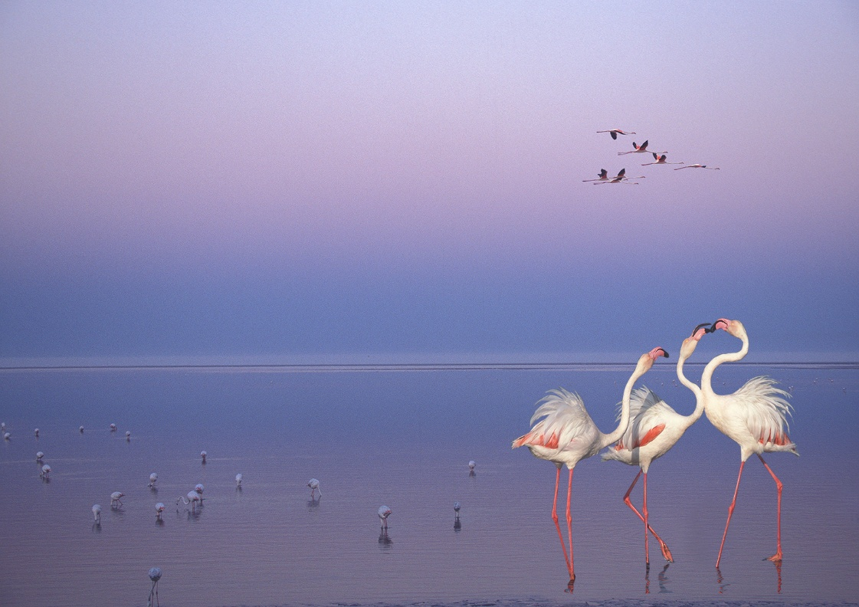
All parts/elements of the image have to be photographed by the author.

Slide 29
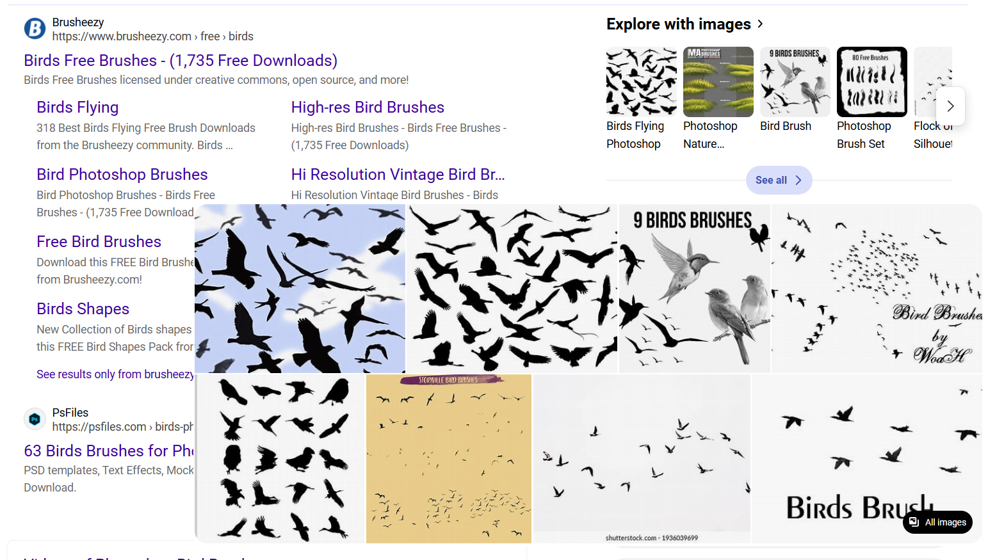
You cannot download brushes and use them to create your images –
you can make your own brushes and use them.
Notes:
You cannot download brushes and use them to create your images – you can make your own brushes and use them.

Slide 30
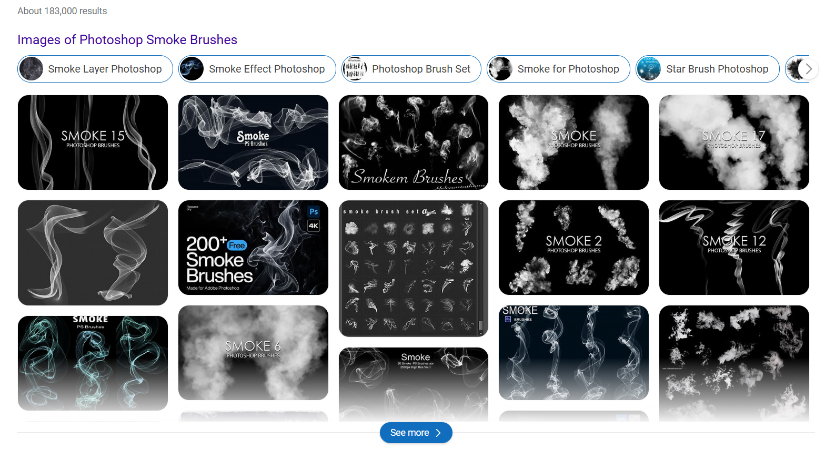
You cannot download brushes and use them to create your images –
you can make your own brushes and use them.
Notes:
You cannot download brushes and use them to create your images – you can make your own brushes and use them.

Slide 31
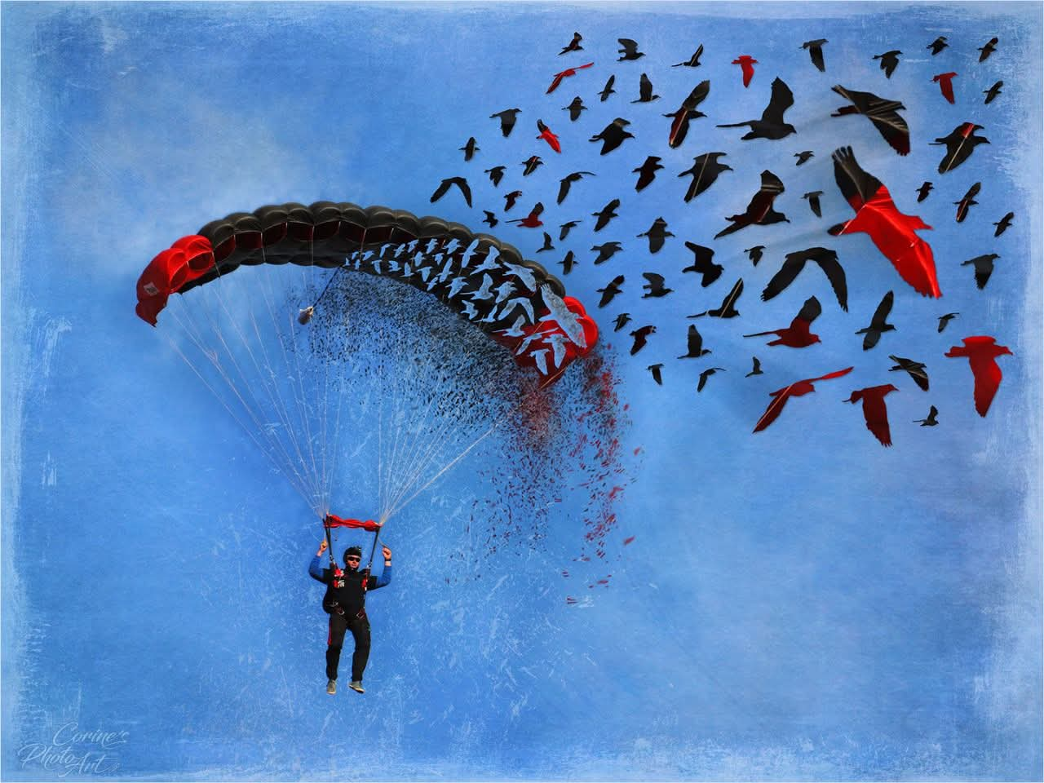
The Birds have been created by the author.
Notes:
You cannot download brushes and use them to create your images – you can make your own brushes and use them.

Slide 32
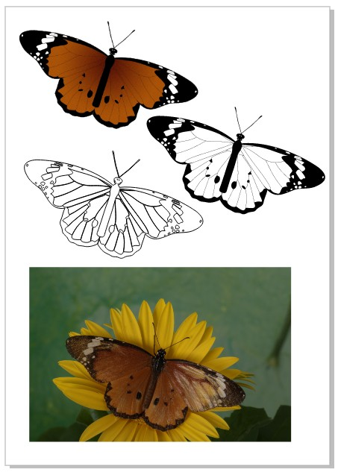
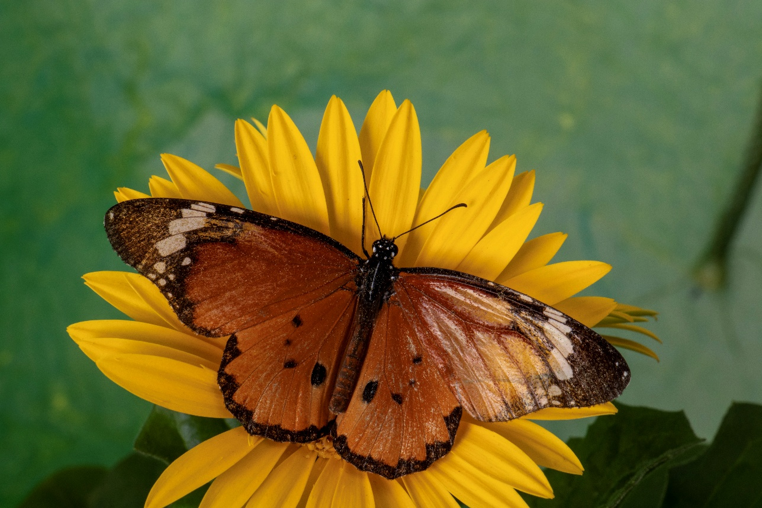
You can photograph a live, or even an artificial butterfly and use your artistic skills to create the elements.
Notes:
You cannot download brushes and use them to create your images – you can make your own brushes from your own images and use them.
You can photograph a live, or even an artificial butterfly and use your artistic skills to create the elements.

Slide 33
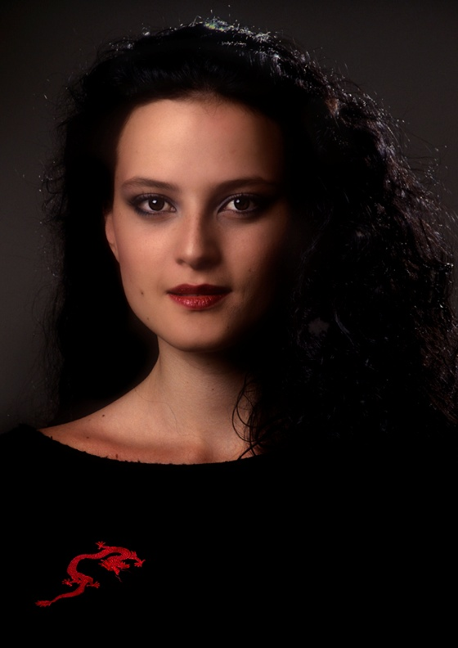
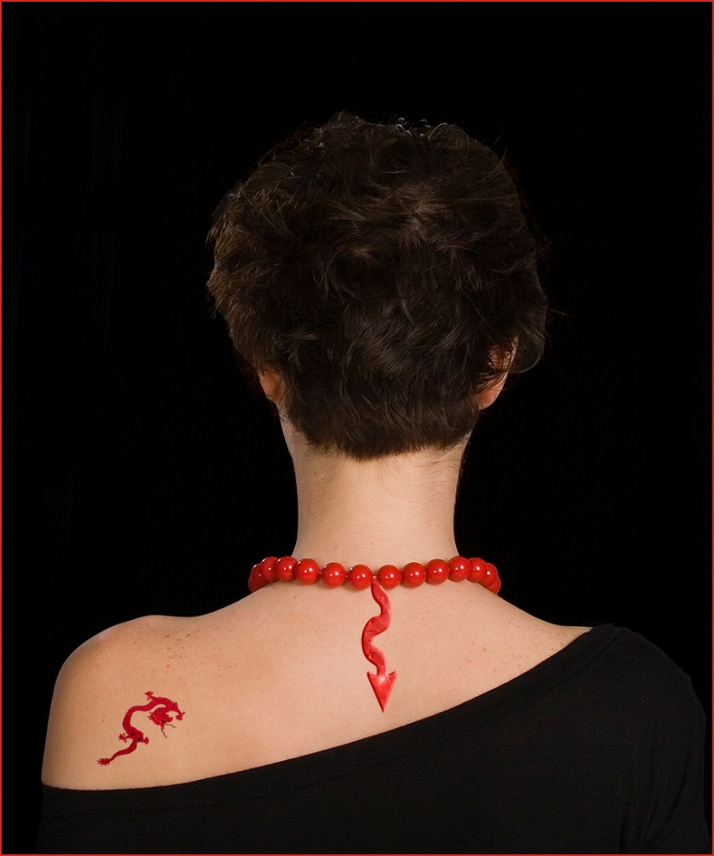
You cannot download the dragon and insert it.
Notes:
You cannot download brushes and use them to create your images – neither can you download an image and us it

Slide 34
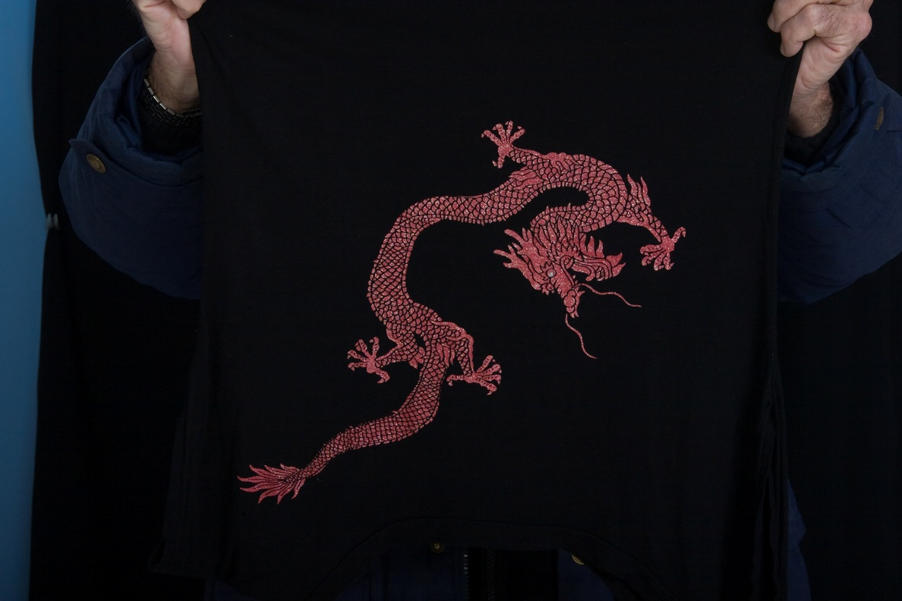
You cannot download the dragon and insert it.
But you can photograph it off, for instance, a jersey and then insert it.
Notes:
You need to photograph it yourself.

Slide 35
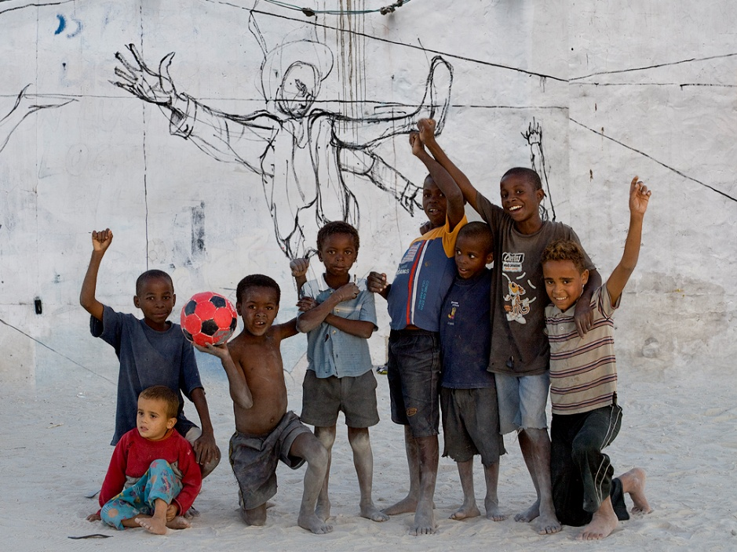
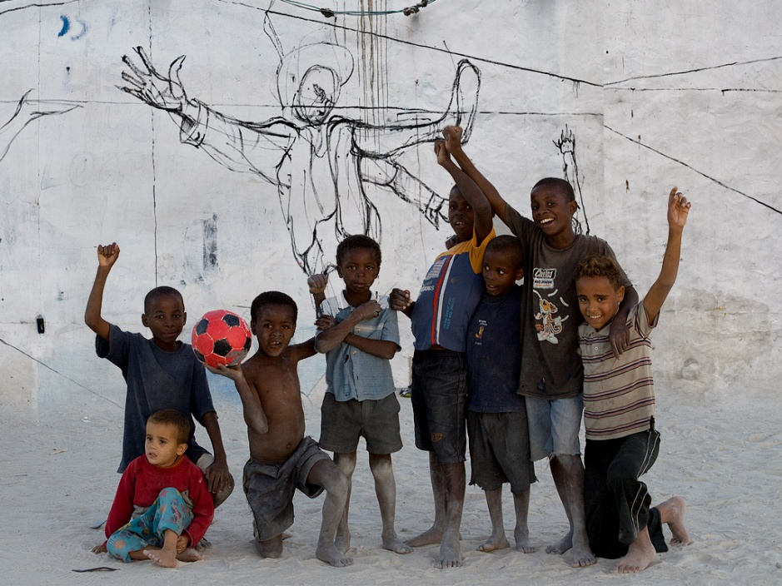
You need to have photographed all the elements in your composite.
Notes:
You need to have photographed all the elements in your composite.

Slide 36
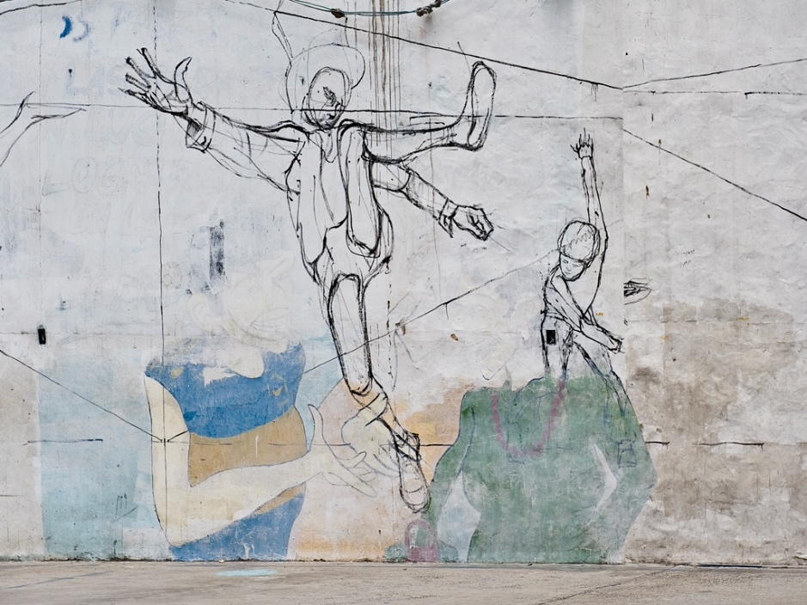
You need to have photographed all the elements in your composite.
The background I shot in Argentina – street art – not an image on its own.
Notes:
The background I shot in Argentina – street art – not an image on its own

Slide 37
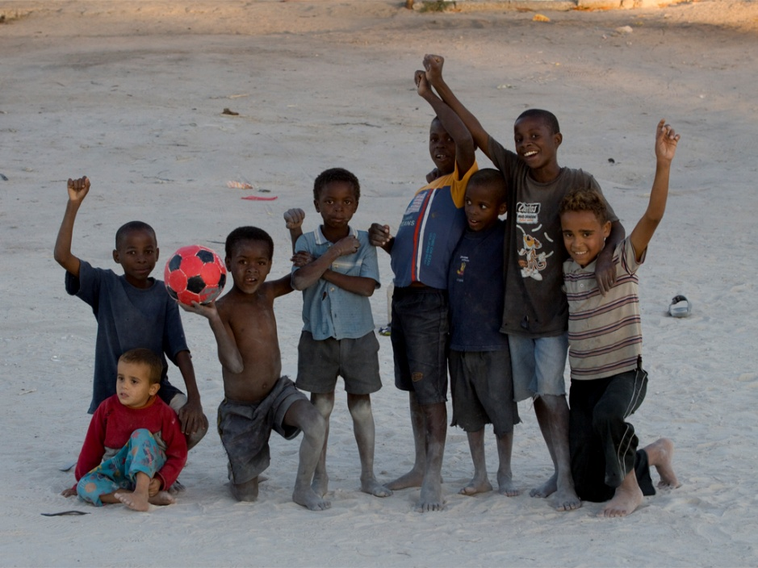
You need to have photographed all the elements in your composite.
The background I shot in Argentina – street art – not an image on its own.
The soccer boys I photographed in Namibia.
Notes:
The soccer boys I photographed in Namibia

Slide 38
You need to have photographed all the elements in your composite.
The background I shot in Argentina – street art – not an image on its own.
The soccer boys I photographed in Namibia.
Both my own images so it is OK..
Notes:
Both my own images so it is OK.

Slide 39
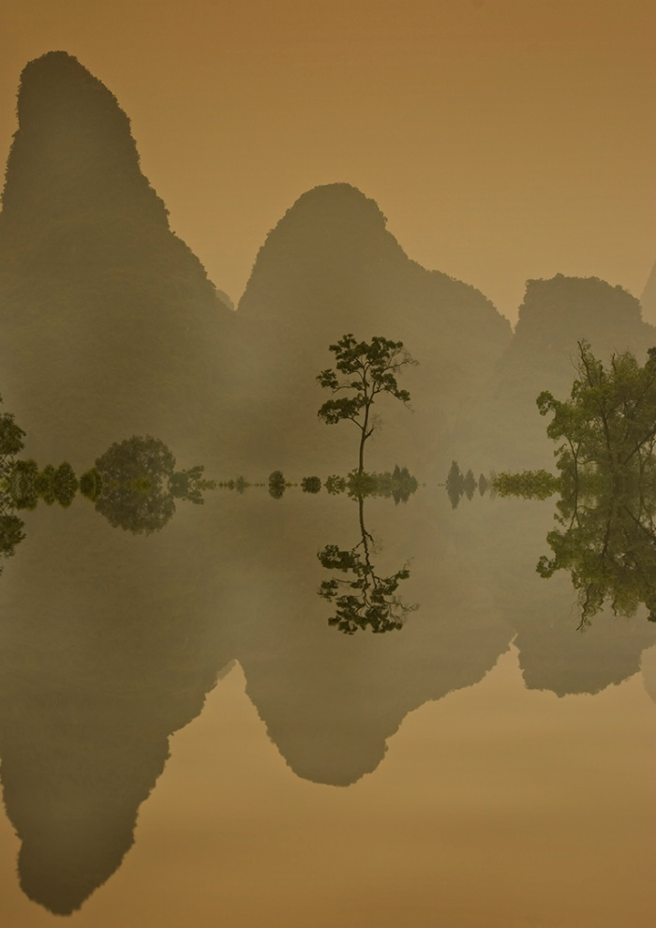
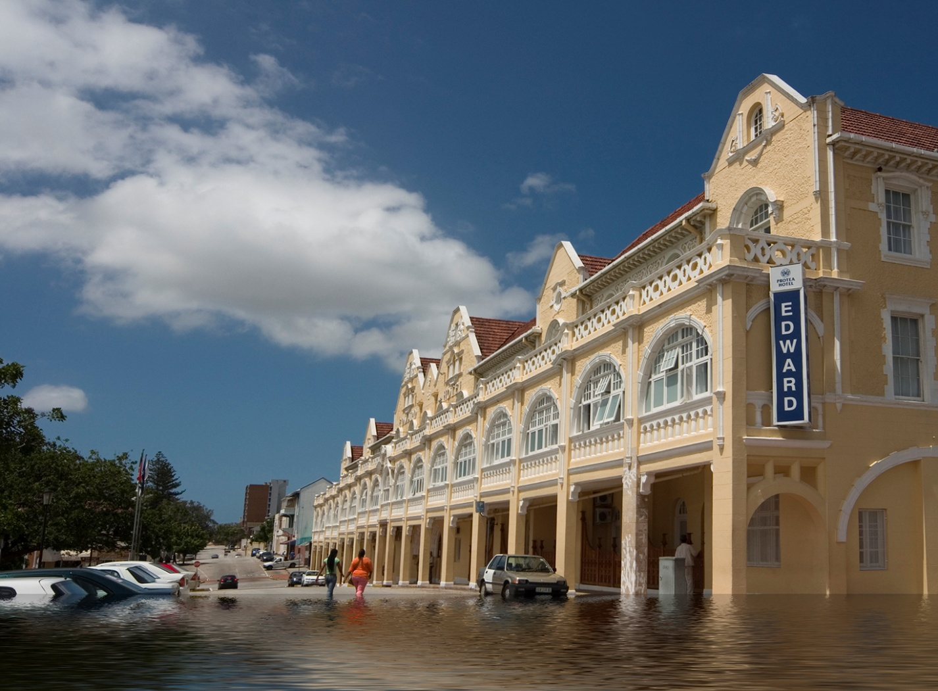
You can change the foreground by just duplicating and flipping
But you can’t add the flood in that you didn’t shoot
Notes:
You can change the foreground by just duplicating and flipping
But you can’t add the flood in that you didn’t shoot

Slide 40
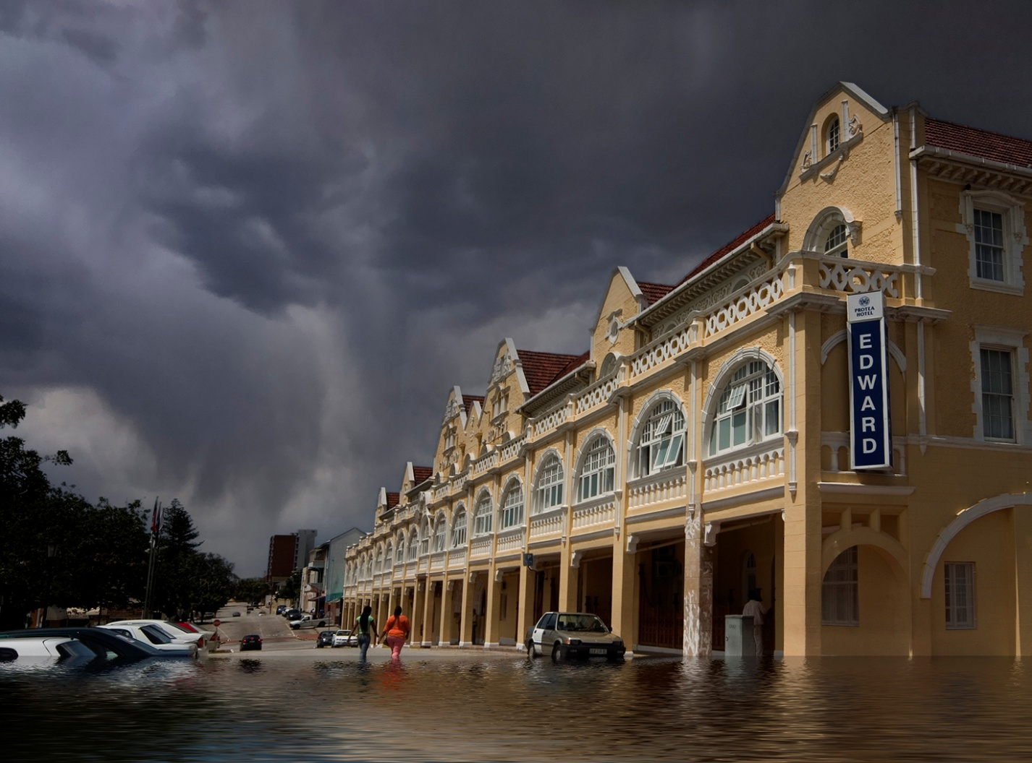
But you can’t add the flood in that you didn’t shoot
You can use sky replacement – but the sky must be your own
Notes:
You can use sky replacement – but the sky must be your own
Bur you can’t add the flood in that you didn’t shoot and then add a sky whether your own or not.

Slide 41
MANIPULATION
Manipulation is strictly prohibited
in the Nature, Photo Travel, Street, Sport, and Photojournalism categories, as well as in any categories defined accordingly.
Processing or editing must be limited to making the image look as close to the original scene as possible, apart from conversion to grayscale monochrome, which is permitted. Over processed images will be disqualified.
Techniques that enhance the presentation of the photograph, without changing the nature story or the pictorial content, or without altering the content of the original scene, are permitted.

Slide 42
MANIPULATION
Manipulation is strictly prohibited
in the Nature, Photo Travel, Street, Sport, and Photojournalism categories, as well as in any categories defined accordingly.
Processing or editing must be limited to making the image look as close to the original scene as possible, apart from conversion to grayscale monochrome, which is permitted. Over processed images will be disqualified.
Techniques that enhance the presentation of the photograph, without changing the nature story or the pictorial content, or without altering the content of the original scene, are permitted.

Slide 43
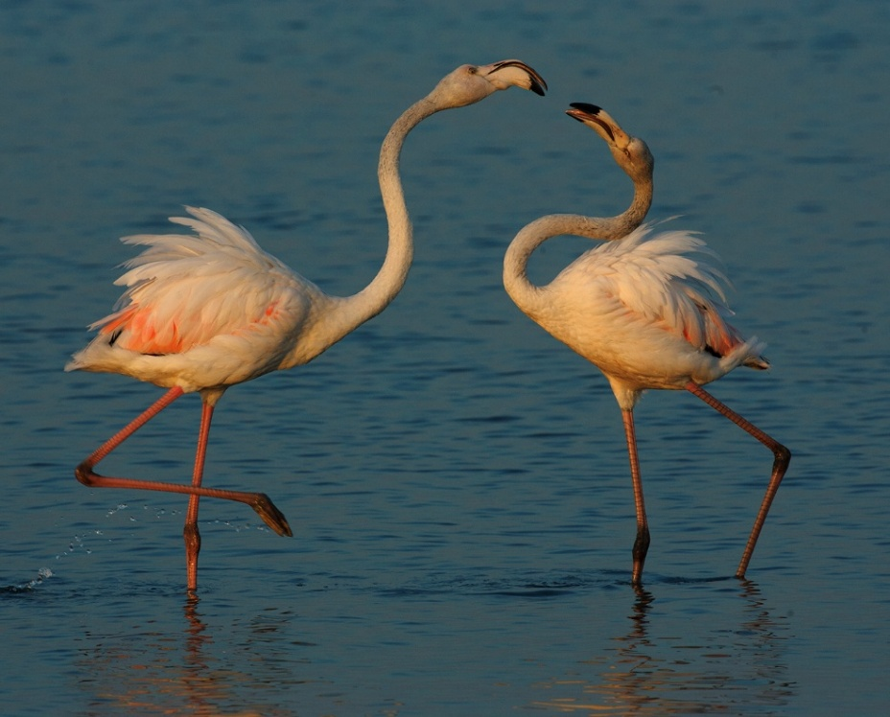

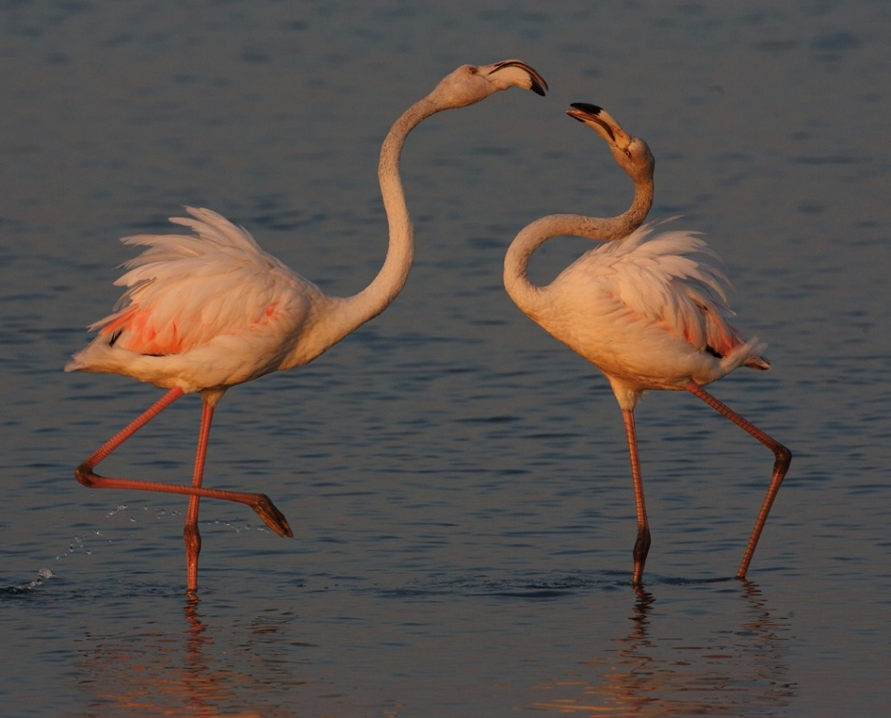
Processing or editing must be limited to making the image look as close to the original scene as possible.
Techniques that enhance the presentation of the photograph, without changing the nature story or the pictorial content, or without altering the content of the original scene, are permitted.
We don’t know what the exact scene looked like in terms of colour so any of these could be correct – you may not like all of them.
Notes:
We don’t know what the exact scene looked like in terms of colour so any of these could be correct – you may not like all of them.

Slide 44
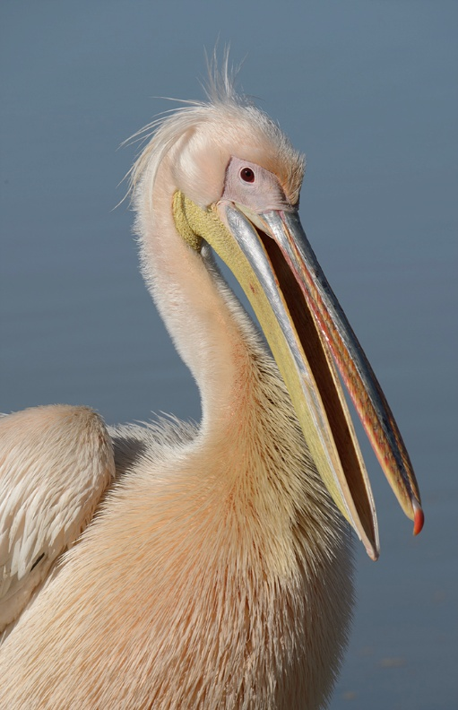
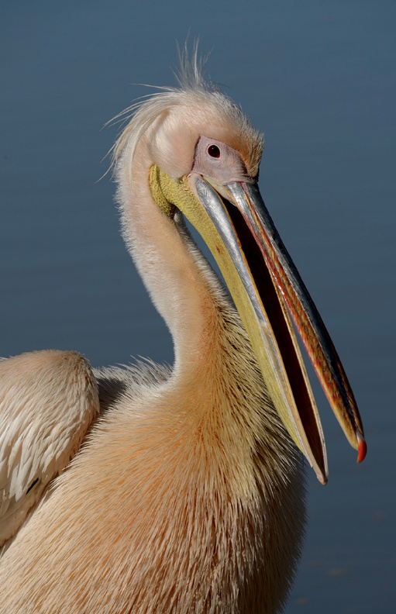
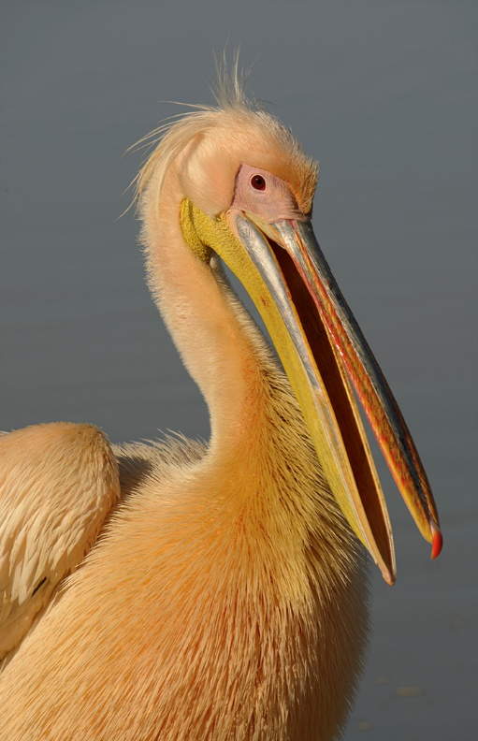
Processing or editing must be limited to making the image look as close to the original scene as possible.
Over processed images will be disqualified.
We don’t know what the exact scene looked like in terms of colour so any of these could be correct – you may not like all of them.
Notes:
No-one knows what the exact scene looked like in terms of colour so any of these could be correct – you may not like all of them or you might think one has gone too far.

Slide 45
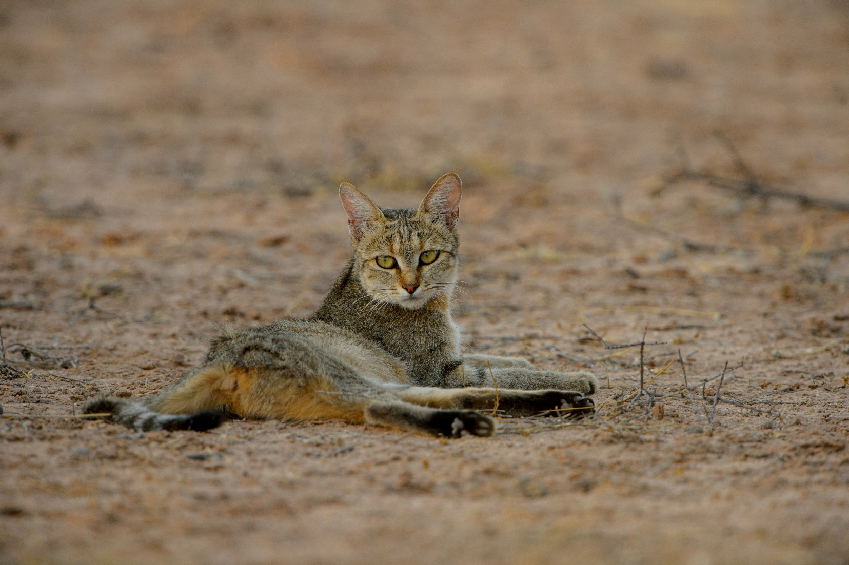
We don’t know what the exact scene looked like in terms of colour but we do know what sort of light there was – here we don’t have shadows so we can correctly assume the lighting was flat and the colour not great.
BUT
There has never been any rule that says we can’t enhance the scene.
Processing or editing must be limited to making the image look as close to the original scene as possible – enhancements are allowed.
Notes:
We don’t know what the exact scene looked like in terms of colour but we do know what sort of light there was – here we don’t have shadows so we can correctly assume the lighting was flat and the colour not great. There has never been any rule that says we can’t enhance the scene.

Slide 46
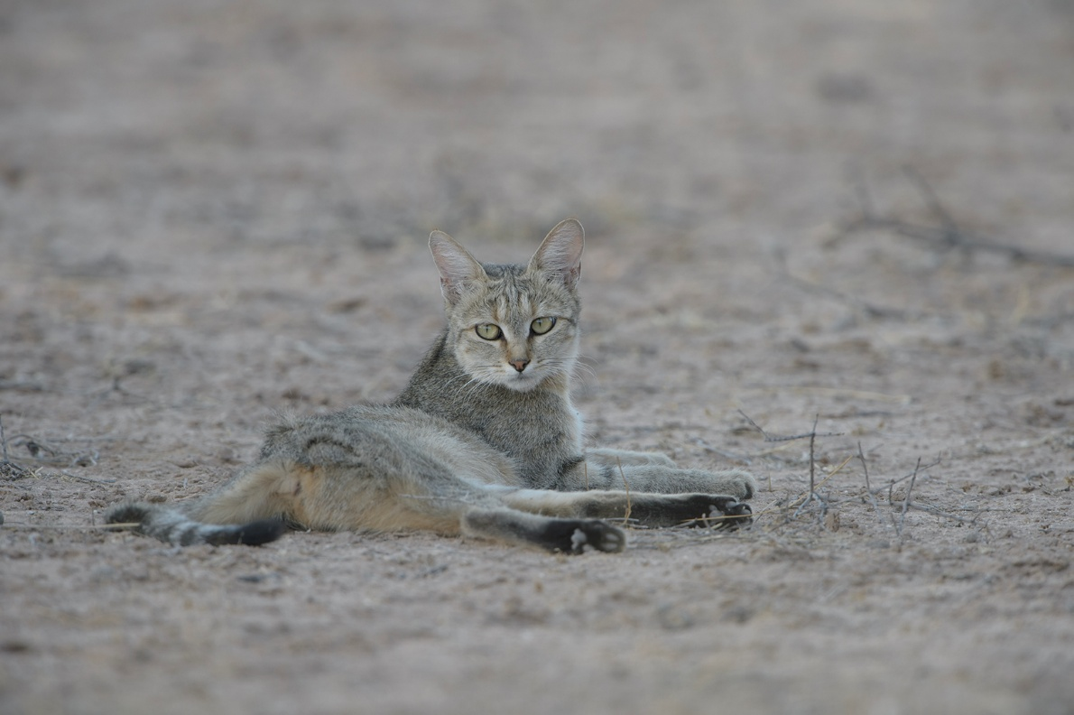
Processing or editing must be limited to making the image look as close to the original scene as possible – enhancements are allowed.
Notes:
No-one knows what the exact scene looked like in terms of colour but we do know what sort of light there was – here we don’t have shadows so we can correctly assume the lighting was flat and the colour not great. There has never been any rule that says we can’t enhance the scene. So this is acceptable.

Slide 47
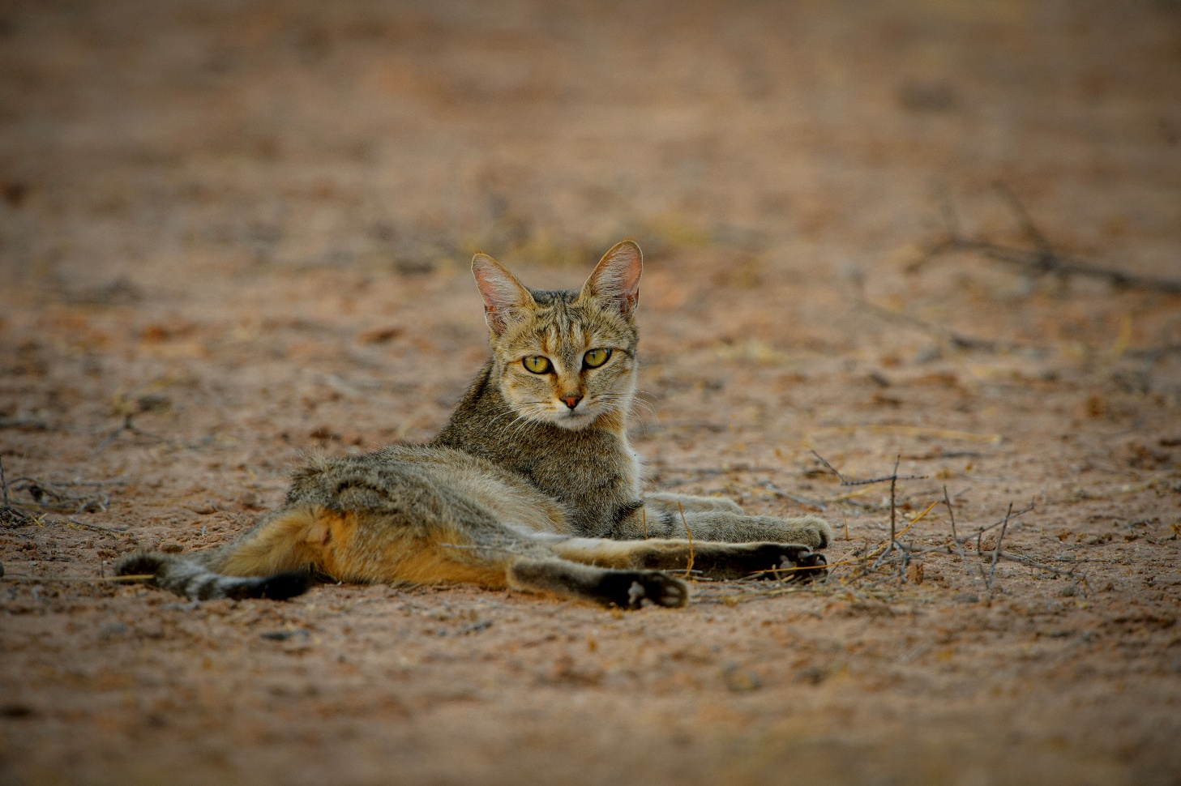
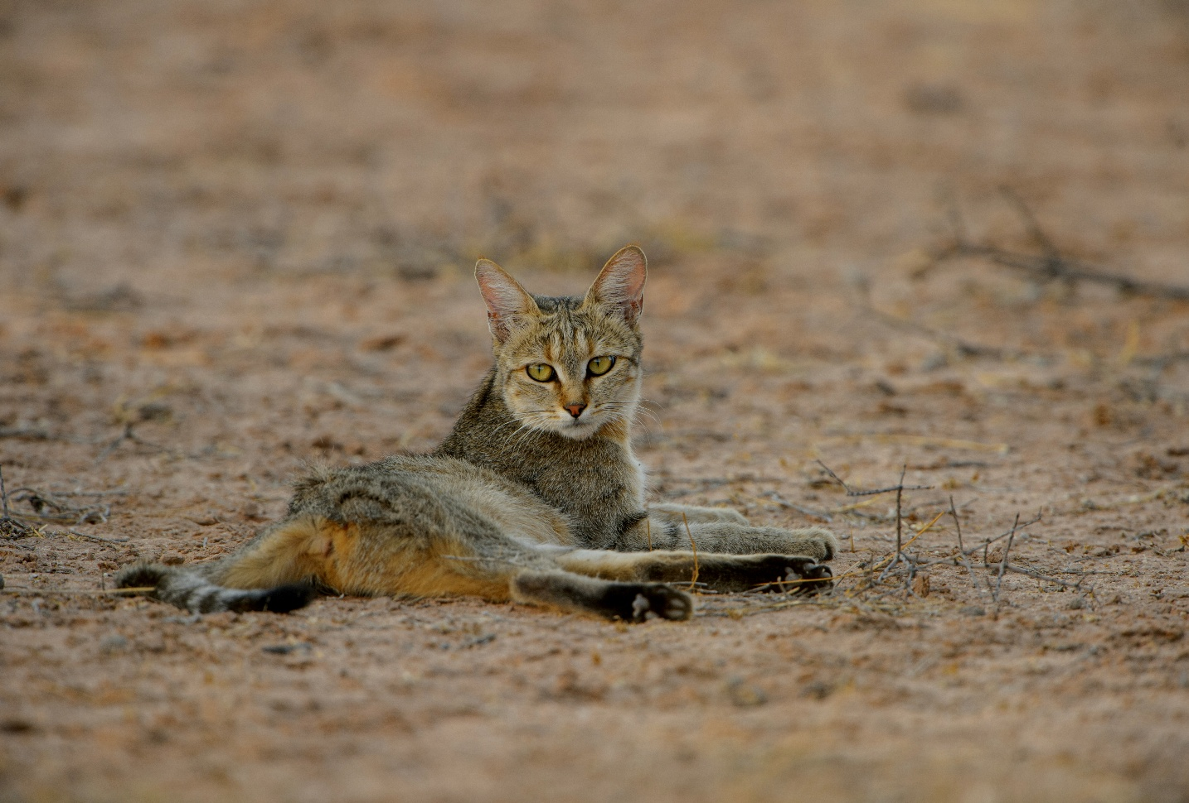
In Nature and Wildlife, NO vignette may be added.

Slide 48
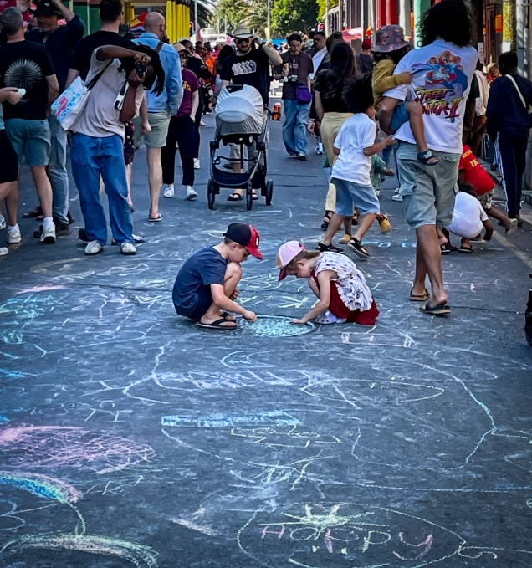
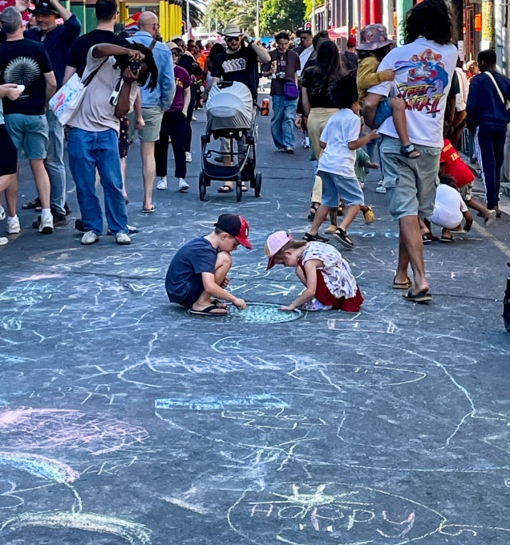
In Nature and Wildlife, NO vignette may be added.
In the other no-manipulation categories a very subtle vignette is allowed in PSSA salons.

Slide 49
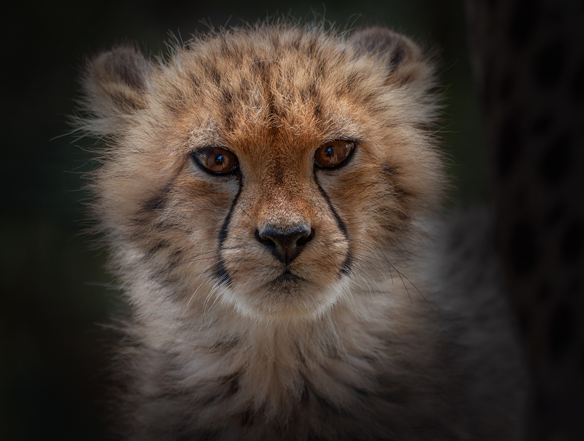
In the categories
Nature/Wildlife, Photo Travel, Street, Sport and Photojournalism,
manipulation is not allowed.
Manipulation shall constitute any or all of the following modifications to the original image:
Adding a vignette during processing;
A very effective image with the dark surrounds emphasizing the cuteness of the cheetah cub. But did you shoot it like that?
Notes:
A very effective image with the dark surrounds emphasizing the cuteness of the cheetah cub. But did you shoot it like that?

Slide 50
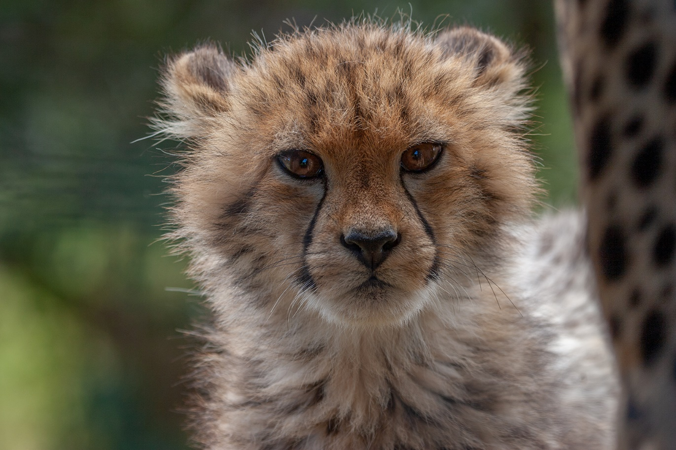
In the categories
Nature/Wildlife, Photo Travel, Street, Sport and Photojournalism,
manipulation is not allowed.
Manipulation shall constitute any or all of the following modifications to the original image:
Adding a vignette during processing;
A vignette has been used to darken the surrounds i.e. remove the areas you don’t want to see – therefore it is manipulation and not allowed.
Notes:
A vignette has been used to darken the surrounds i.e. remove the areas you don’t want to see – therefore it is manipulation and not allowed.

Slide 51
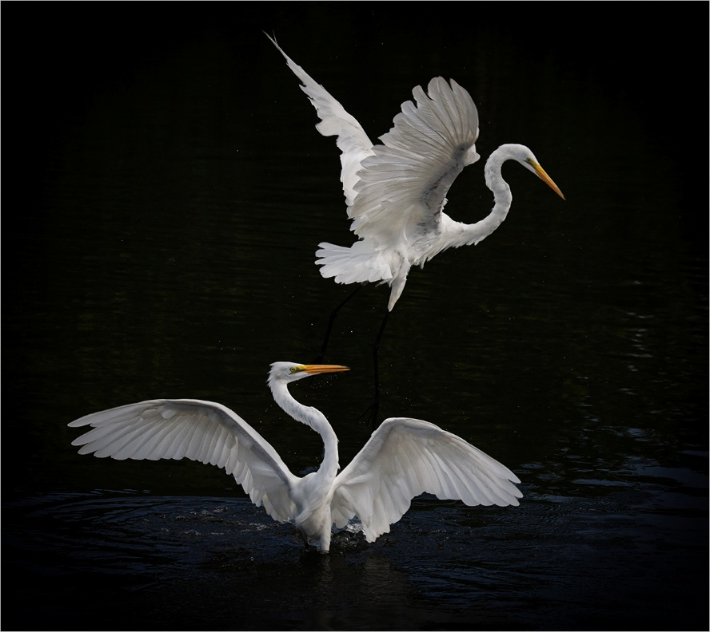
Is the dark background real?
Processing or editing must be limited to making the image look as close to the original scene as possible.
Techniques that enhance the presentation of the photograph, without changing the nature story or the pictorial content, or without altering the content of the original scene, are permitted.
Notes:
Is the dark background real?

Slide 52
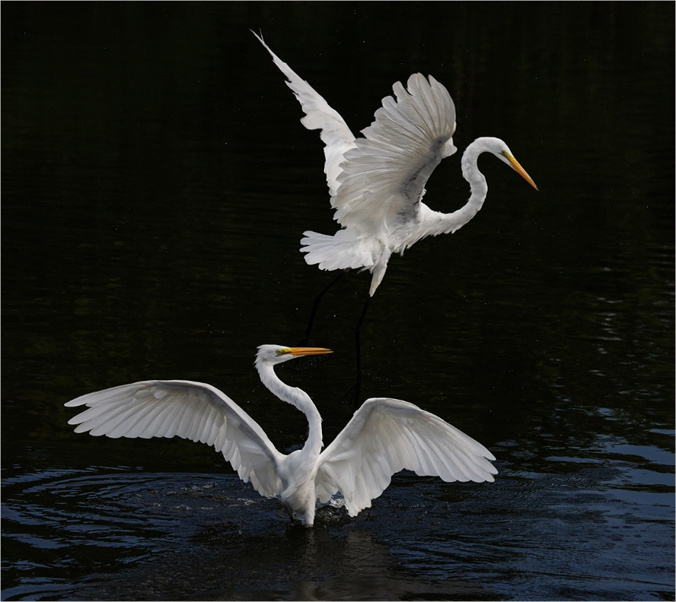
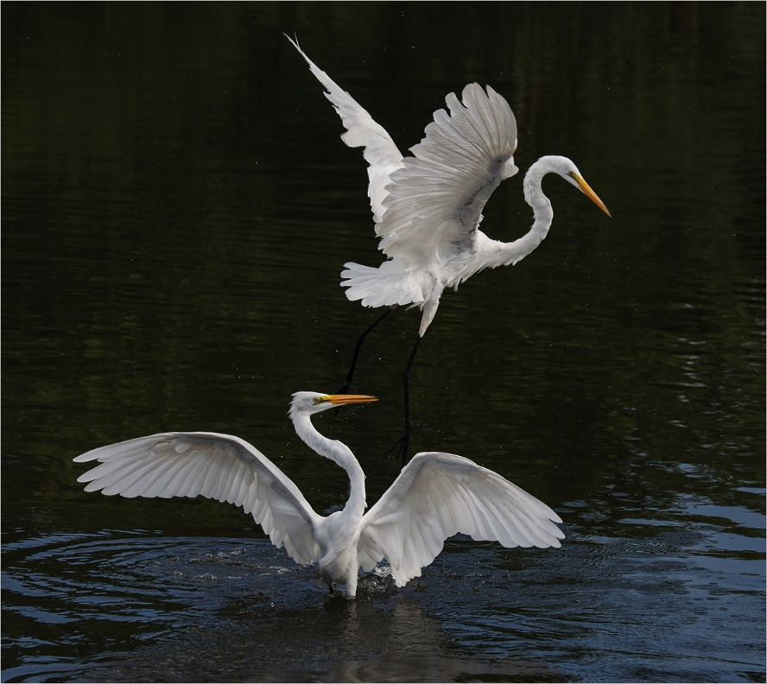
Is the dark background real?
Yes it is real because the background was obviously dark, but be careful of going too far – the first image probably did go too far because you are effectively removing the water by darkening it.
Processing or editing must be limited to making the image look as close to the original scene as possible.
Techniques that enhance the presentation of the photograph, without changing the nature story or the pictorial content, or without altering the content of the original scene, are permitted.
Notes:
Yes it is real because the background was obviously dark, but be careful of going too far – the first image was probably gone too far because you are effectively removing the water by darkening it.

Slide 53

In the categories
Nature/Wildlife, Photo Travel, Street, Sport and Photojournalism,
manipulation is not allowed.
Manipulation shall constitute any or all of the following modifications to the original image:
Removing an element from the image that was contained in the original scene by darkening
This image looks quite “normal” and it was entered into a nature section and was accepted. It was only on requesting the raw image that the problem could be seen.
Notes:
This image looks quite “normal” and it was entered into a nature section and was accepted. It was only on requesting the raw image that the problem could be seen.

Slide 54

In the categories
Nature/Wildlife, Photo Travel, Street, Sport and Photojournalism,
manipulation is not allowed.
Manipulation shall constitute any or all of the following modifications to the original image:
Removing an element from the image that was contained in the original scene by DARKENING
The whole background has been darkened far too much – not just enhancing the image but totally changing the time of day and removing the surrounds. It is definitely not allowed.
Notes:
The whole background has been darkened far too much – not just enhancing the image but totally changing the time of day and removing the surrounds. It is definitely not allowed.

Slide 55

Techniques that enhance the presentation of the photograph without changing the nature story or the pictorial content, or without altering the content of the original scene, are permitted.
Notes:
In other words you can enhance your image by making dark areas brighter and bright areas darker etc.

Slide 56
Techniques that enhance the presentation of the photograph, without changing the nature story or the pictorial content, or without altering the content of the original scene, are permitted.

Slide 57
Techniques that enhance the presentation of the photograph, without changing the nature story or the pictorial content, or without altering the content of the original scene, are permitted.
No techniques that add, relocate, replace, or remove any elements except by cropping are permitted.
Notes:
While enhancing your image you may not process it to such an extent that you are actually removing anything. You should also ensure that it still looks natural.

Slide 58

No techniques that add, relocate, replace, or remove any elements except by cropping are permitted.
P enhance
crop
O replace
O remove
Notes:
Here is the original image and you can see the rocks, shadows and trees have been removed and this is not allowed. Removing the foreground by cropping it out is allowed.

Slide 59

No techniques that add, relocate, replace, or remove any elements except by cropping are permitted.
P enhance
crop
O replace
O remove

Slide 60


In the categories
Nature/Wildlife, Photo Travel, Street, Sport and Photojournalism,
manipulation is not allowed.
Manipulation shall constitute any or all of the following modifications to the original image:
Removing an element from the image that was contained in the original scene, whether done via lightening, darkening, cloning, blurring or any other photo editing technique, except for cropping and straightening
Notes:
Here you can see that the background is at a bit of an angle so you can straighten the image, crop it and obviously enhance it.

Slide 61

In the categories
Nature/Wildlife, Photo Travel, Street, Sport and Photojournalism,
manipulation is not allowed.
Manipulation shall constitute any or all of the following modifications to the original image:
Removing an element from the image that was contained in the original scene, whether done via lightening, darkening, cloning, blurring or any other photo editing technique, except for cropping and straightening

Slide 62

In the categories
Nature/Wildlife, Photo Travel, Street, Sport and Photojournalism,
manipulation is not allowed.
Manipulation shall constitute any or all of the following modifications to the original image:
Removing an element from the image that was contained in the original scene by CLONING
Notes:
You cannot however remove anything – not even just a small white stone which is a bit distracting.

Slide 63
In the categories
Nature/Wildlife, Photo Travel, Street, Sport and Photojournalism,
manipulation is not allowed.
Manipulation shall constitute any or all of the following modifications to the original image:
Removing an element from the image that was contained in the original scene by CLONING
You cannot however remove anything – not even just a small white stone which is a bit distracting.

Slide 64

In the categories
Nature/Wildlife, Photo Travel, Street, Sport and Photojournalism,
manipulation is not allowed.
Manipulation shall constitute any or all of the following modifications to the original image:
Removing an element from the image that was contained in the original scene by CLONING
When looking at this image all looks fine whether it is entered into an Open or Photo Travel or Street Photography.
As judges we take images at face value and trust the photographer to follow the rules.
So when do we query it?
Every so often there will be an audit to make sure that everyone is following the rules.

Slide 65

In the categories
Nature/Wildlife, Photo Travel, Street, Sport and Photojournalism,
manipulation is not allowed.
If the image was entered under Photo Travel or Street Photography it should have been DQ’d – the only way to remove the unwanted elements in these categories is by cropping and this could have been successfully done to all elements except the wires in the top left.
The addition of the sky above is done using your own pixels (in content aware fill) and is therefore allowed in Open.
When looking at this image all looks fine whether it is entered into an Open or Photo Travel or Street Photography.
As judges we take images at face value and trust the photographer to follow the rules.
So when do we query it?
Every so often there will be an audit to make sure that everyone is following the rules.

Slide 66

In the categories
Nature/Wildlife, Photo Travel, Street, Sport and Photojournalism,
manipulation is not allowed.
Manipulation shall constitute any or all of the following modifications to the original image:
Removing an element from the image that was contained in the original scene, by any photo editing technique.
All looks fine in this image – but take a look at the raw image.
Notes:
All looks fine in this image – but take a look at the raw image.

Slide 67

In the categories
Nature/Wildlife, Photo Travel, Street, Sport and Photojournalism,
manipulation is not allowed.
Manipulation shall constitute any or all of the following modifications to the original image:
Removing an element from the image that was contained in the original scene, by any photo editing technique.
All looks fine in this image – but take a look at the raw image.
You can crop, and it doesn’t matter how small a part of the image you crop.
Notes:
You can crop, and it doesn’t matter how small a part of the image you crop.

Slide 68

In the categories
Nature/Wildlife, Photo Travel, Street, Sport and Photojournalism,
manipulation is not allowed.
Manipulation shall constitute any or all of the following modifications to the original image:
Removing an element from the image that was contained in the original scene, by any photo editing technique.
When you go in close however you can see that the highlights around the bird have very effectively been removed. You may not remove anything so this has been manipulated.
Notes:
When you go in close however you can see that the highlights around the bird have very effectively been removed. You may not remove anything so this has been manipulated.

Slide 69
In the categories
Nature/Wildlife, Photo Travel, Street, Sport and Photojournalism,
manipulation is not allowed.
Manipulation shall constitute any or all of the following modifications to the original image:
Removing an element from the image that was contained in the original scene, by any photo editing technique.
When you go in close however you can see that the highlights around the bird have very effectively been removed. You may not remove anything so this has been manipulated.
Notes:
When you go in close however you can see that the highlights around the bird have very effectively been removed. You may not remove anything so this has been manipulated.

Slide 70


In the categories
Nature/Wildlife, Photo Travel, Street, Sport and Photojournalism,
manipulation is not allowed.
There is a distinct difference between nature and wildlife – all wildlife is nature but only those creatures that are living free and unrestricted in an area of their own choosing are wildlife.
Creatures in a reserve such as shown here are nature but NOT wildlife – all arranged action shoots are nature and not wildlife.
Notes:
There is a distinct difference between nature and wildlife – all wildlife is nature but only those creatures that are living free and unrestricted in an area of their own choosing are wildlife. Creatures in a reserve such as shown here are nature but NOT wildlife – all arranged action shoots are nature.

Slide 71

In the categories
Nature/Wildlife, Photo Travel, Street, Sport and Photojournalism,
manipulation is not allowed.
Neither of these are Wildlife as they are not living free and unrestricted in an area of their own choosing
It is not always obvious but we have to trust ourselves and our fellow photographers.
Notes:
It is not always obvious but we have to trust ourselves and our fellow photographers.

Slide 72

In the categories
Nature/Wildlife, Photo Travel, Street, Sport and Photojournalism,
manipulation is not allowed.
A very effective image with a beautiful soft out of focus background.
But did you shoot it like that?
Notes:
A very effective image with a beautiful soft our of focus background. But did you shoot it like that?

Slide 73

In the categories
Nature/Wildlife, Photo Travel, Street, Sport and Photojournalism,
manipulation is not allowed.
Manipulation shall constitute any or all of the following modifications to the original image:
Blurring parts of the image during processing to hide elements in the original scene;
A very effective image with a beautiful soft our of focus background.
But did you shoot it like that?
The background is distracting but that’s how it was shot, and you can do nothing about it if you want to enter it as nature.
Notes:
The background is distracting but that’s how it was shot, and you can do nothing about it if you want to enter it as nature.

Slide 74

In the categories
Nature/Wildlife, Photo Travel, Street, Sport and Photojournalism,
manipulation is not allowed.
Techniques that enhance the presentation of the photograph without changing the nature story or the pictorial content, or without altering the content of the original scene, are permitted.

Slide 75

In the categories
Nature/Wildlife, Photo Travel, Street, Sport and Photojournalism,
manipulation is not allowed.
Manipulation shall constitute any or all of the following modifications to the original image:
Adding an element to the image that was not contained in the original scene;

Slide 76
In the categories
Nature/Wildlife, Photo Travel, Street, Sport and Photojournalism,
manipulation is not allowed.
Techniques that enhance the presentation of the photograph without changing the nature story or the pictorial content, or without altering the content of the original scene, are permitted.
Who will know?

Slide 77
In the categories
Nature/Wildlife, Photo Travel, Street, Sport and Photojournalism,
manipulation is not allowed.
Techniques that enhance the presentation of the photograph without changing the nature story or the pictorial content, or without altering the content of the original scene, are permitted.
Who will know?
You will know!
“Trust takes years to build, seconds to break, and forever to repair.”
Dhar Mann

Slide 78

In the categories
Nature/Wildlife, Photo Travel, Street, Sport and Photojournalism,
manipulation is not allowed.
Techniques that enhance the presentation of the photograph without changing the nature story or the pictorial content, or without altering the content of the original scene, are permitted.
Cropping, Straightening, Flipping are permitted.

Slide 79

In the categories
Nature/Wildlife, Photo Travel, Street, Sport and Photojournalism,
manipulation is not allowed.
Techniques that enhance the presentation of the photograph without changing the nature story or the pictorial content, or without altering the content of the original scene, are permitted.
Cropping, Straightening, Flipping are permitted.

Slide 80
In the categories
Nature/Wildlife, Photo Travel, Street, Sport and Photojournalism,
manipulation is not allowed.
Manipulation shall constitute any or all of the following modifications to the original image:
Removing an element from the image that was contained in the original scene, whether done via lightening, darkening, cloning, blurring or any other photo editing technique, except for cropping and straightening.

Slide 81

In the categories
Nature/Wildlife, Photo Travel, Street, Sport and Photojournalism,
manipulation is not allowed.
Manipulation shall constitute any or all of the following modifications to the original image:
Removing an element from the image that was contained in the original scene, whether done via lightening, darkening, cloning, blurring or any other photo editing technique, except for cropping and straightening.
Up to this stage everything that has been done is allowed.
Notes:
Up to this stage everything done has been allowed.

Slide 82

In the categories
Nature/Wildlife, Photo Travel, Street, Sport and Photojournalism,
manipulation is not allowed.
Manipulation shall constitute any or all of the following modifications to the original image:
Removing an element from the image that was contained in the original scene, whether done via lightening, darkening, cloning, blurring or any other photo editing technique, except for cropping and straightening.
Converting to Monochrome is allowed.
Notes:
Up to this stage everything done is allowed.

Slide 83

In the categories
Nature/Wildlife, Photo Travel, Street, Sport and Photojournalism,
manipulation is not allowed.
Manipulation shall constitute any or all of the following modifications to the original image:
Removing an element from the image that was contained in the original scene by LIGHTENING
But now it has gone too far – it is fine for a pictorial image but it could not be entered into a nature category as the bushes and ground have been removed – in this case by making it lighter.
Notes:
But now it has gone too far – it is fine for a pictorial image but it could not be entered into a nature category as the bushes and ground have been removed – in this case by making it lighter.

Slide 84

This image is made up of two images, one shot immediately after the other, and then combined.
A beautiful image but one that does break the rules and is therefore manipulation.
Notes:
This image is made up of two images, one shot immediately after the other, and then combined. A beautiful image but one that does break the rules and is therefore manipulation.

Slide 85
Many manipulations result in great images.
So don’t give up – just don’t enter these images in a category that does not allow manipulation.
Enjoy your Photography!!
Notes:
This image is made up of two images, one shot immediately after the other, and then combined. A beautiful image but one that does break the rules and is therefore manipulation.

