Slide 1

Visual art and Visual literacy
Steff Hughes

Slide 2
AGENDA
Visual Art​
Visual Literacy
Abstract Art
​Examples
You be the judge
​Feedback​

Slide 3


Introduction
We are entering the creative side of photography.
I have used definitions from the art world.
Immerse yourself in the world of Visual Art by attending gallery openings, visiting art museums and following contemporary artists and photographers.
Free yourself from the conventions of traditional, representational photography.

Slide 4
Definition:
Art
The conscious use of skill and creative imagination especially in the production of aesthetic objects.
https://www.merriam-webster.com/dictionary/art

Slide 5
Definition:
Visual Art
"Visual Arts" is a modern but imprecise umbrella term for a broad category of art which includes artistic disciplines from various sub-categories. Its wide ambit renders meaningless any attempt at definition.
http://www.visual-arts-cork.com/definitions/visual-art.htm

Slide 6
The main focus of visual arts is creative expression through visual means. This means there is communication without the need for words and without the need for the other human senses.
“
”
https://study.com/academy/lesson/visual-arts-types-characteristics-examples.html

Slide 7
How do you assess Visual art?
Composition – arrangement of elements
Line – soft, hard, edgy, smooth, fast, slow, actual or implied
Colour – bright, subtle, harmonious, jarring, happy, sad, moody
Shape – a line bounding a 2D (flat) shape e.g. a circle or a square
Form – an attempt to represent a 3D object, e.g. a ball or a cube
Space – perspective, implied distance, positive and negative space
Pattern - a repeated design element of shapes or lines
Texture – an attempt to visually describe what something feels like
Repetition – adds visual rhythm
Contrast/Value – light and dark, colour tones, high key/low key
Balance – harmonious or imbalanced
Mood / feeling
Meaning / Symbolism

Slide 8
Definition:
Visual literacy
“Visual literacy” is the ability to read, write and create visual images. Visual media is a linguistic tool with which we communicate, exchange ideas and navigate our complex world.
https://visualliteracytoday.org/

Slide 9
3.2 billion images and 720,000 hours of video are shared online daily
https://theconversation.com/
Statistics from 2020

Slide 10
Do you “look” or do you “see?
Look?
See?
Superficial
With or without intent (autopilot)
Practical and necessary (maps)
Take in information without processing
Slow down
Conceptualize, analyze, synthesize and evaluate information
Think independently
Assess what you see
Look for mood / feeling
Look for meaning / symbolism

Slide 11
Visual language
The ability to decode the language of images helps us realise that a single image may have multiple meanings.
Fluency in visual language enriches our understanding of Art and the world.
It influences our creativity, empathy and critical thinking.
https://crawfordartgallery.ie/

Slide 12
Images in the digital era
Bombardment
Altered
Too many to process intellectually
Deliberately emotive
Bias:
  Marketing
  Political
Misinformation
Disinformation
Artificial Intelligence
Deep fakes

Slide 13
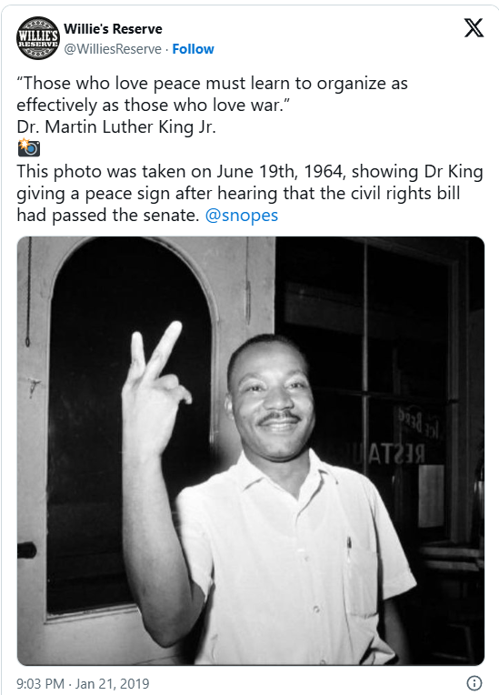
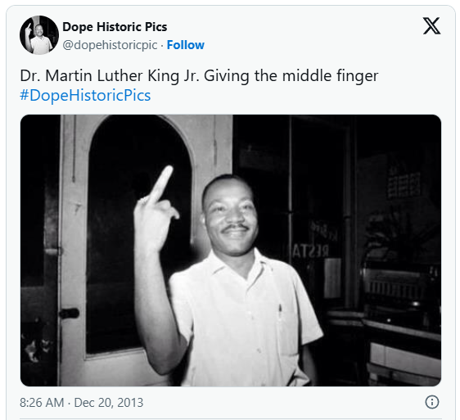
Photo manipulation

Slide 14
Definition:
Abstract Art
Abstract art is art that does not attempt to represent an accurate depiction of a visual reality but instead uses shapes, colours, forms and gestural marks to achieve its effect.
https://www.tate.org.uk/art/art-terms/a/abstract-art

Slide 15
Guidelines for assessment
Overall impact
Discuss the use of art criteria (colour, line, composition, shape, balance, contrast, repetition, pattern and texture)
Does it evoke a mood?
Is there symbolism or a deeper meaning?
Does it “hang together”?
Are the technical aspects well handled?

Slide 16



DISCUSSION
CREATIVITY
AESTHETICS
CONCEPTual
Created rather than imitated
Responsive to or appreciative of what is pleasurable to the senses
An art form in which the artist's intent is to convey a concept rather than to create an art object
https://www.merriam-webster.com/dictionary

Slide 17
Some examples
Let’s discuss some examples as a group

Slide 18


Slide 19
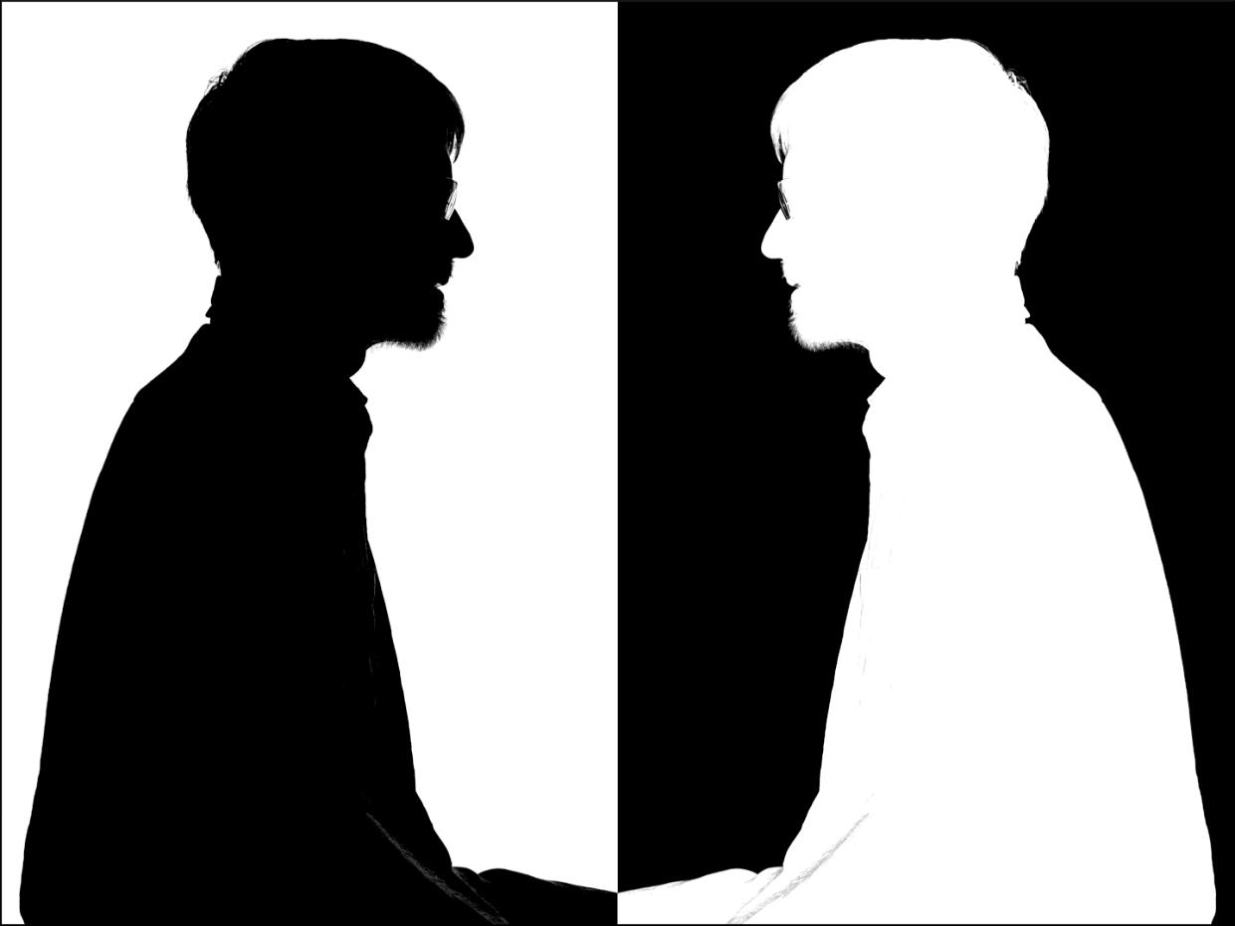

Slide 20
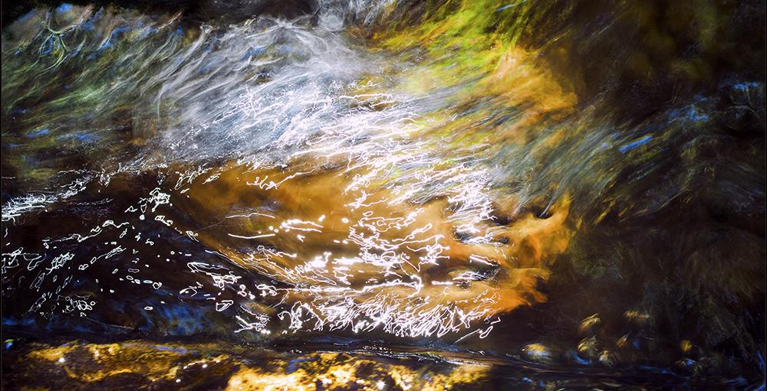

Slide 21
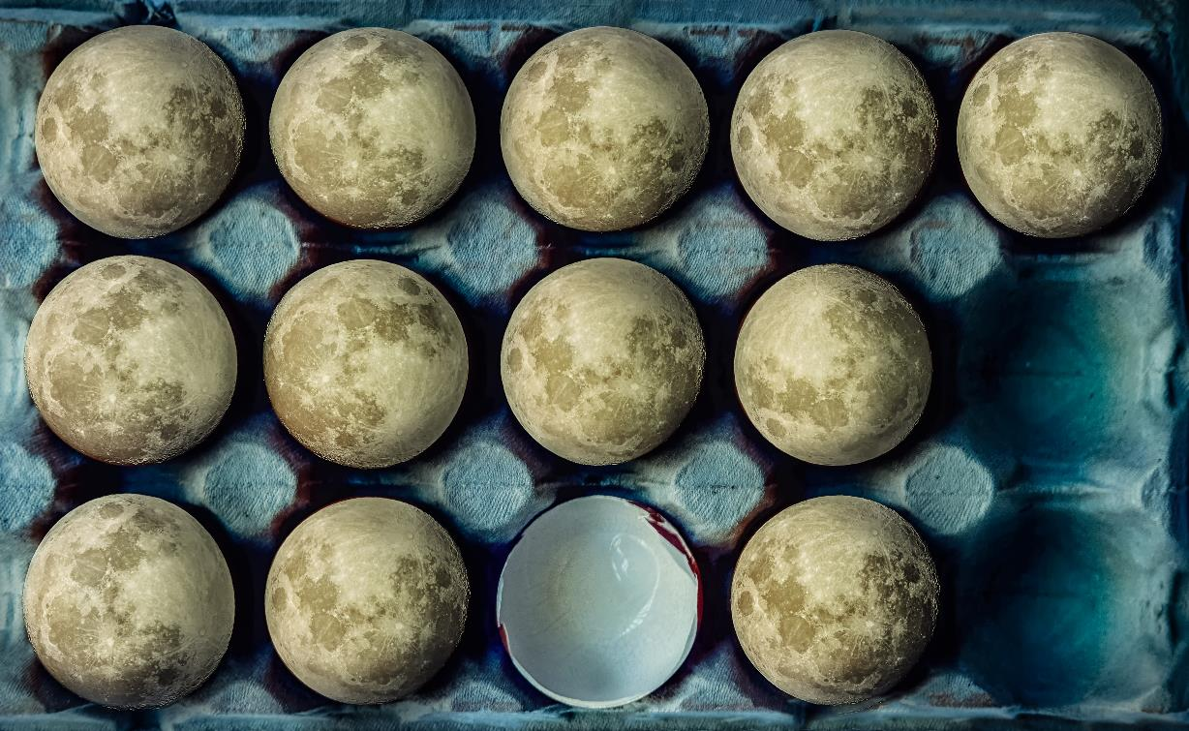

Slide 22
Q & A

Slide 23
Steff Hughes
Photography judge and mentor
Workshops, one-on-one, help with editing, learn photoshop and lightroom
082 356 3979
Steffnehughes@gmail.com

Slide 24
It’s your turn to be the judge
I will show an image and ask one person to assess it.
I’ll provide feedback on your judging.

Slide 25


Slide 26


Slide 27


Slide 28
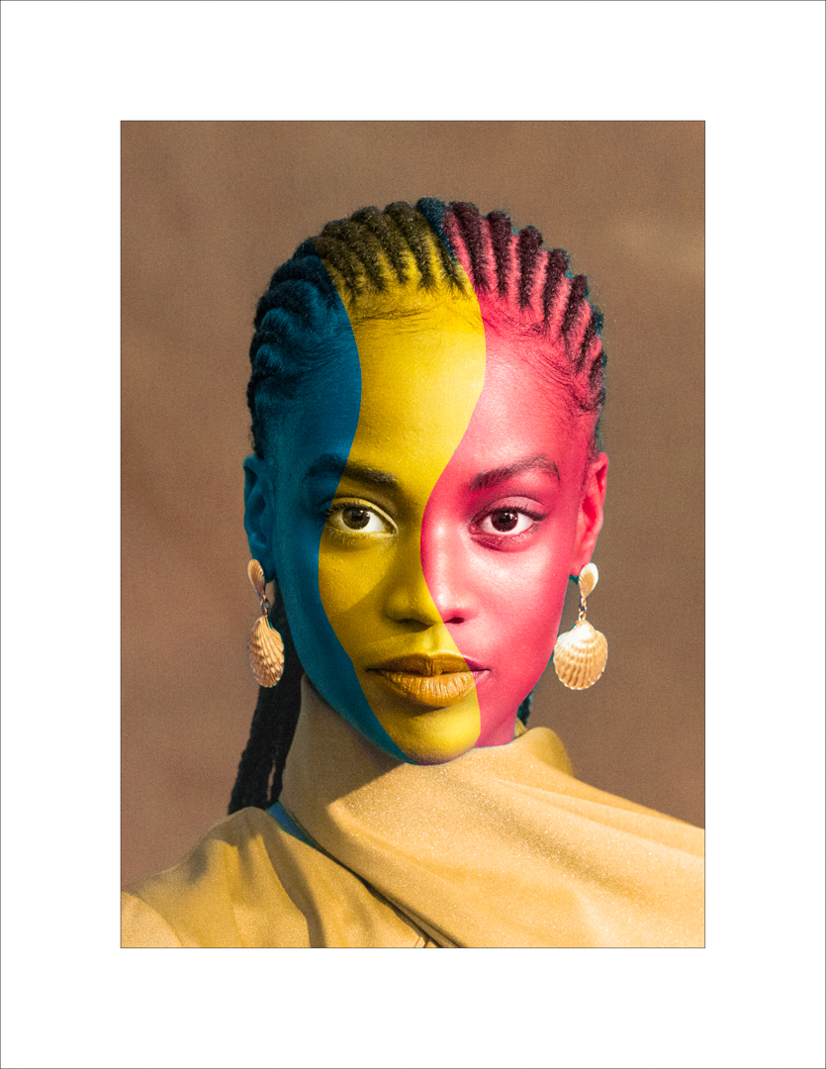

Slide 29


Slide 30


Slide 31
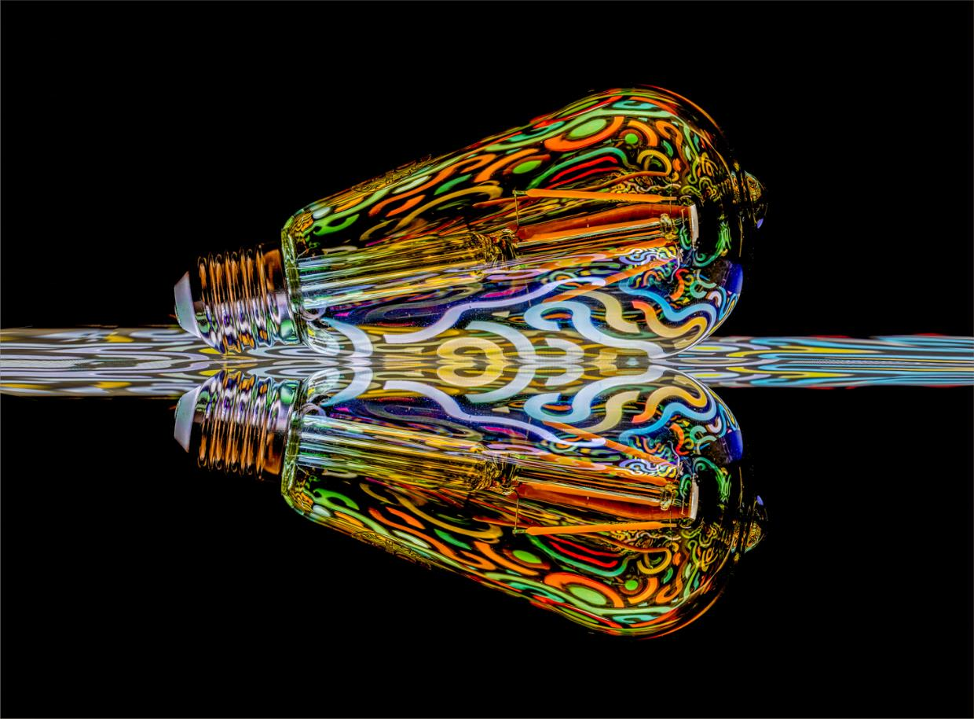

Slide 32
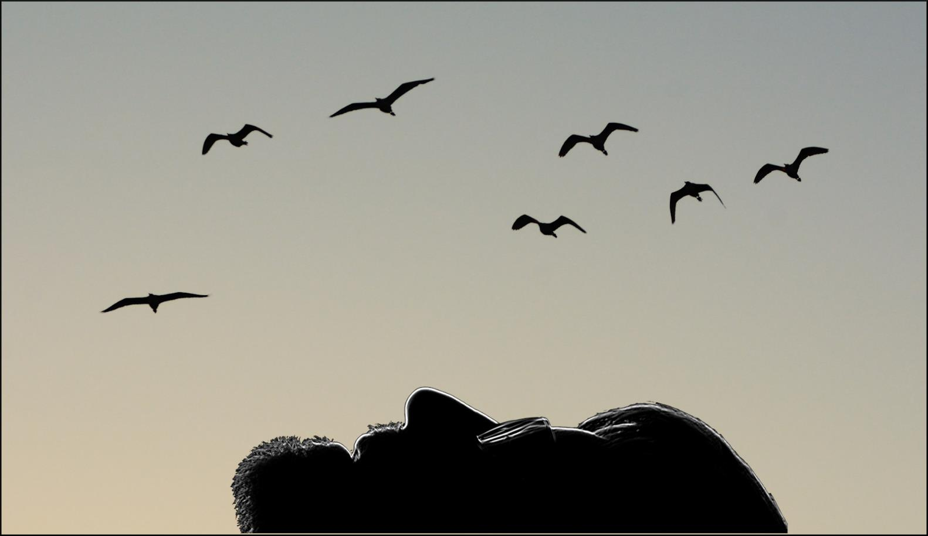

Slide 33
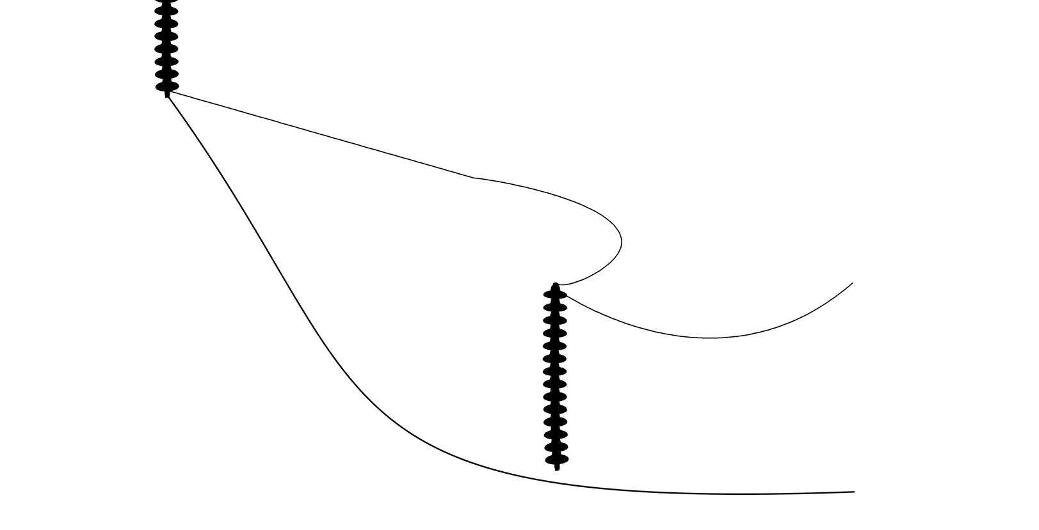

Slide 34


Slide 35
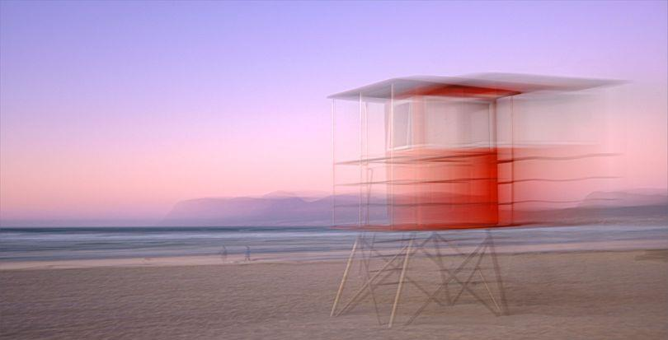

Slide 36


Slide 37
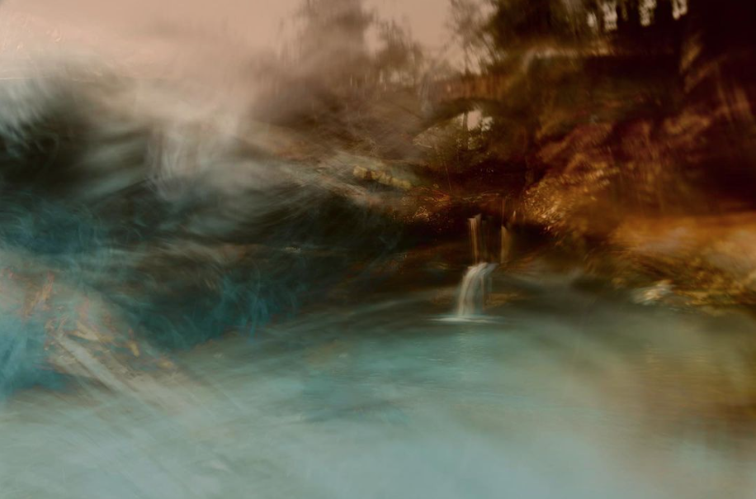

Slide 38


Slide 39


Slide 40
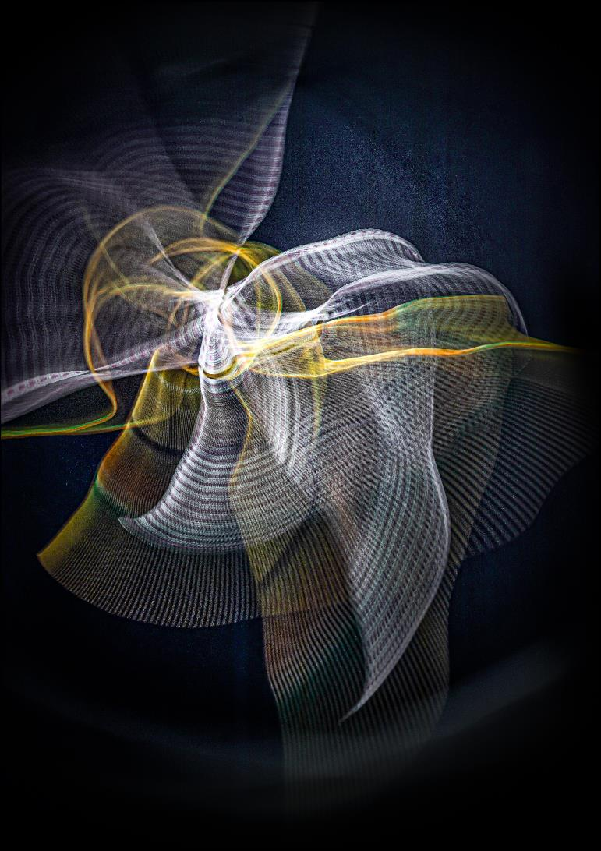

Slide 41
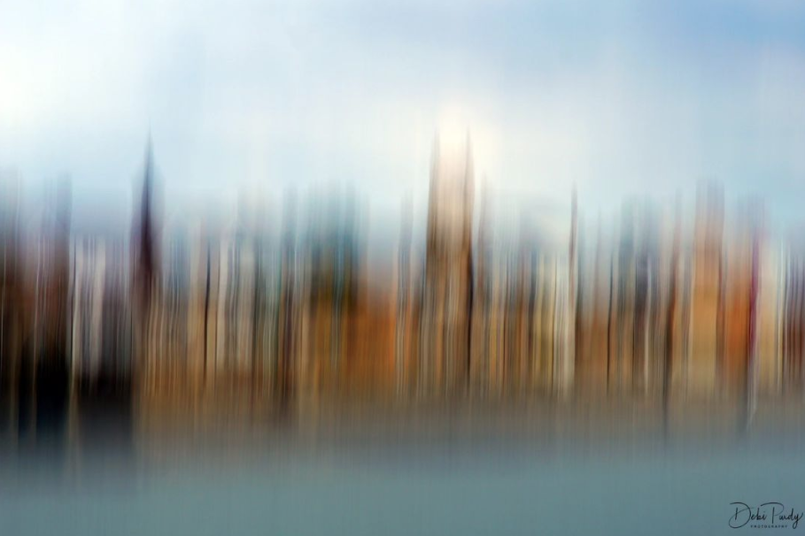

Slide 42
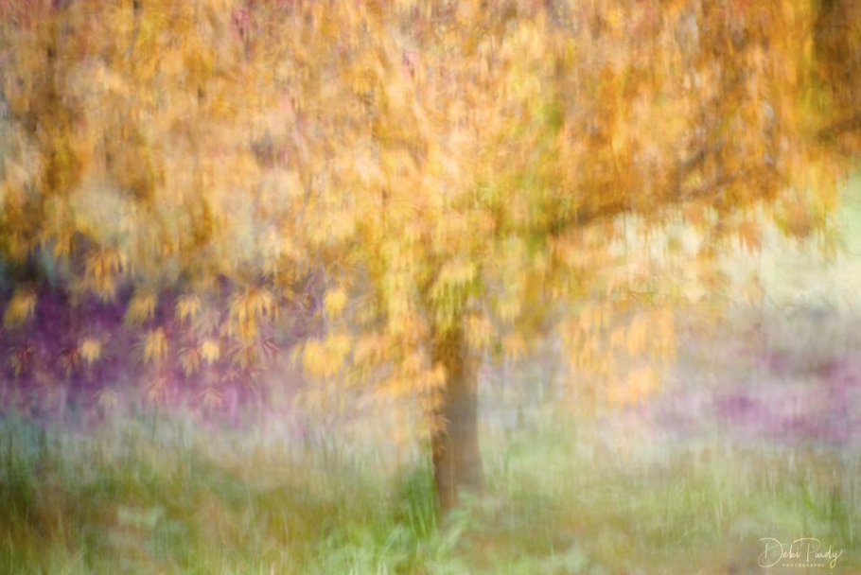

Slide 43
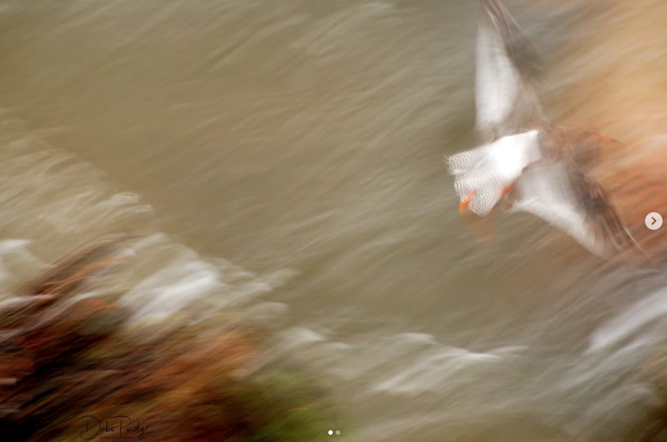

Slide 44


Slide 45
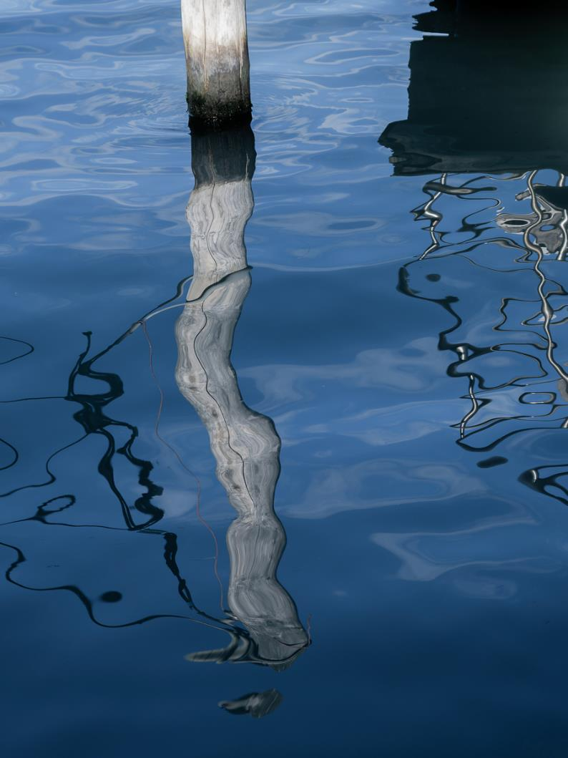

Slide 46



Slide 47
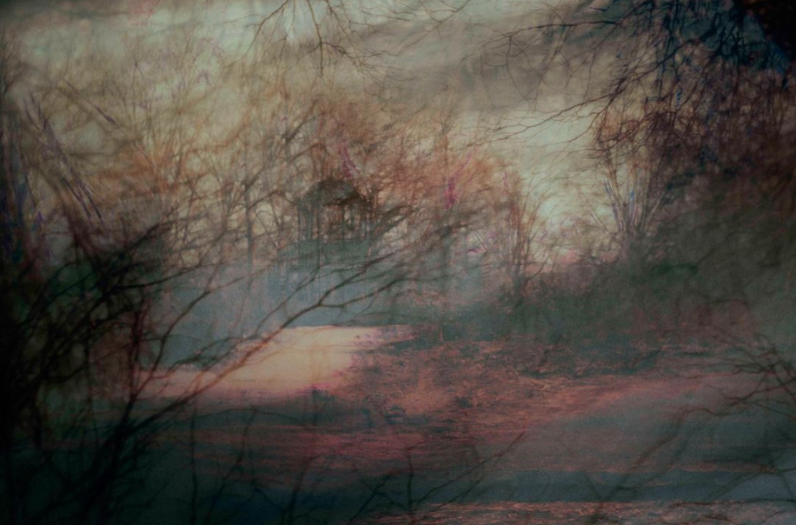

Slide 48
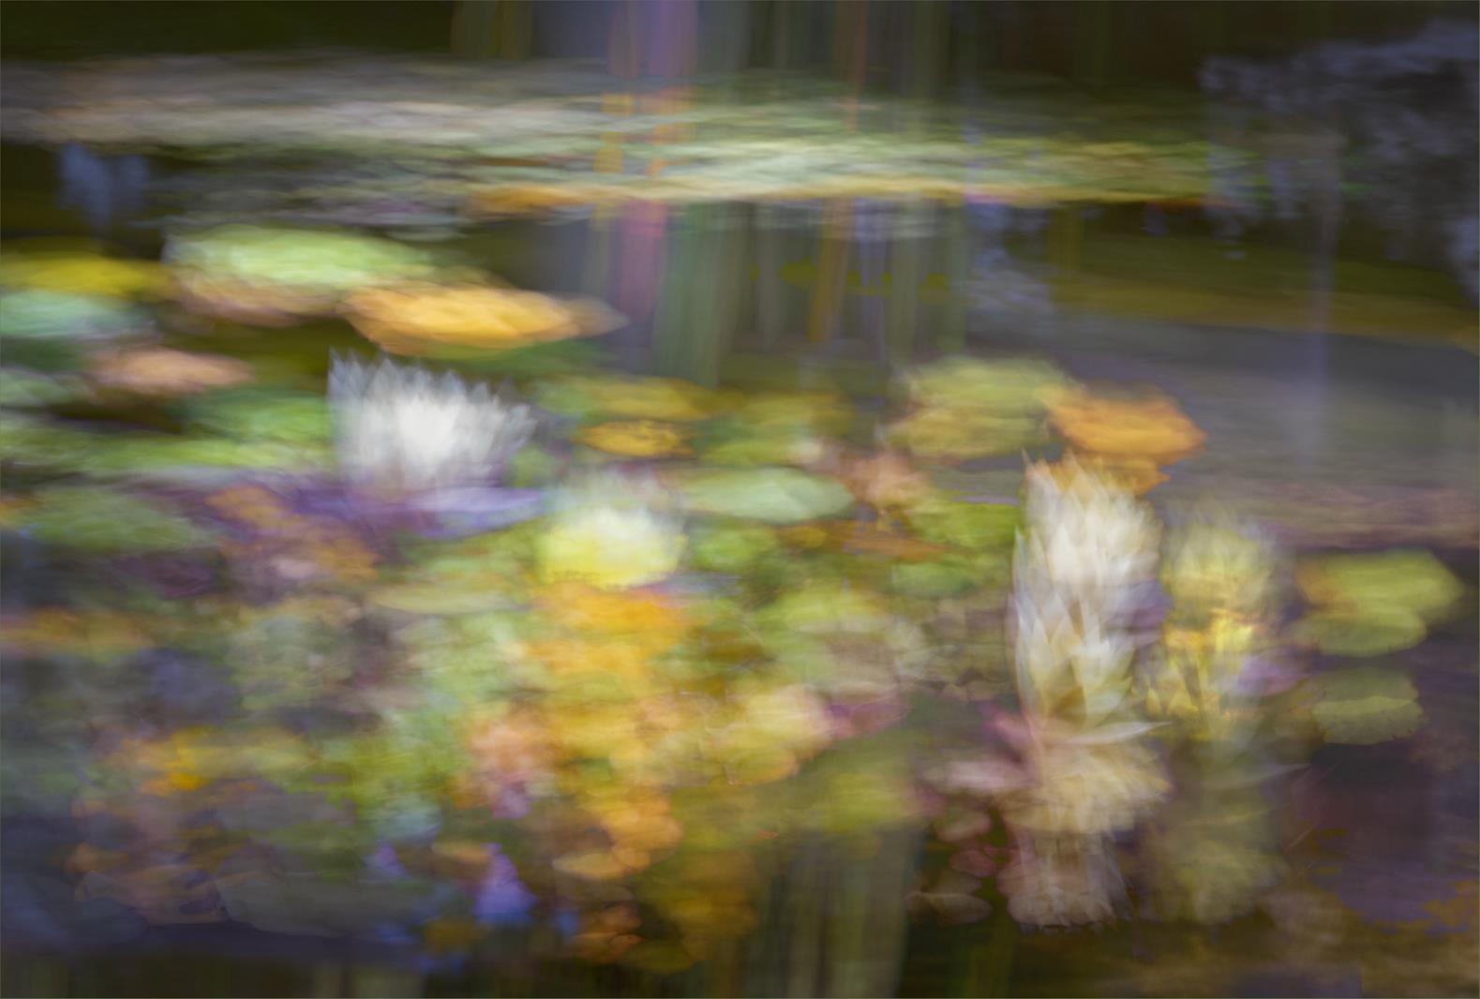

Slide 49
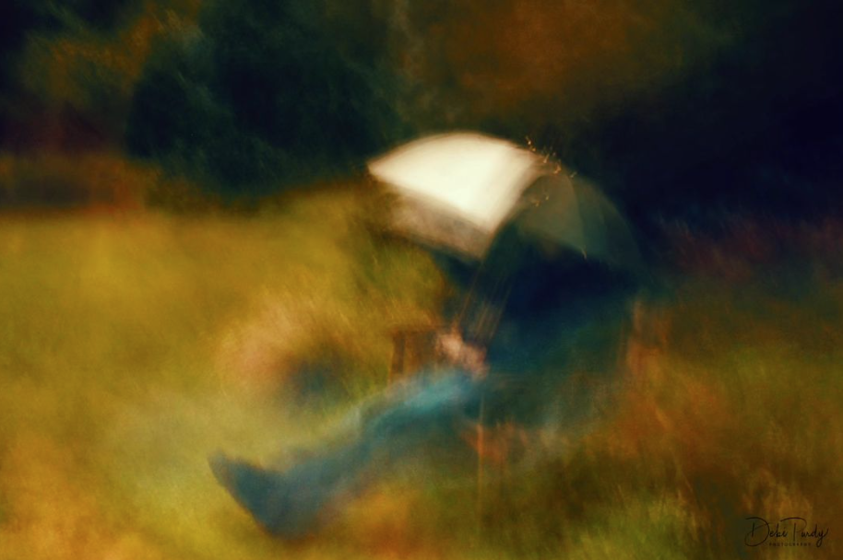

Slide 50
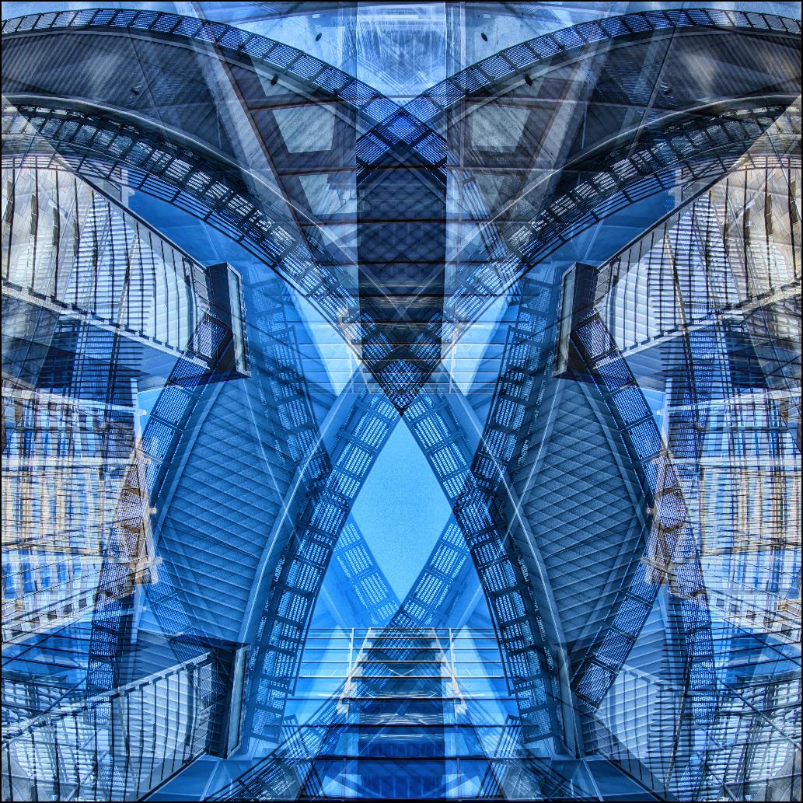

Slide 51
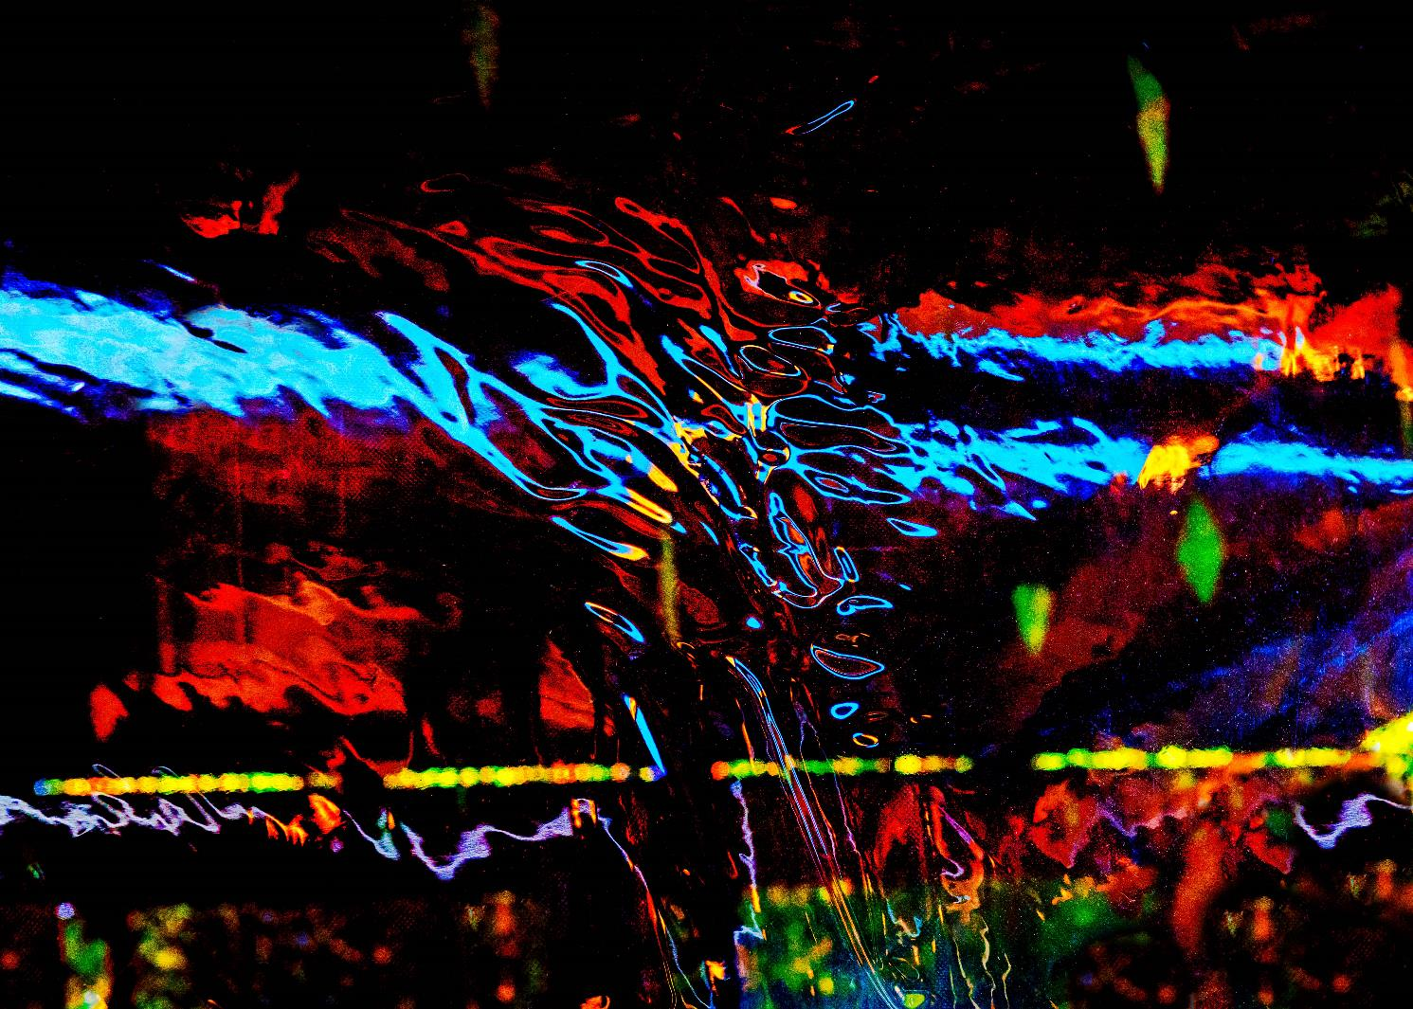

Slide 52
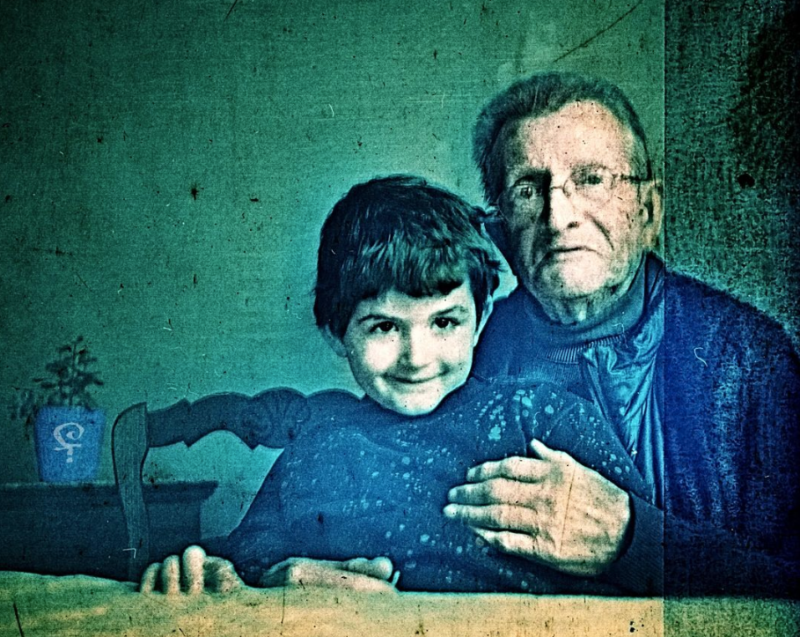

Slide 53
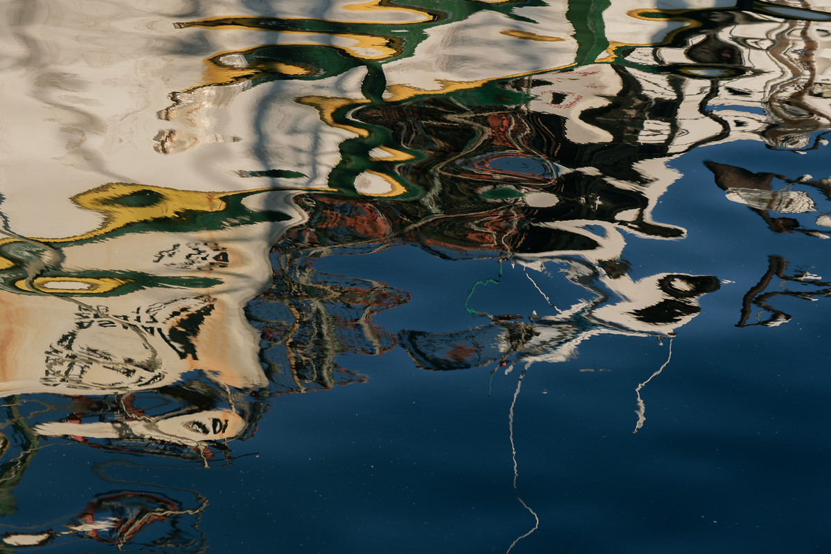

Slide 54
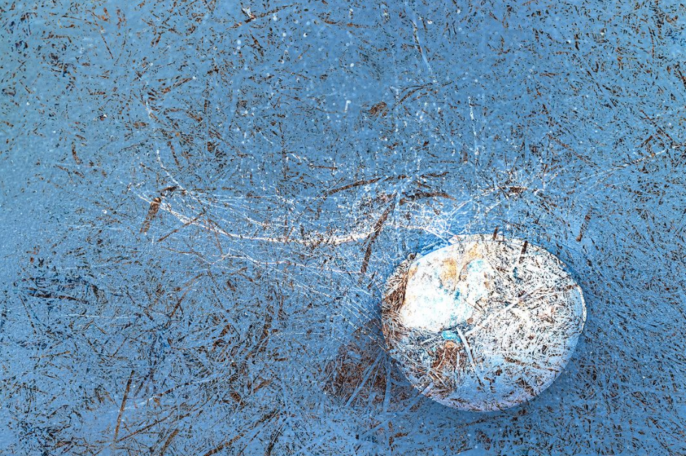

Slide 55
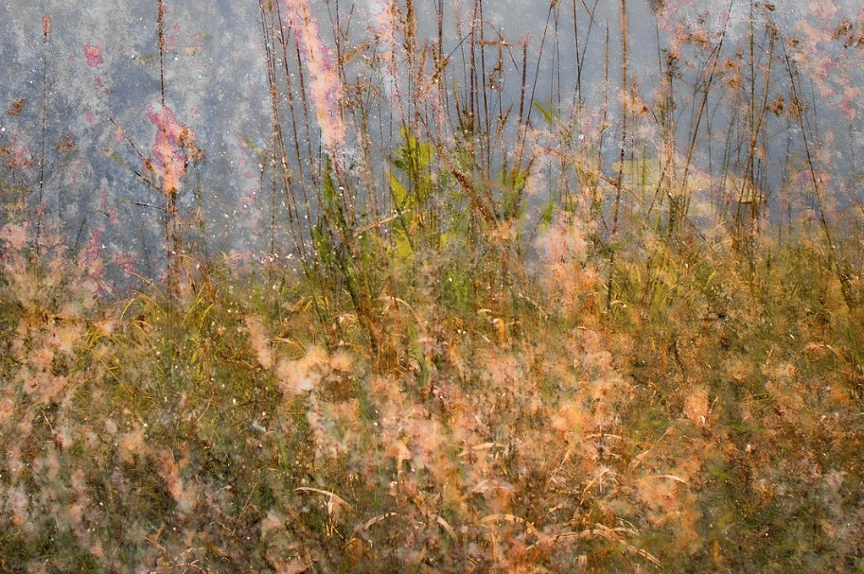

Slide 56


Slide 57
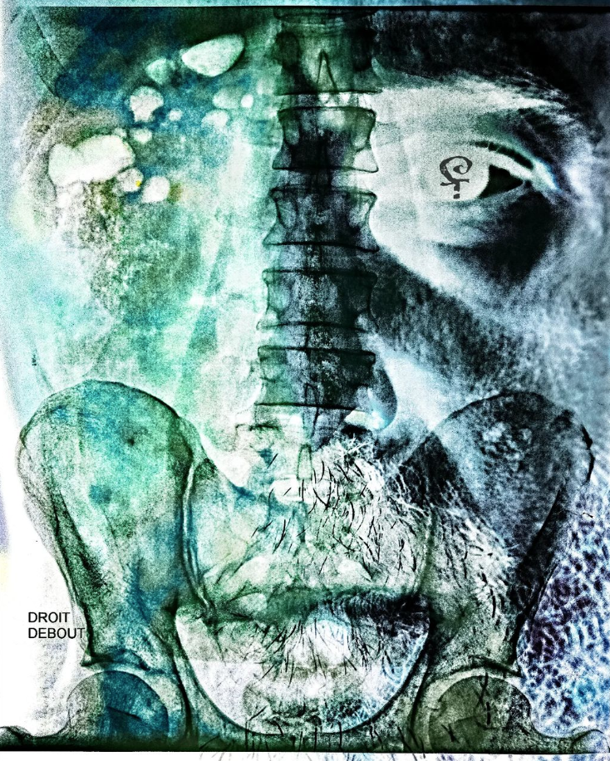

Slide 58
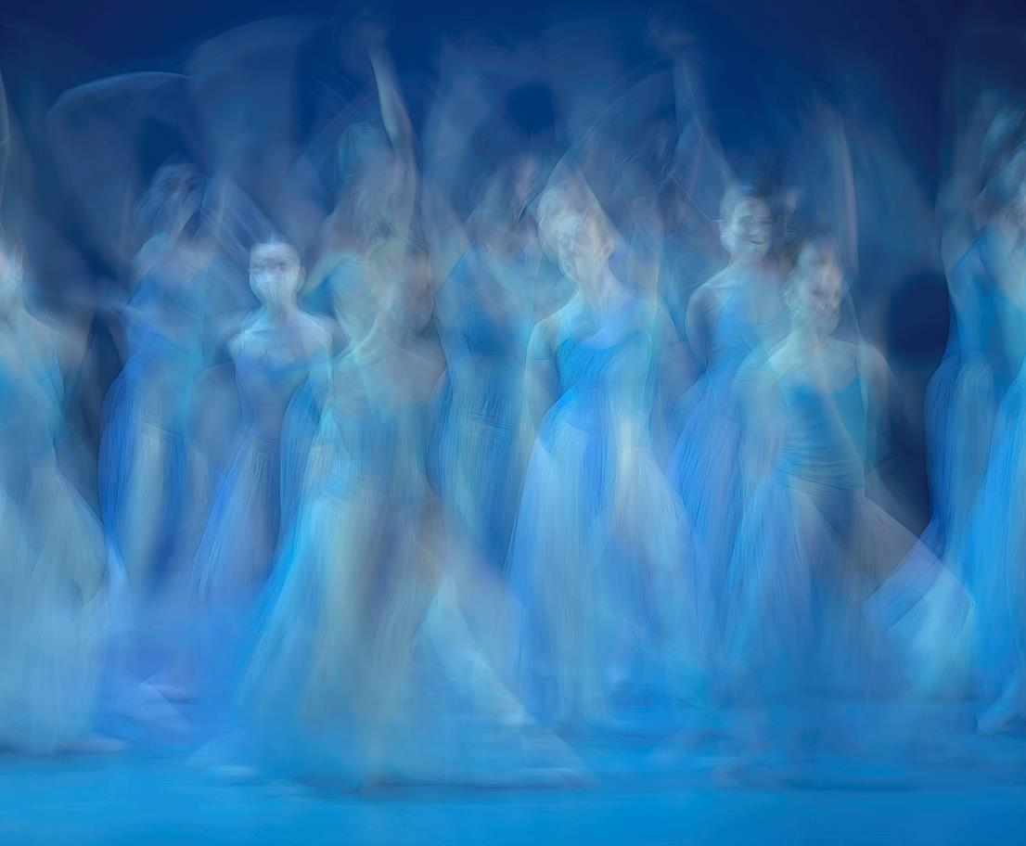

Slide 59
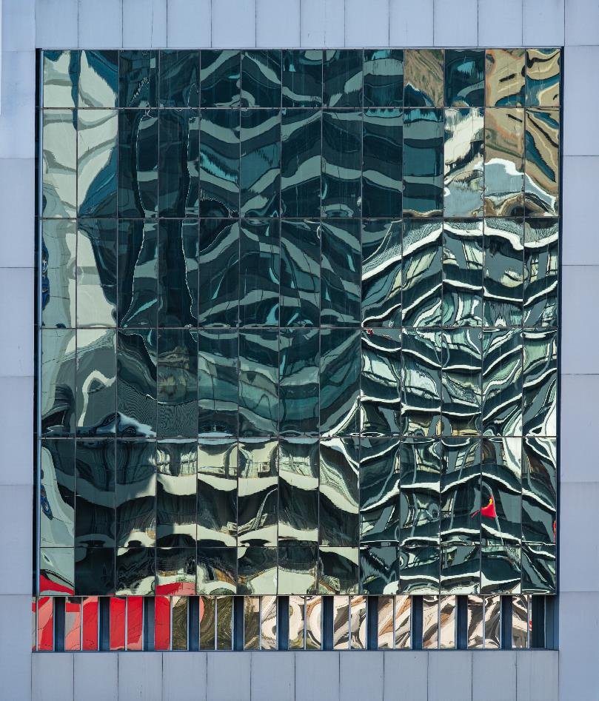

Slide 60
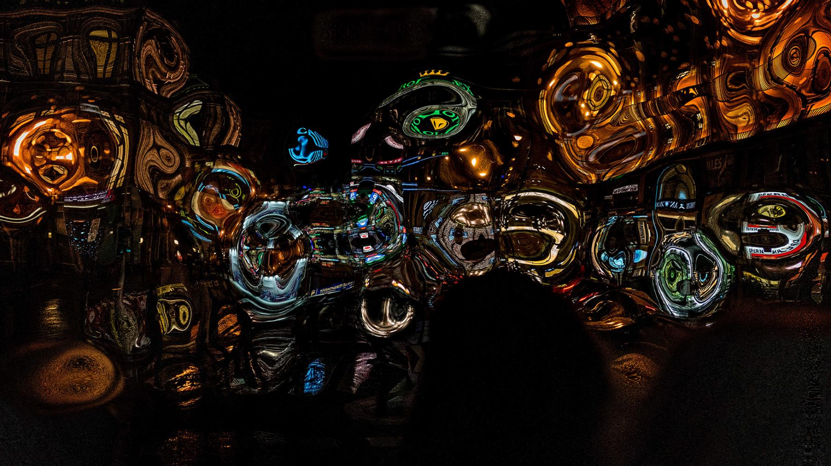

Slide 61
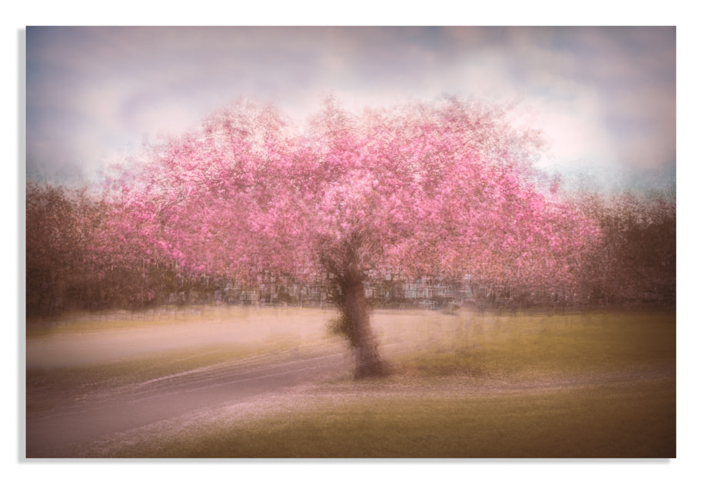

Slide 62
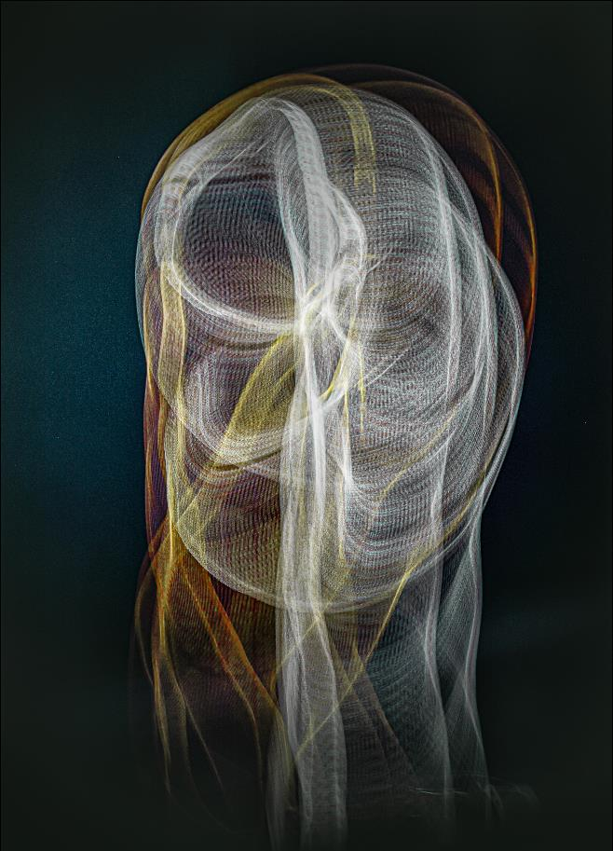

Slide 63
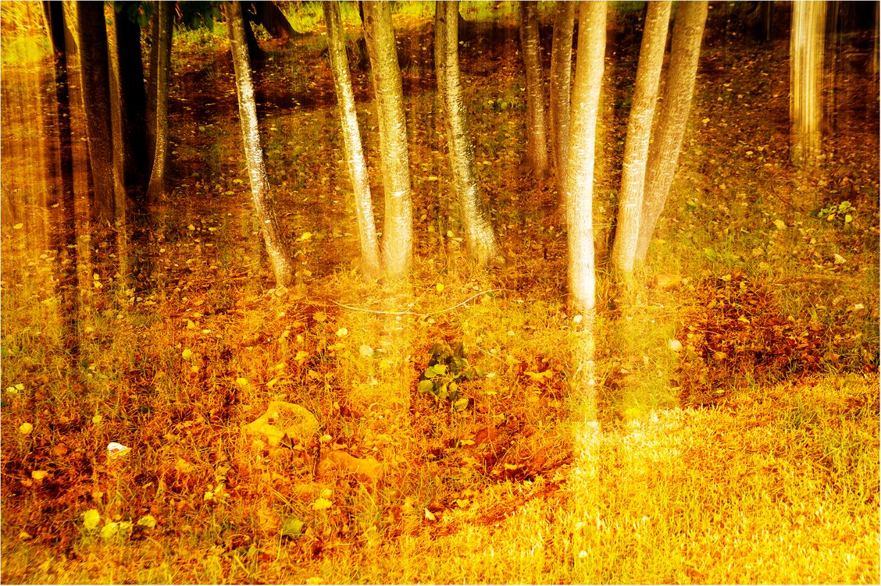

Slide 64
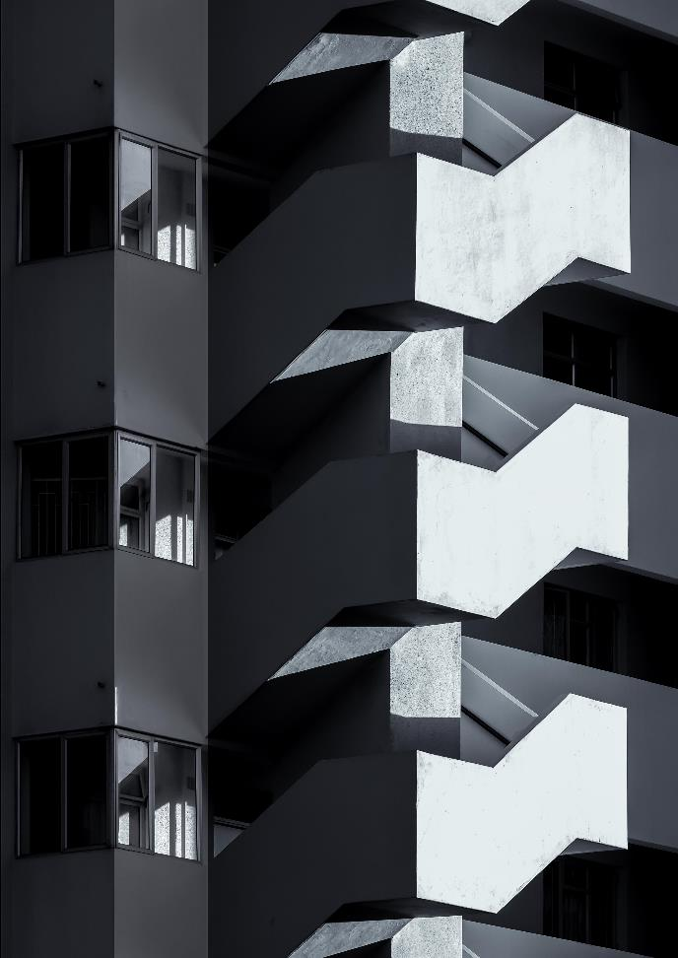

Slide 65
