Slide 1
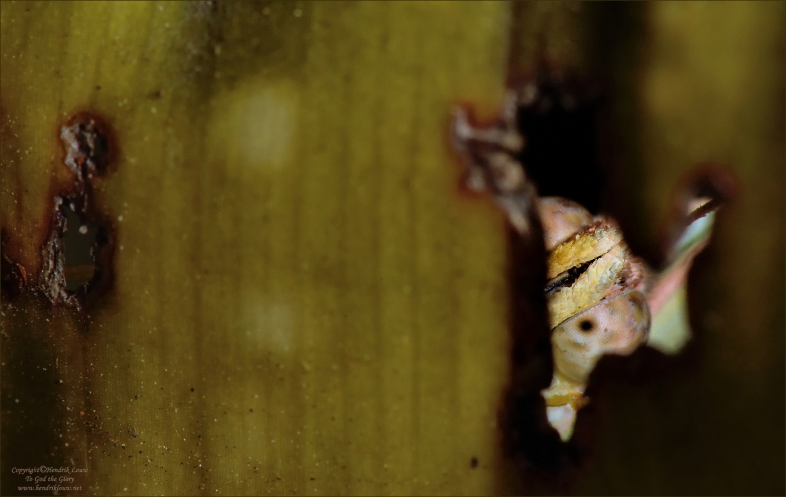
Macro Judging
Seeing from the
other side….
Hendrik Louw
Copyright reserved: all images and presentation

Slide 2
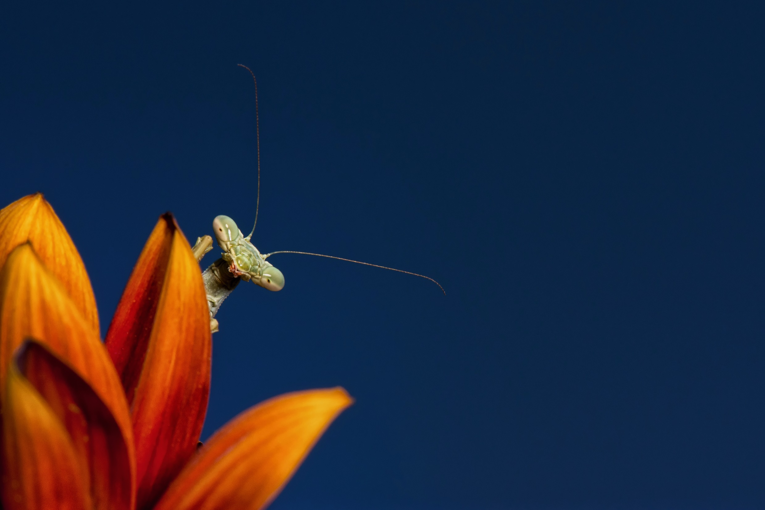
Overview
  History of macro photography
  What is macro photography?
  The Masters!
  The four “boundary” issues
  Golden rules for judging

Slide 3
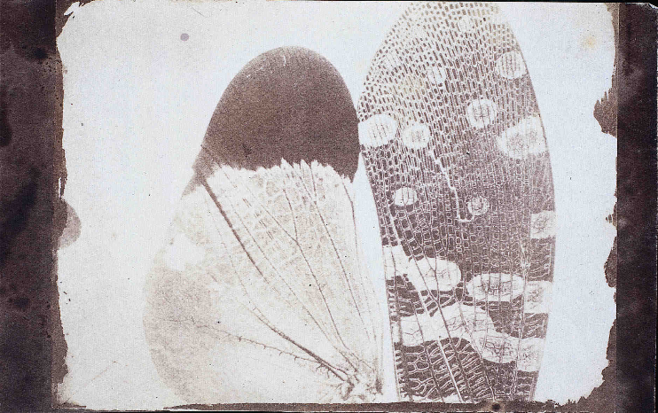
History of macro photography
Thomas Wedgwood (1771 – 1805)
  Proposed the possibility of photomicrography from microscopes – 1802
  Proposed as one of the benefits of photography
William Henry Fox Talbot
  Since 1834, Talbot used small cameras
  to record images on paper
  (20x enlargement;
  transverse section of a stem)
W. H. Walmsley
  Proposed term “photomacrography” in 1899
    Photomicrography (10:1 - ∞:1)
    Photomacrography (1:1 – 10:1)

Slide 4
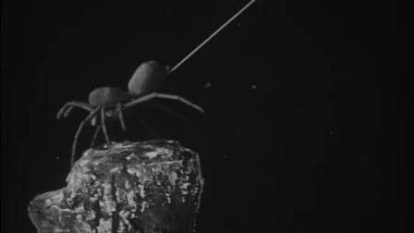
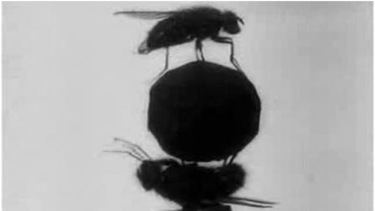
History of macro photography
Frank Percy Smith
  “To demonstrate how spiders
  fly” (1909)
  “The acrobatic fly” (1910)
  BBC documentary in 2013 trying to
  recreate acrobatic fly
  https://youtu.be/8hlocZhNc0M
  Started the series
  “Secrets of nature” (1925)
  The Bedtime Stories of Archie the Ant
Kilfitt Makro-Kilar 40mm
  1955

Slide 5
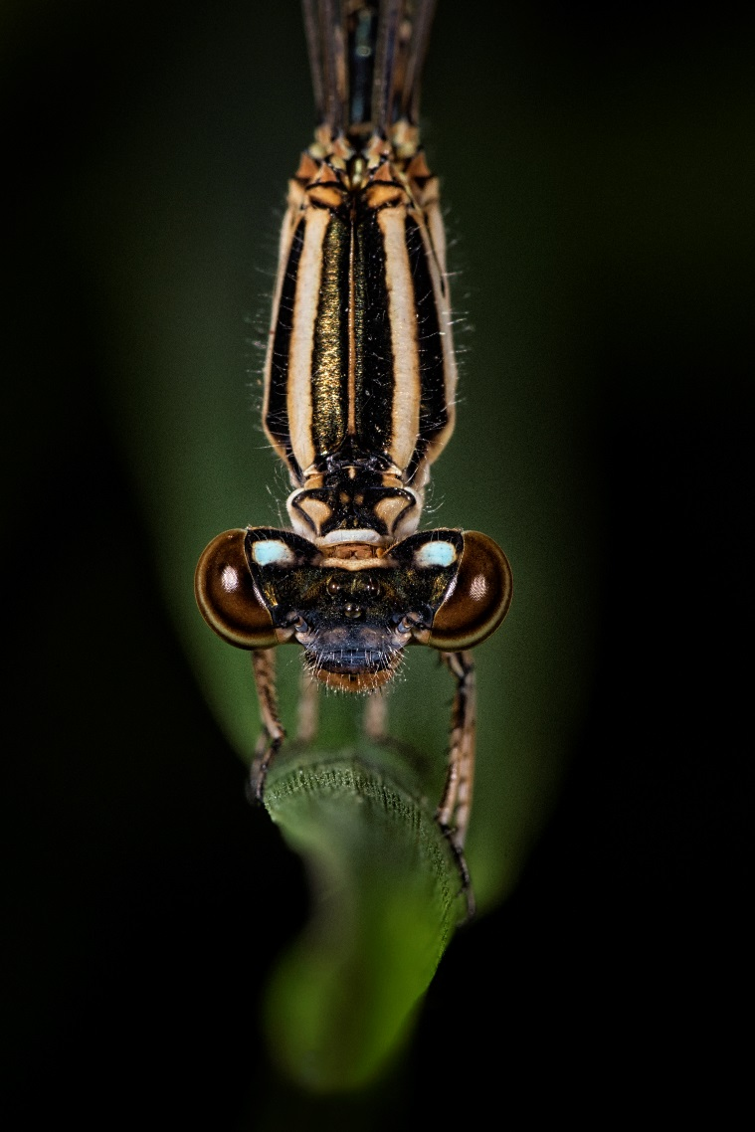
What is macro photography
What is macro photography?
  Photomicrography (10:1 - ∞:1)
  Photomacrography (1:1 – 10:1)
Sensor area size: subject area size
  Stamp (36 x 24 mm : 36 x 24mm)
  Full frame? Cell? Medium format?
Macro vs close-up

Slide 6
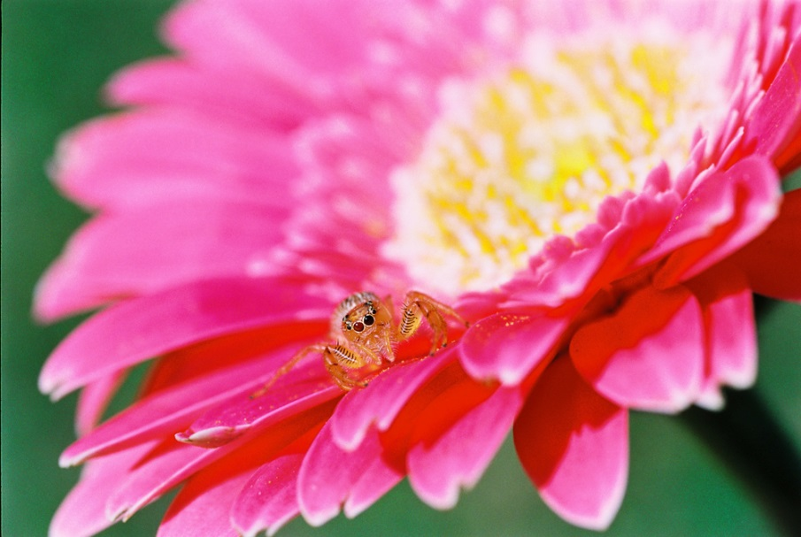
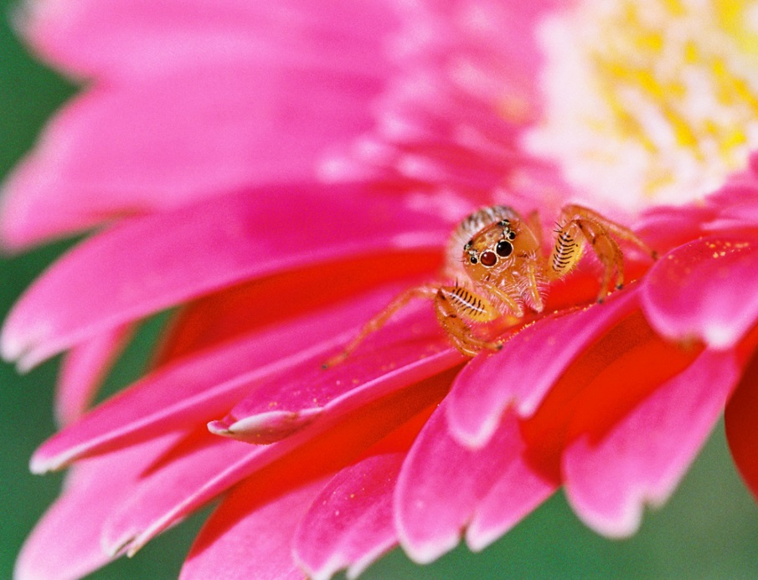
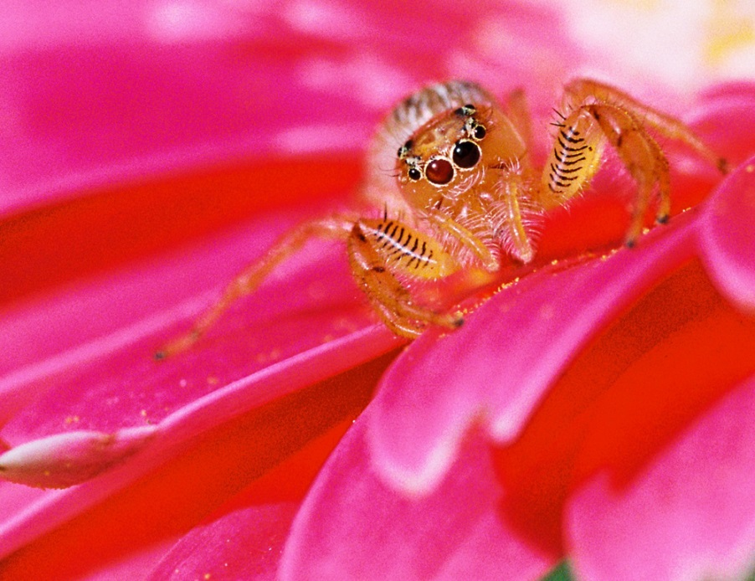
Close-up
Macro
Super Macro

Slide 7
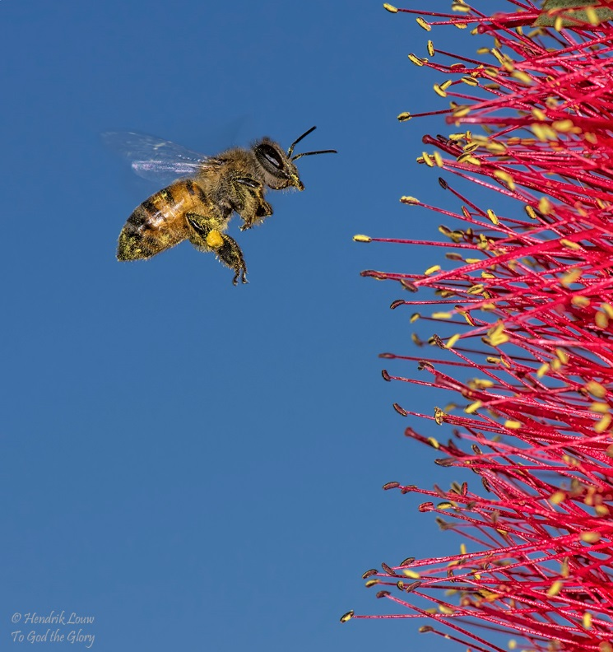
What is Macro Photography
PSSA Standard
  Wikipedia & tradition – 1X
  National Geographic – 2X
  SA salons and individual clubs – up to 4X (unofficial)
  International various
  PSSA
  “Macro photography is extreme close-up photography, where you get close to a small subject by physical or optical means. The size of the subject in the finished photograph is usually greater than life size and reveals detail which cannot easily be seen with the naked eye.”
Suggestions?

Slide 8
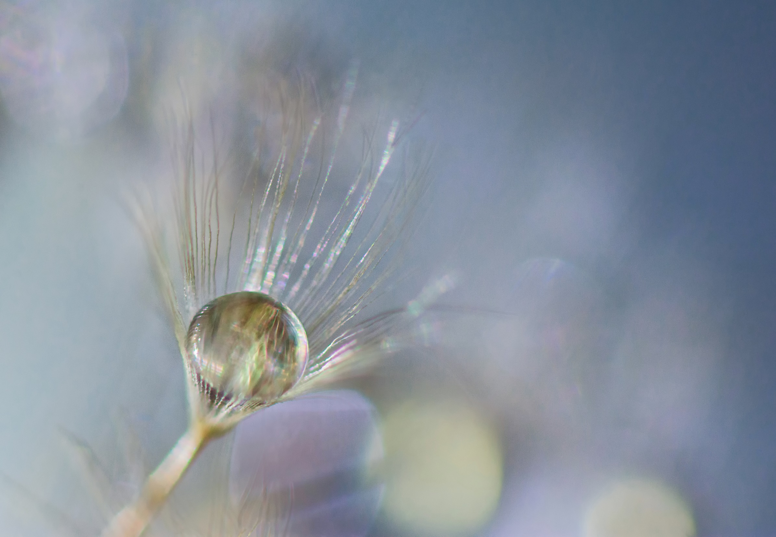
What is Macro Photography is NOT!!
“Macro” is NOT a photography genre!
“Macro” is purely a technical definition

Slide 9
Masters of macro photography
Frank Percy Smith - Brittan
David Fairchild - USA
1950 – 1970
  Jewellery (watch meganisms)
  No one really stood out
Gilles Martin - France
Alberto Ghizzi Panizza - Italy
Ciska Venter – South Africa

Slide 10
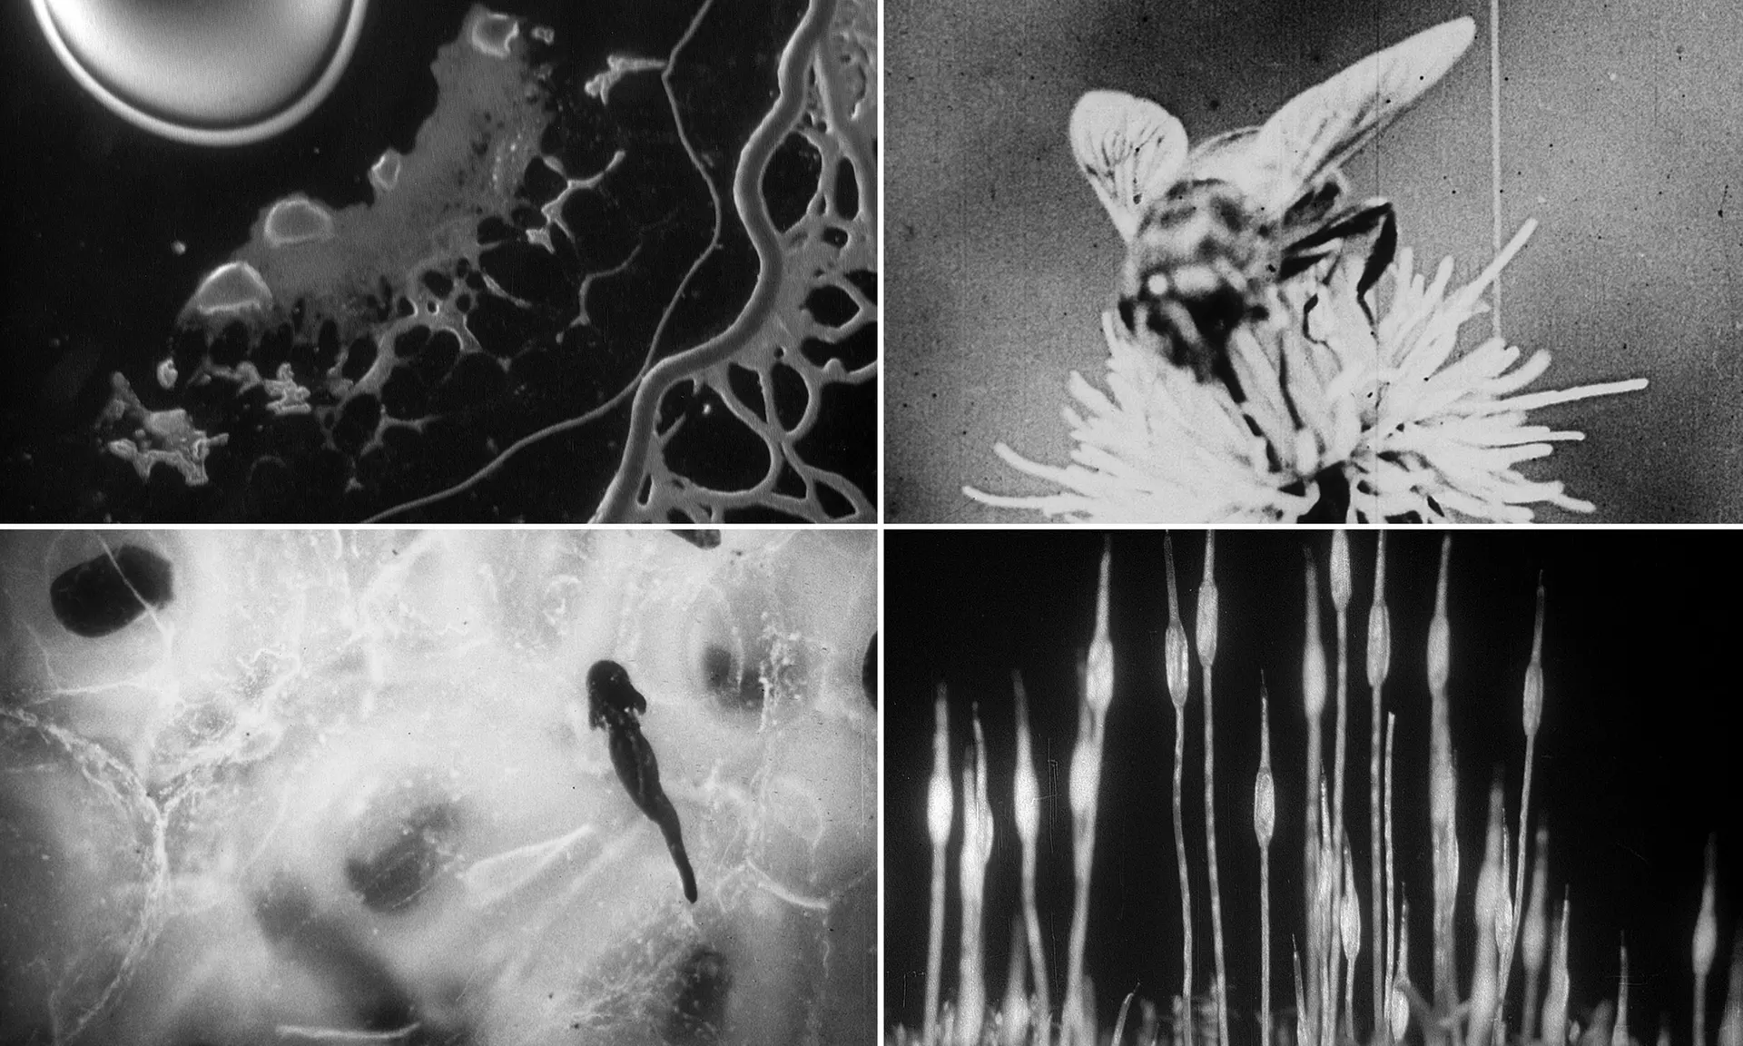

Slide 11
Masters of macro photography
David Fairchild (1869 – 1954)
  American botanist
  Responsible for introduction of more than 200 000 exotic plants in America (nectarines, cotton, rice….)
  Married Marian (Alexander Graham Bell) and on Board of Trustees for National Geographic Society
  Monsters of our backyard (1913 – National Geographic)
    3,7 meter camera lens (Long Tom)
  Book of Monsters (1914)

Slide 12
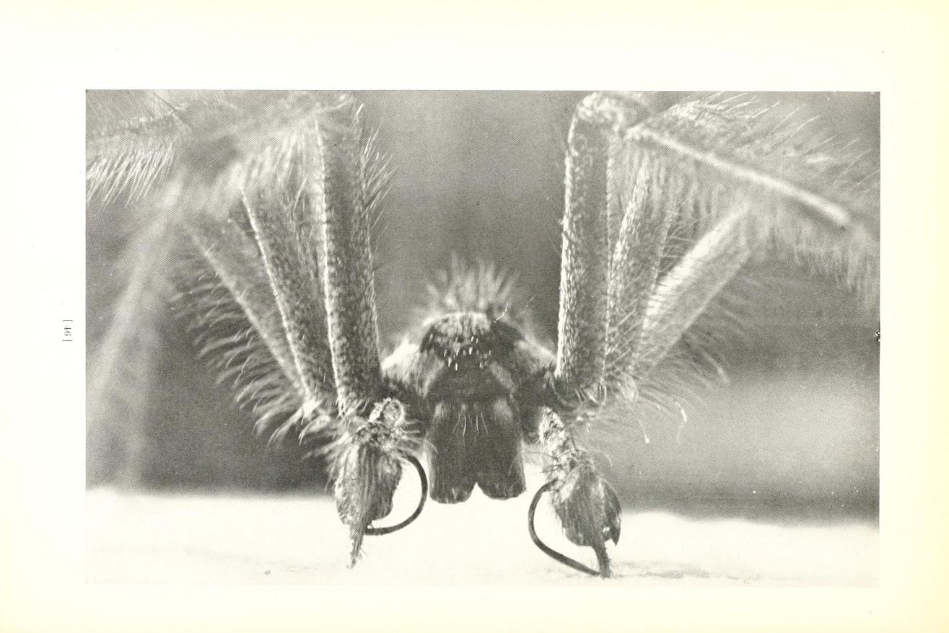
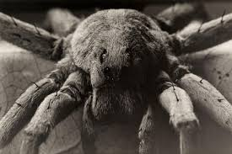
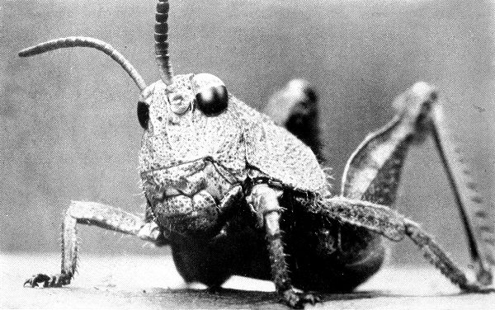
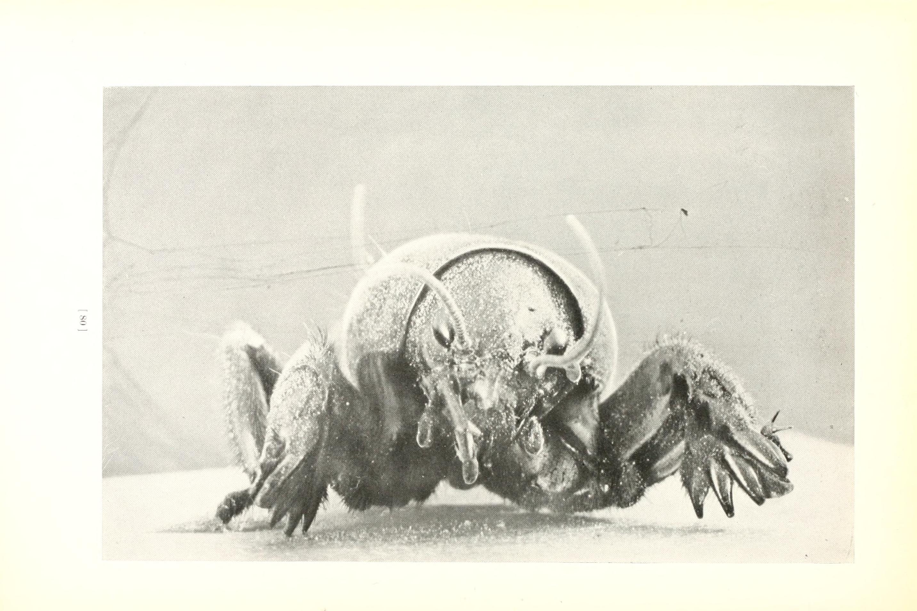
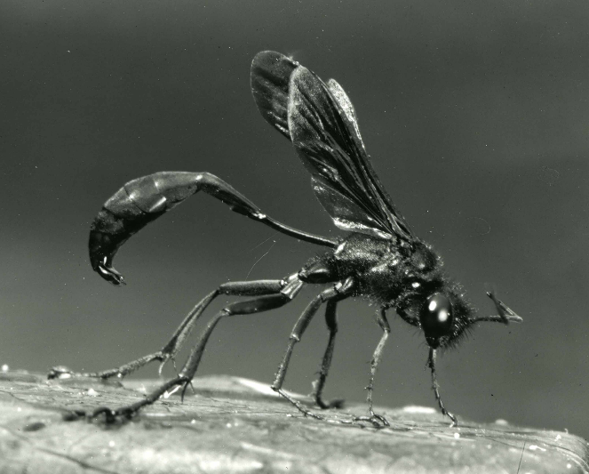

Slide 13
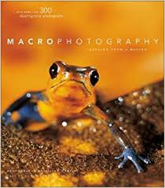
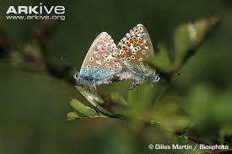
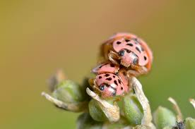
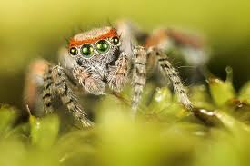
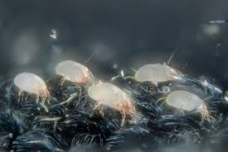
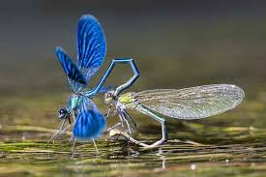
Masters of macro photography
Gilles Martin – France
  - Born 1956 - Father a painter - Started at age 7
  MANY books / films - National GEO
  Archive of endangered species

Slide 14
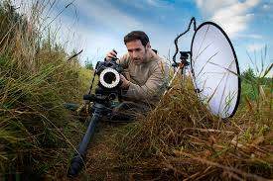
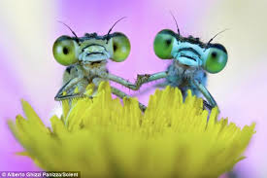
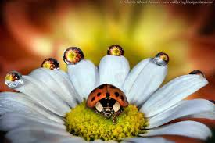
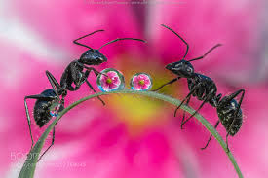
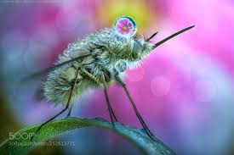
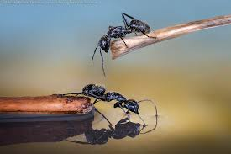

Masters of macro photography
Alberto Ghizzi Panizza - Italy
  Born 1975 - Father a painter
  MANY international awards
  Nikon master and tester

Slide 15

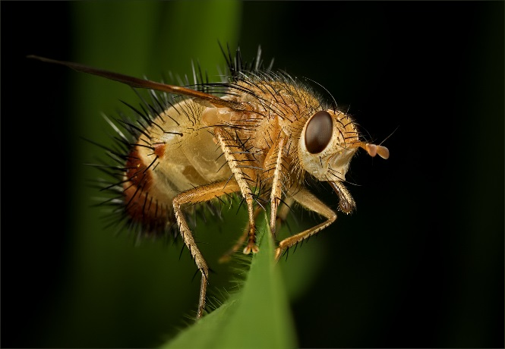
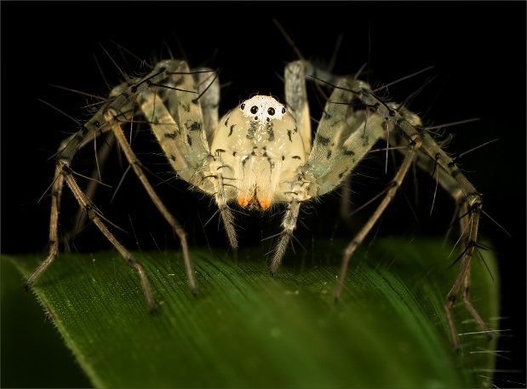
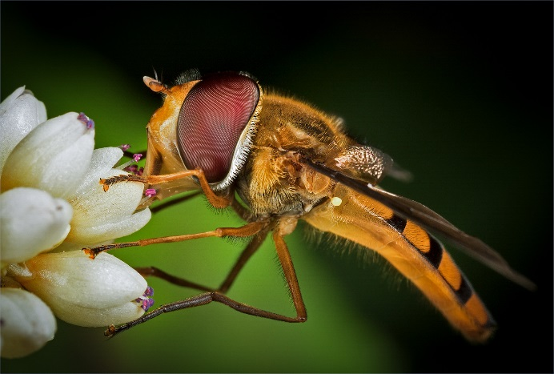
Masters of macro photography
Ciska Venter – South Africa
  Born 1973
  Started primary school; 2009 Westville
  FPSSA; EPSSA
  All natural!
“Love what you do
and the rest will follow”

Slide 16
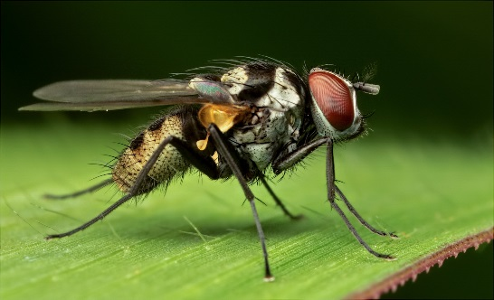
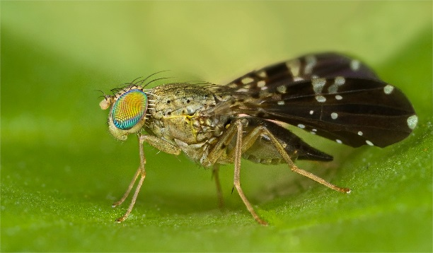
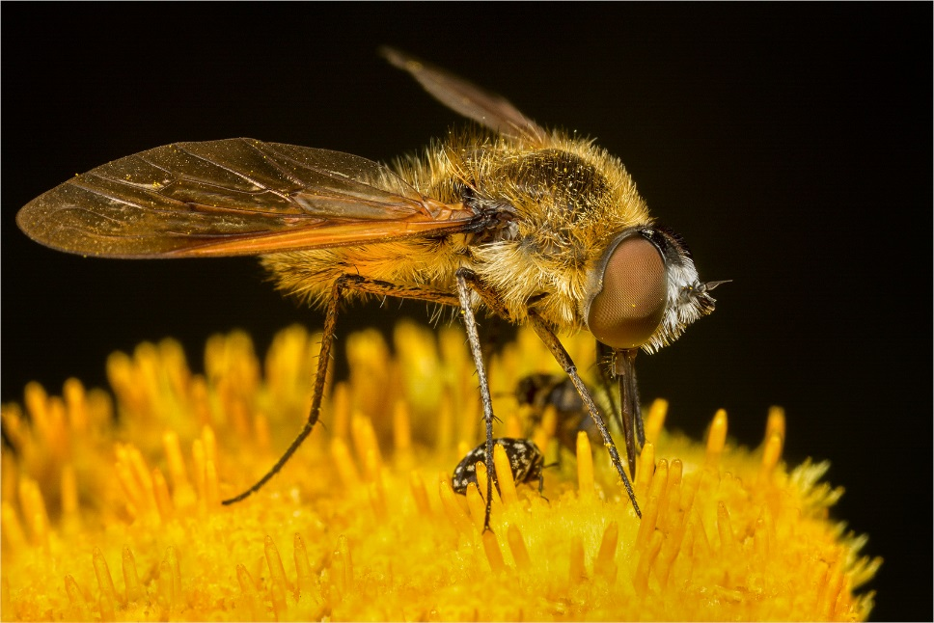
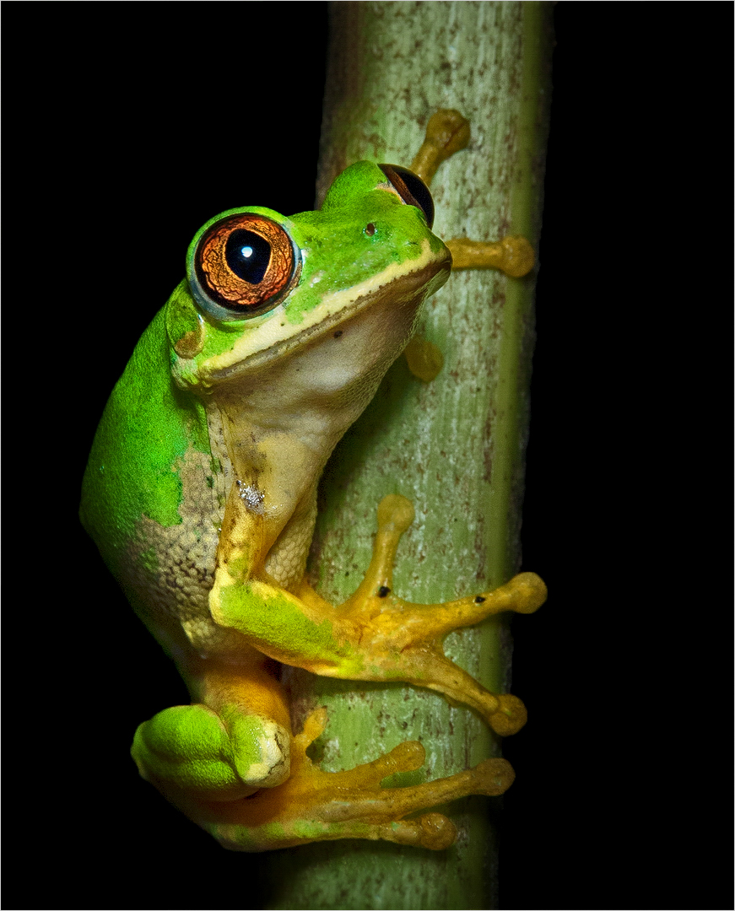
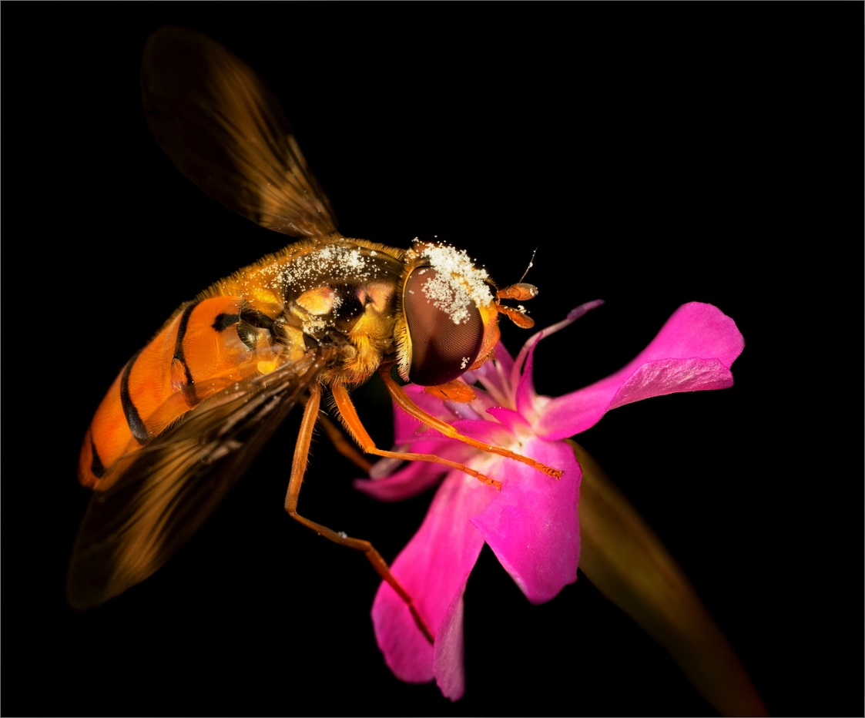

Slide 17

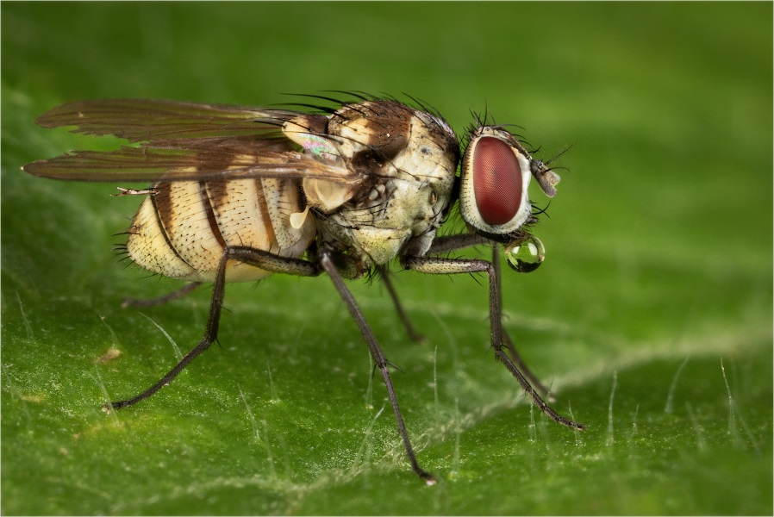
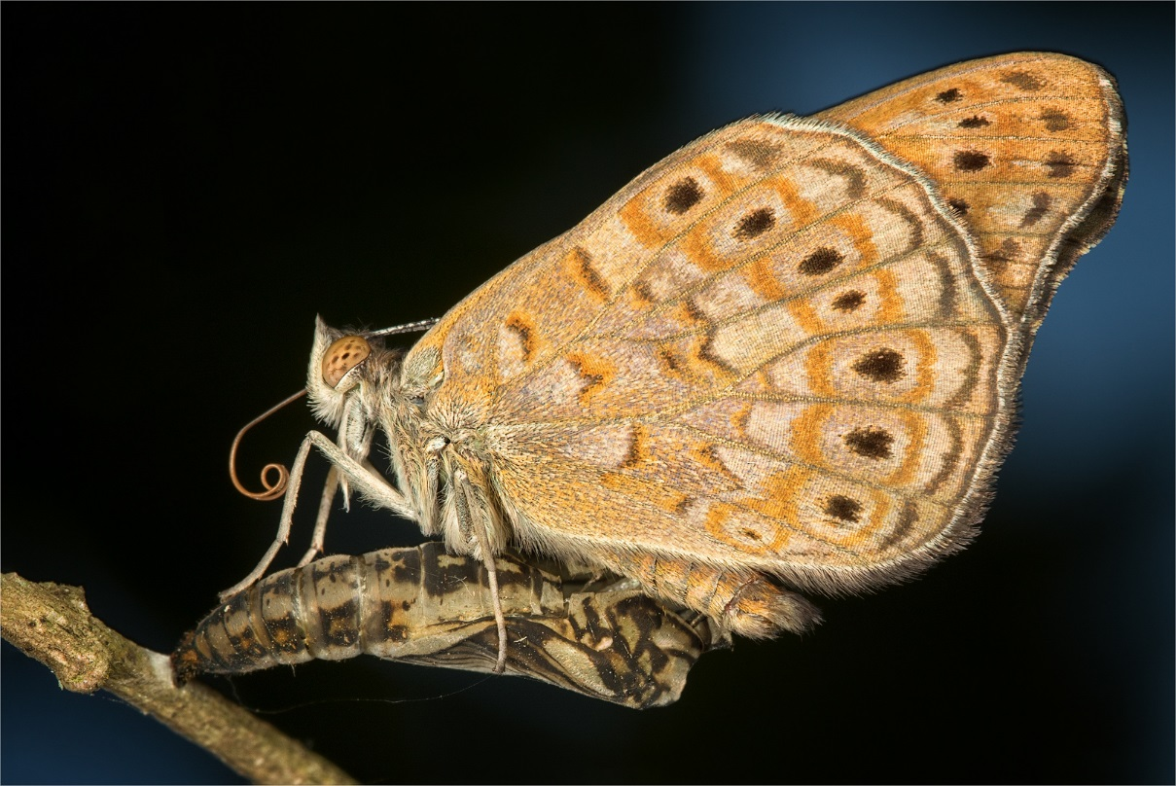
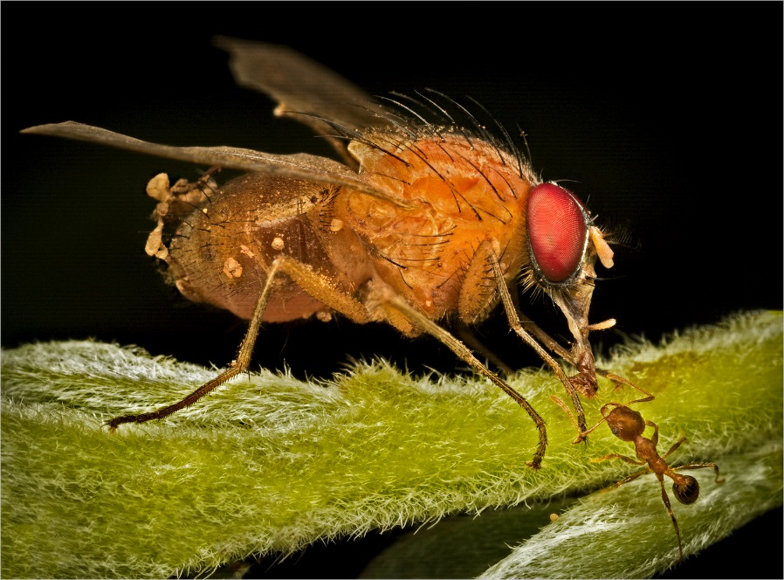

Slide 18
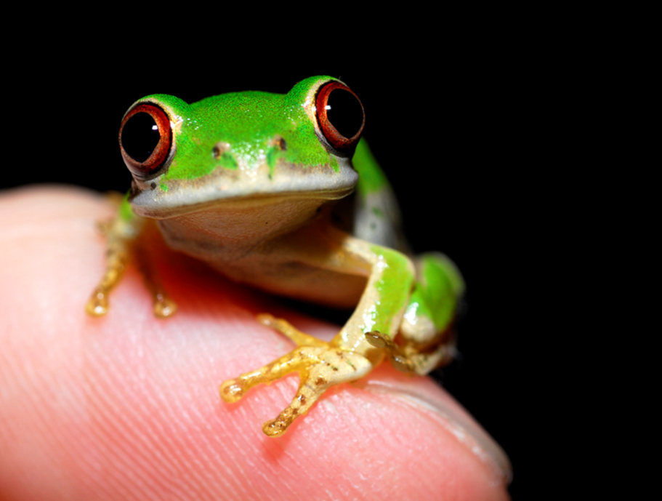
Just another macro photographer
Hendrik Louw – South Africa
  Simplistic style
  Push the boundaries
    Depth of Field (DoF)
    Other techniques
  Create a sense of emotion
  and participation
  Wide angle macro
  I want to create artworks!
“Each little creation;
a big miracle on its own”

Slide 19
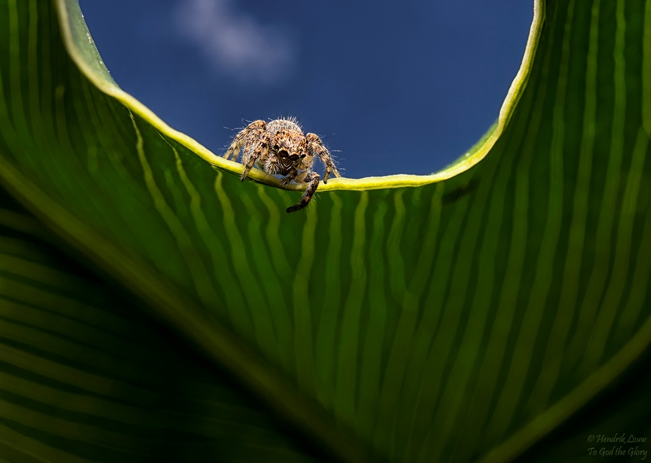
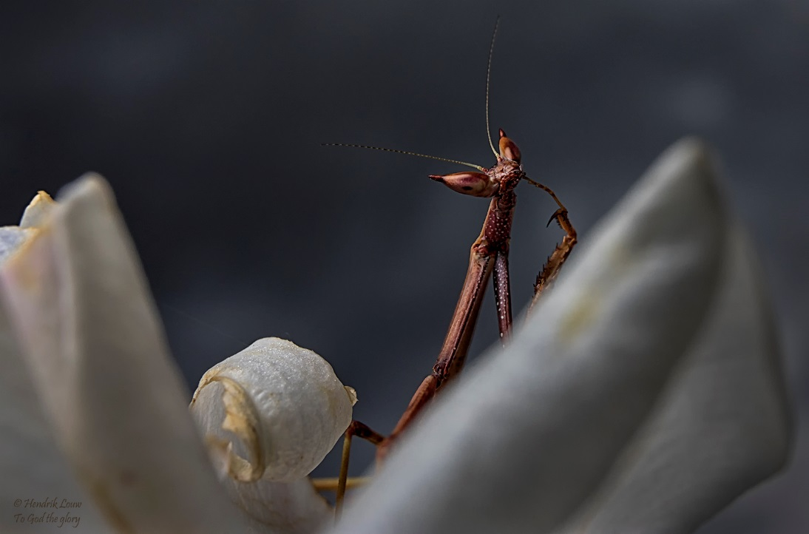
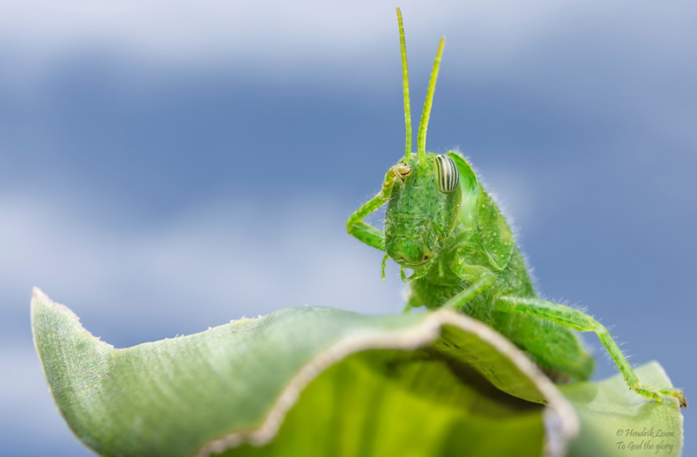
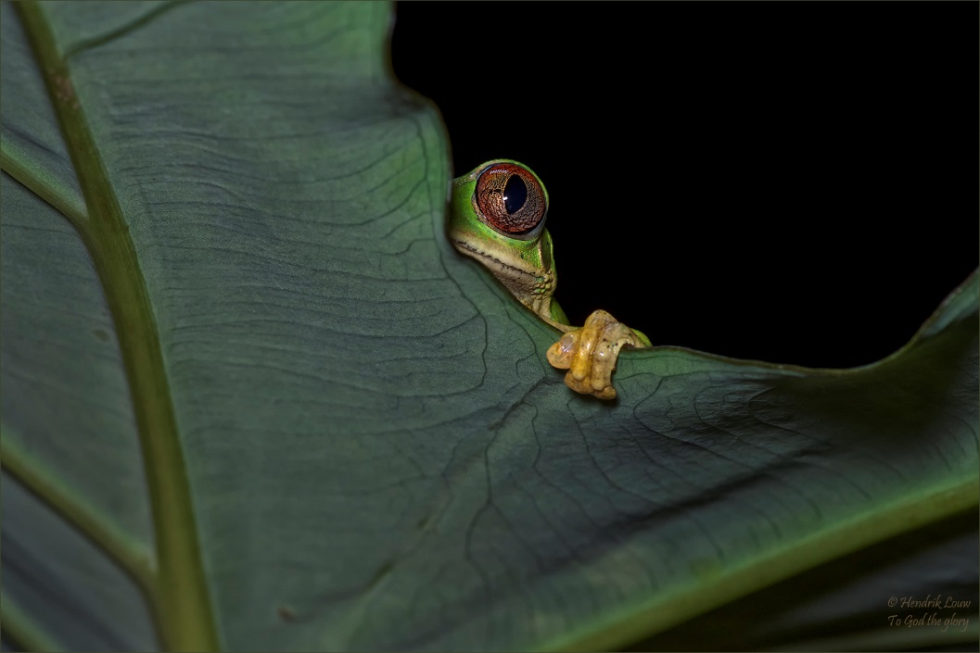

Slide 20
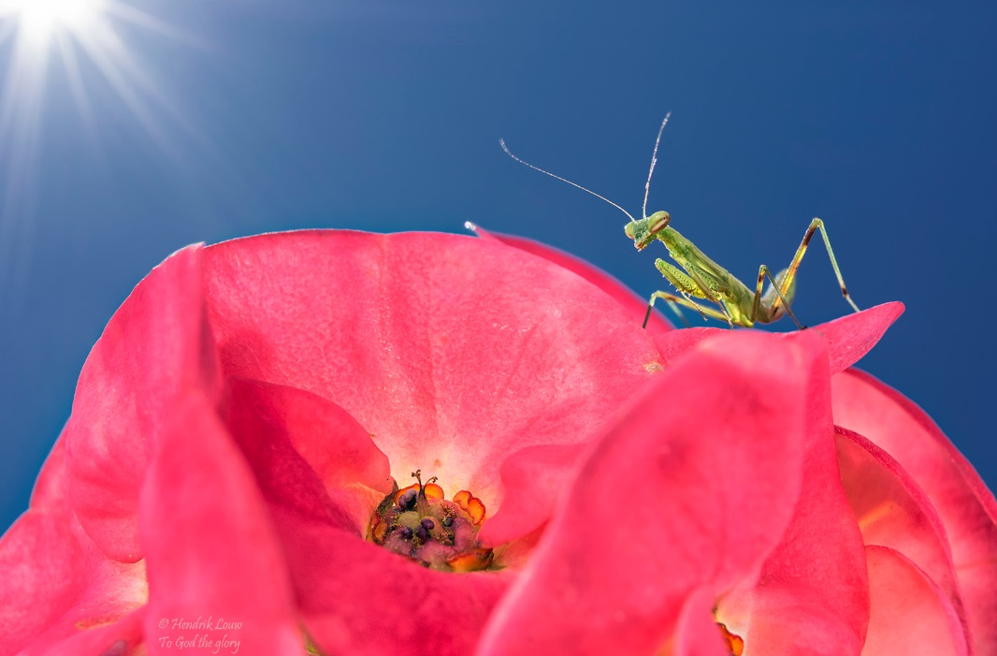
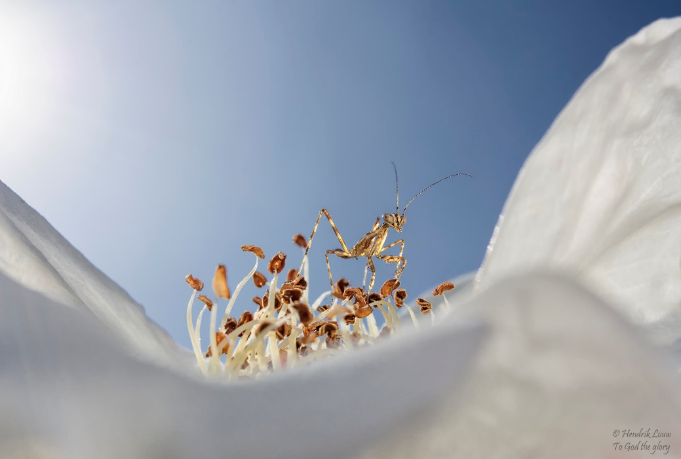
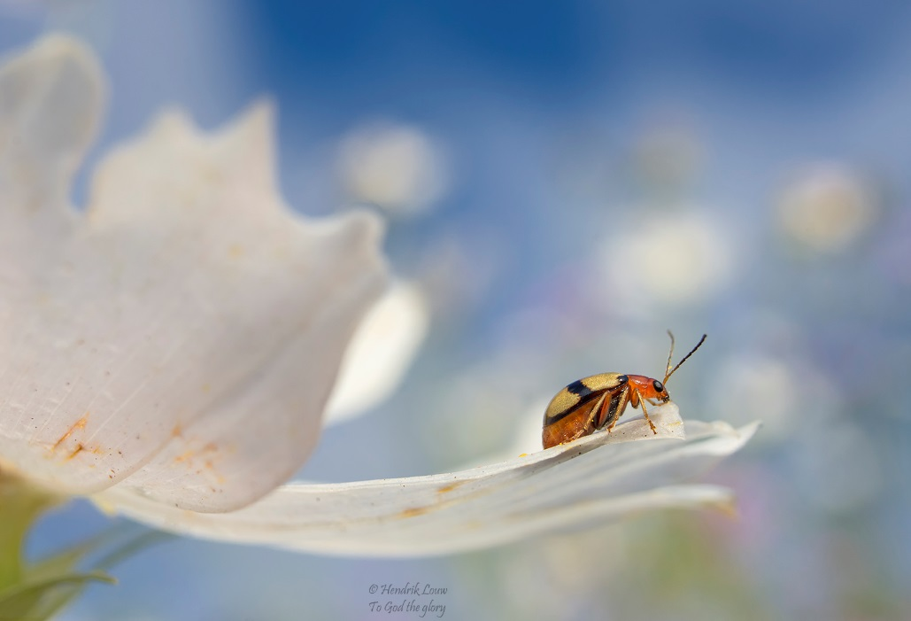
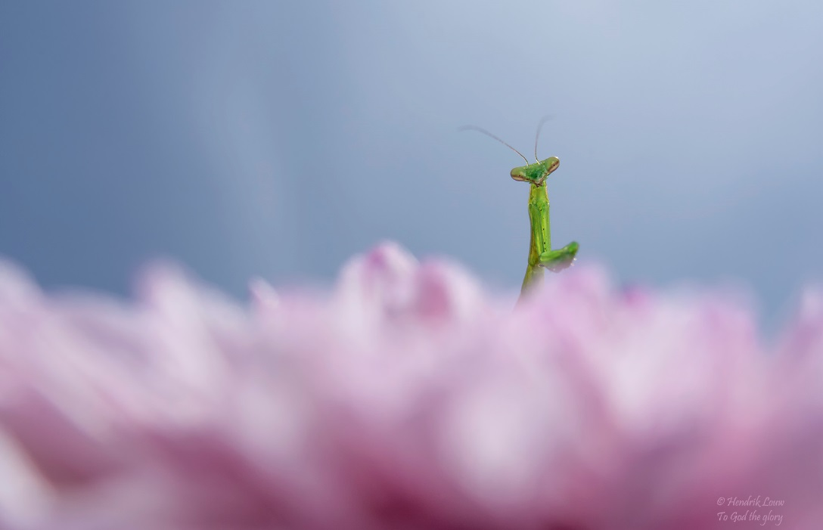

Slide 21
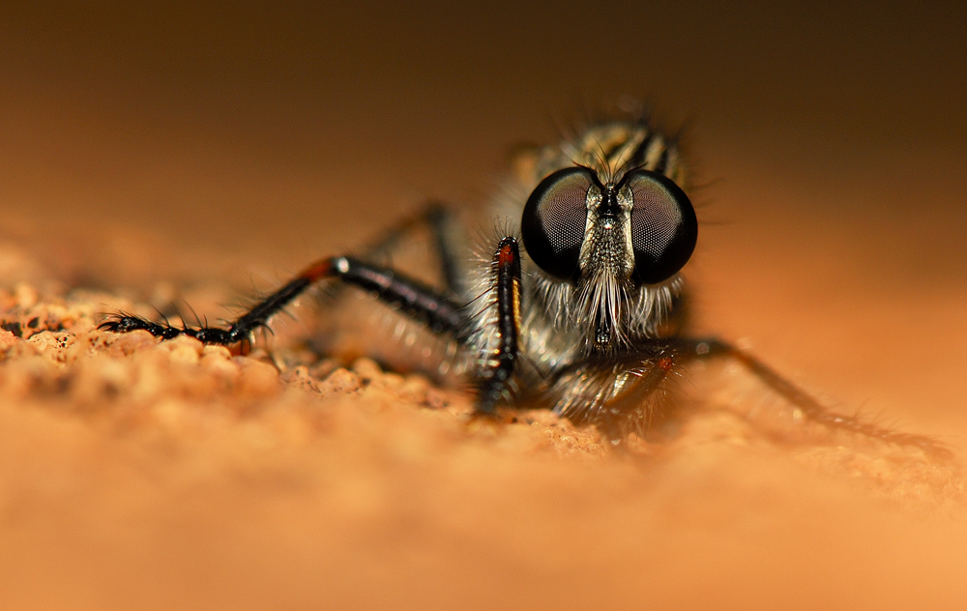
The four “boundary” issues
Speed of events
Depth of Field
Creating light
Processing

Slide 22

The four “boundary” issues
Speed of events

Slide 23


The four “boundary” issues
Depth of Field
  Depth of field refers to “the section of a photograph that appears to be in sharp focus”.
  Fixed by the magnification ratio and the aperture.
  NB: Above is effective aperture (Nikon vs Canon?)
  Setting aperture boundaries

Slide 24



When every
millimetre counts…!!
f16
f29
f64

Slide 25

The four “boundary” issues
Depth of Field
  Relation between aperture, enlargement and DoF
  Setting aperture boundaries – Chromatic aberration – large aperture halo

Slide 26



f13
From a judging point of view: Does the DoF work? Yes / No
f25
f25

Slide 27


Slide 28

The four “boundary” issues
Speed of events
Depth of Field
  DoF boundaries
  Background
  Aperture boundaries
Creating light
  Portraiture
  Texture!!!!!
  Over-exposure
Processing

Slide 29


Slide 30



Slide 31


Slide 32
The four “boundary” issues
Speed of events
Depth of Field
Creating light
Processing
  Saturation!!!!!
  Noise reduction
  Sharpen

Slide 33



Saturation!!!!!

Slide 34


Slide 35
The four “boundary” issues
Speed of events
Depth of Field
Creating light
Processing
  Saturation!!!!!
  Noise reduction
  Sharpen

Slide 36

Golden rules!
Judge it according to any other judging guidelines:
  Technical (Macro? ; DoF; Sharpness; Texture; Detail)
  Impact (Visual and aesthetic; Content; Viewer’s response; General Characteristics)
Know the boundaries
  Macro definition
  Technical
    DoF
    Chromatic Abberation
    Lighting
    Processing
Judge it in line with other categories
  Nature
  Wildlife
  Table top
  Portraiture
  Street photography
  Sport
  Abstract
  PS. Nudity allowed….
A living subject – treat it like a human (photography-wise…)
Some discussion…?

Slide 37

The million $
question……?

Slide 38


